Slide 1
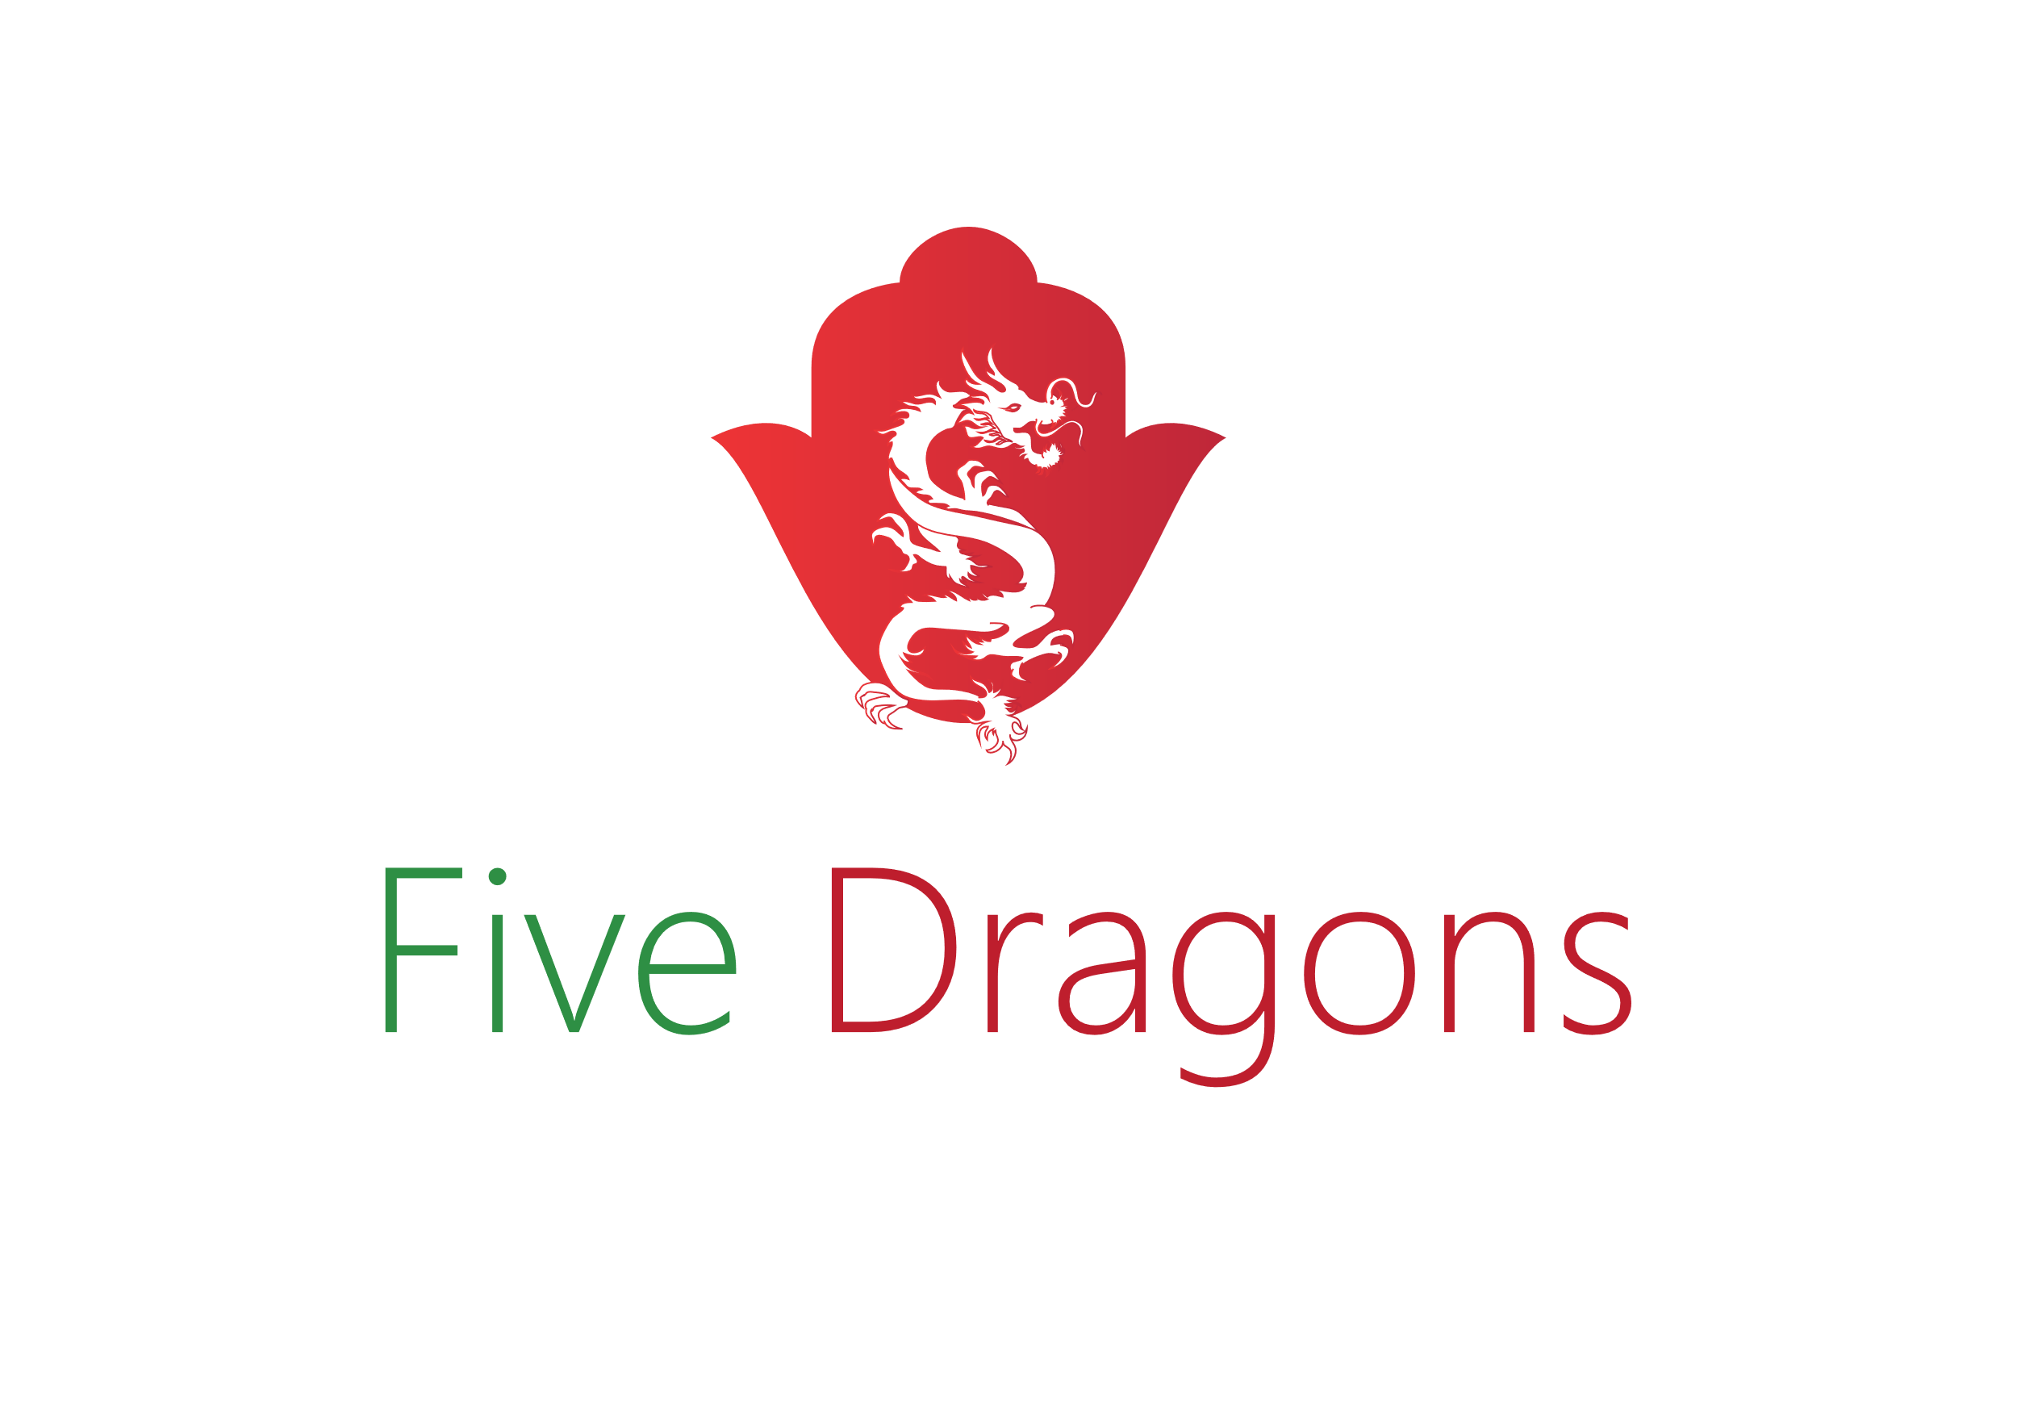
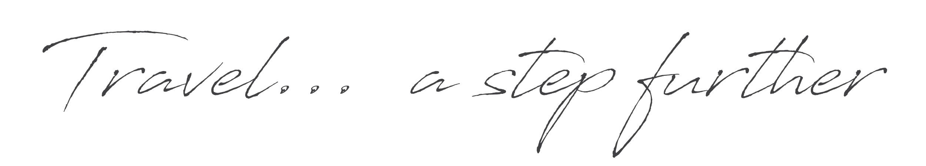

Slide 2
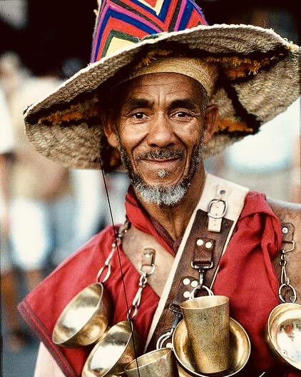
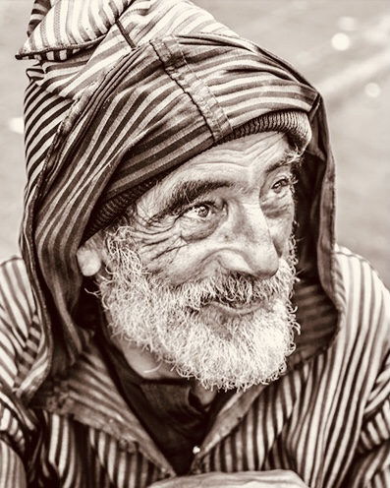
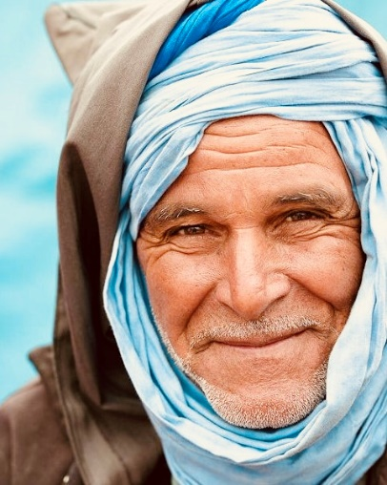
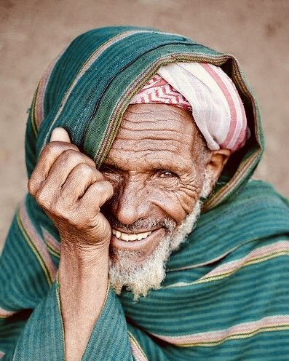




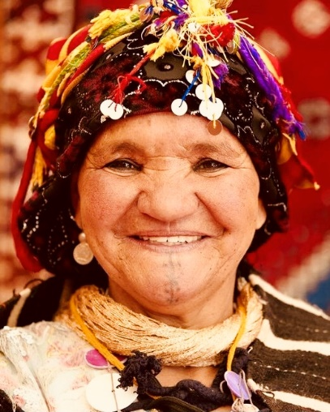
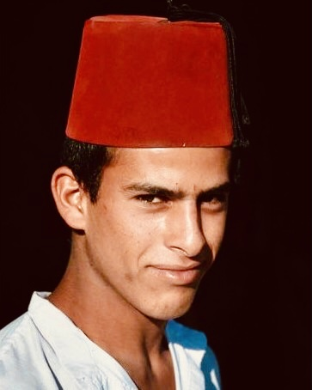
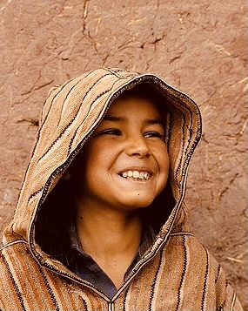
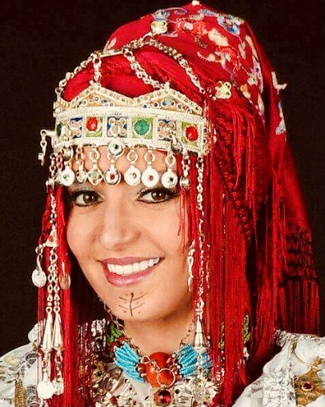
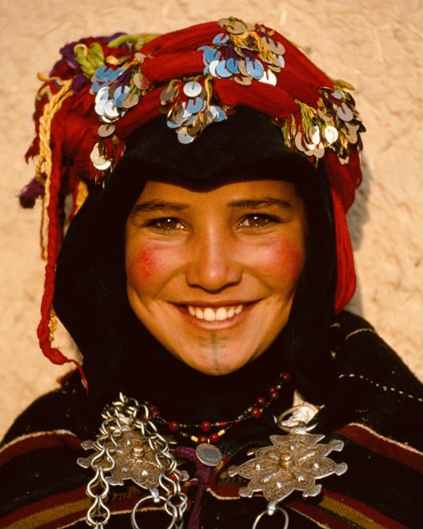
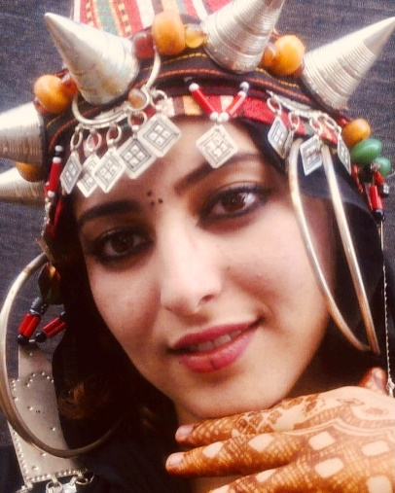
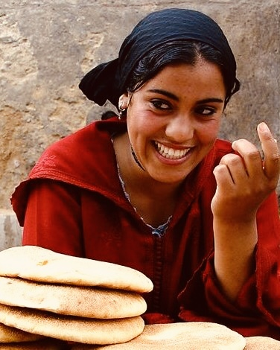
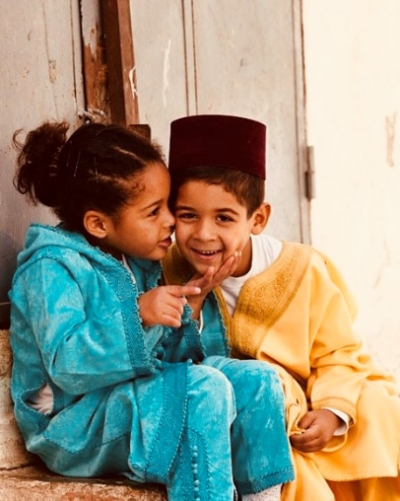
Welcome
back to
Morocco
www.fivetravel.ma
Notes:
A diversity that will welcome you back to morocco with positive vibes

Slide 3
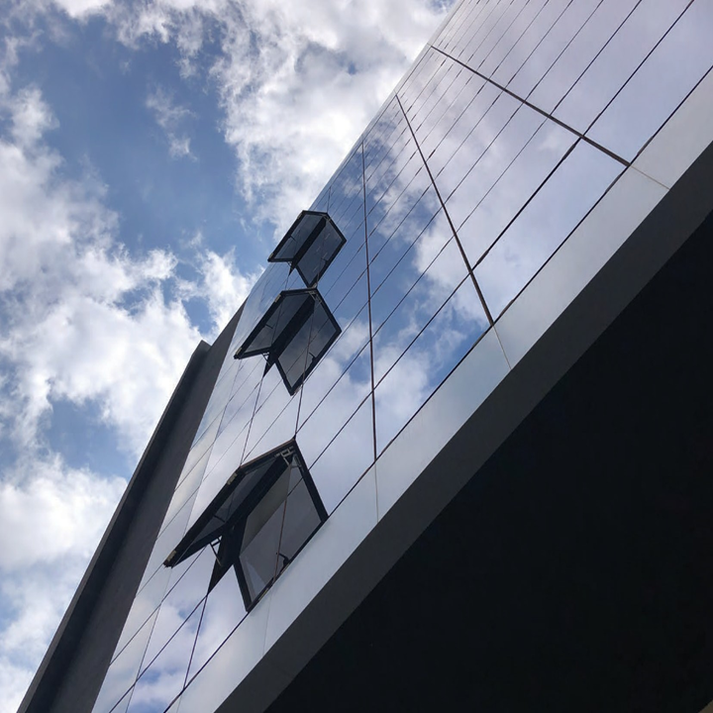
Casablanca, Morocco
Head Offices 2nd + 3rd Floor
www.fivetravel.ma

Slide 4

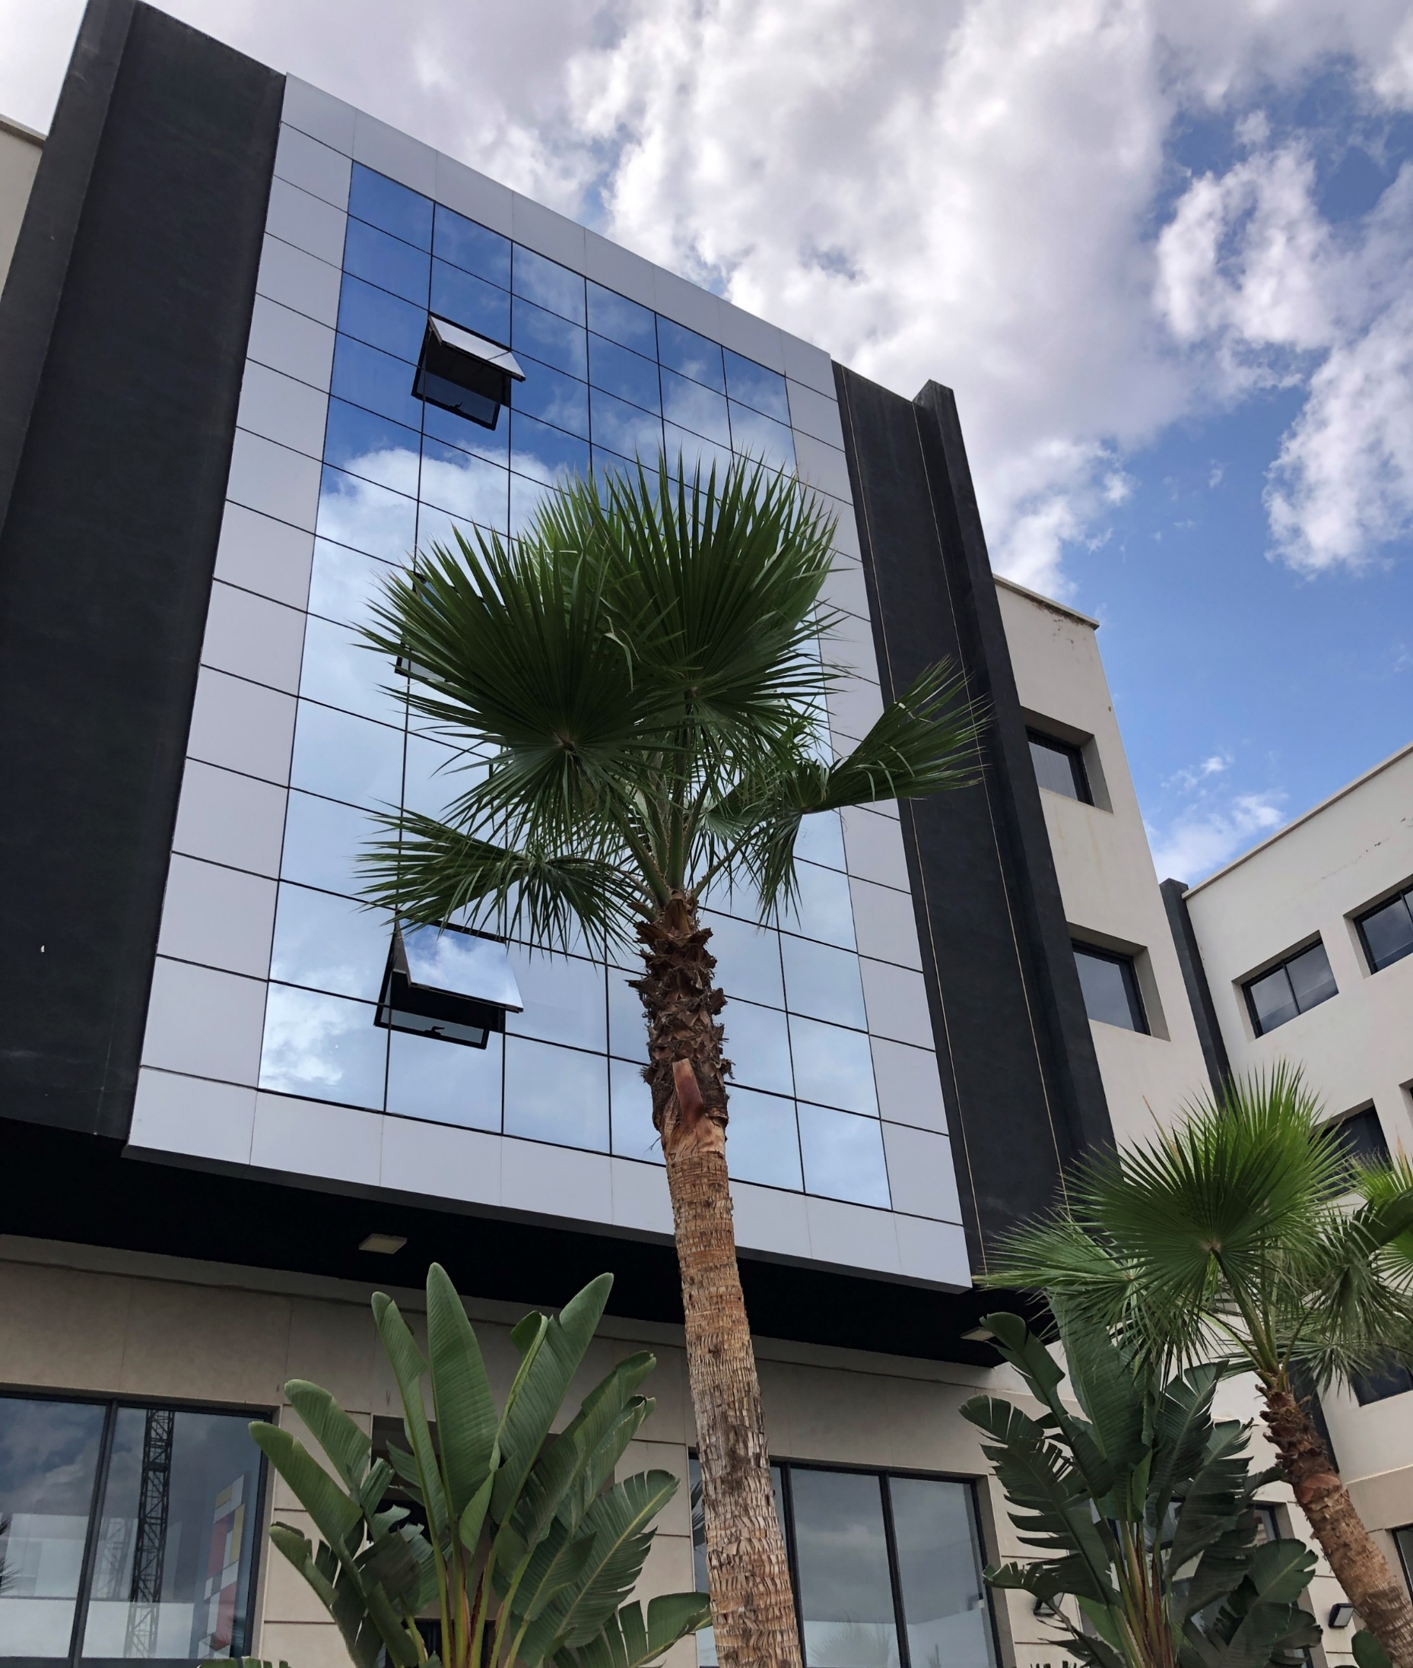


Content…
Presentation of Morocco
Geo Situation
Infrastructure
Culture
Natural diversity
Cities selection
MICE
Meet, Eat, Stay, Play,
Relax, Explore,…
Exclusive activities
About Us
www.fivetravel.ma
Notes:
Presentation of morocco
Its privileged situation

Slide 5

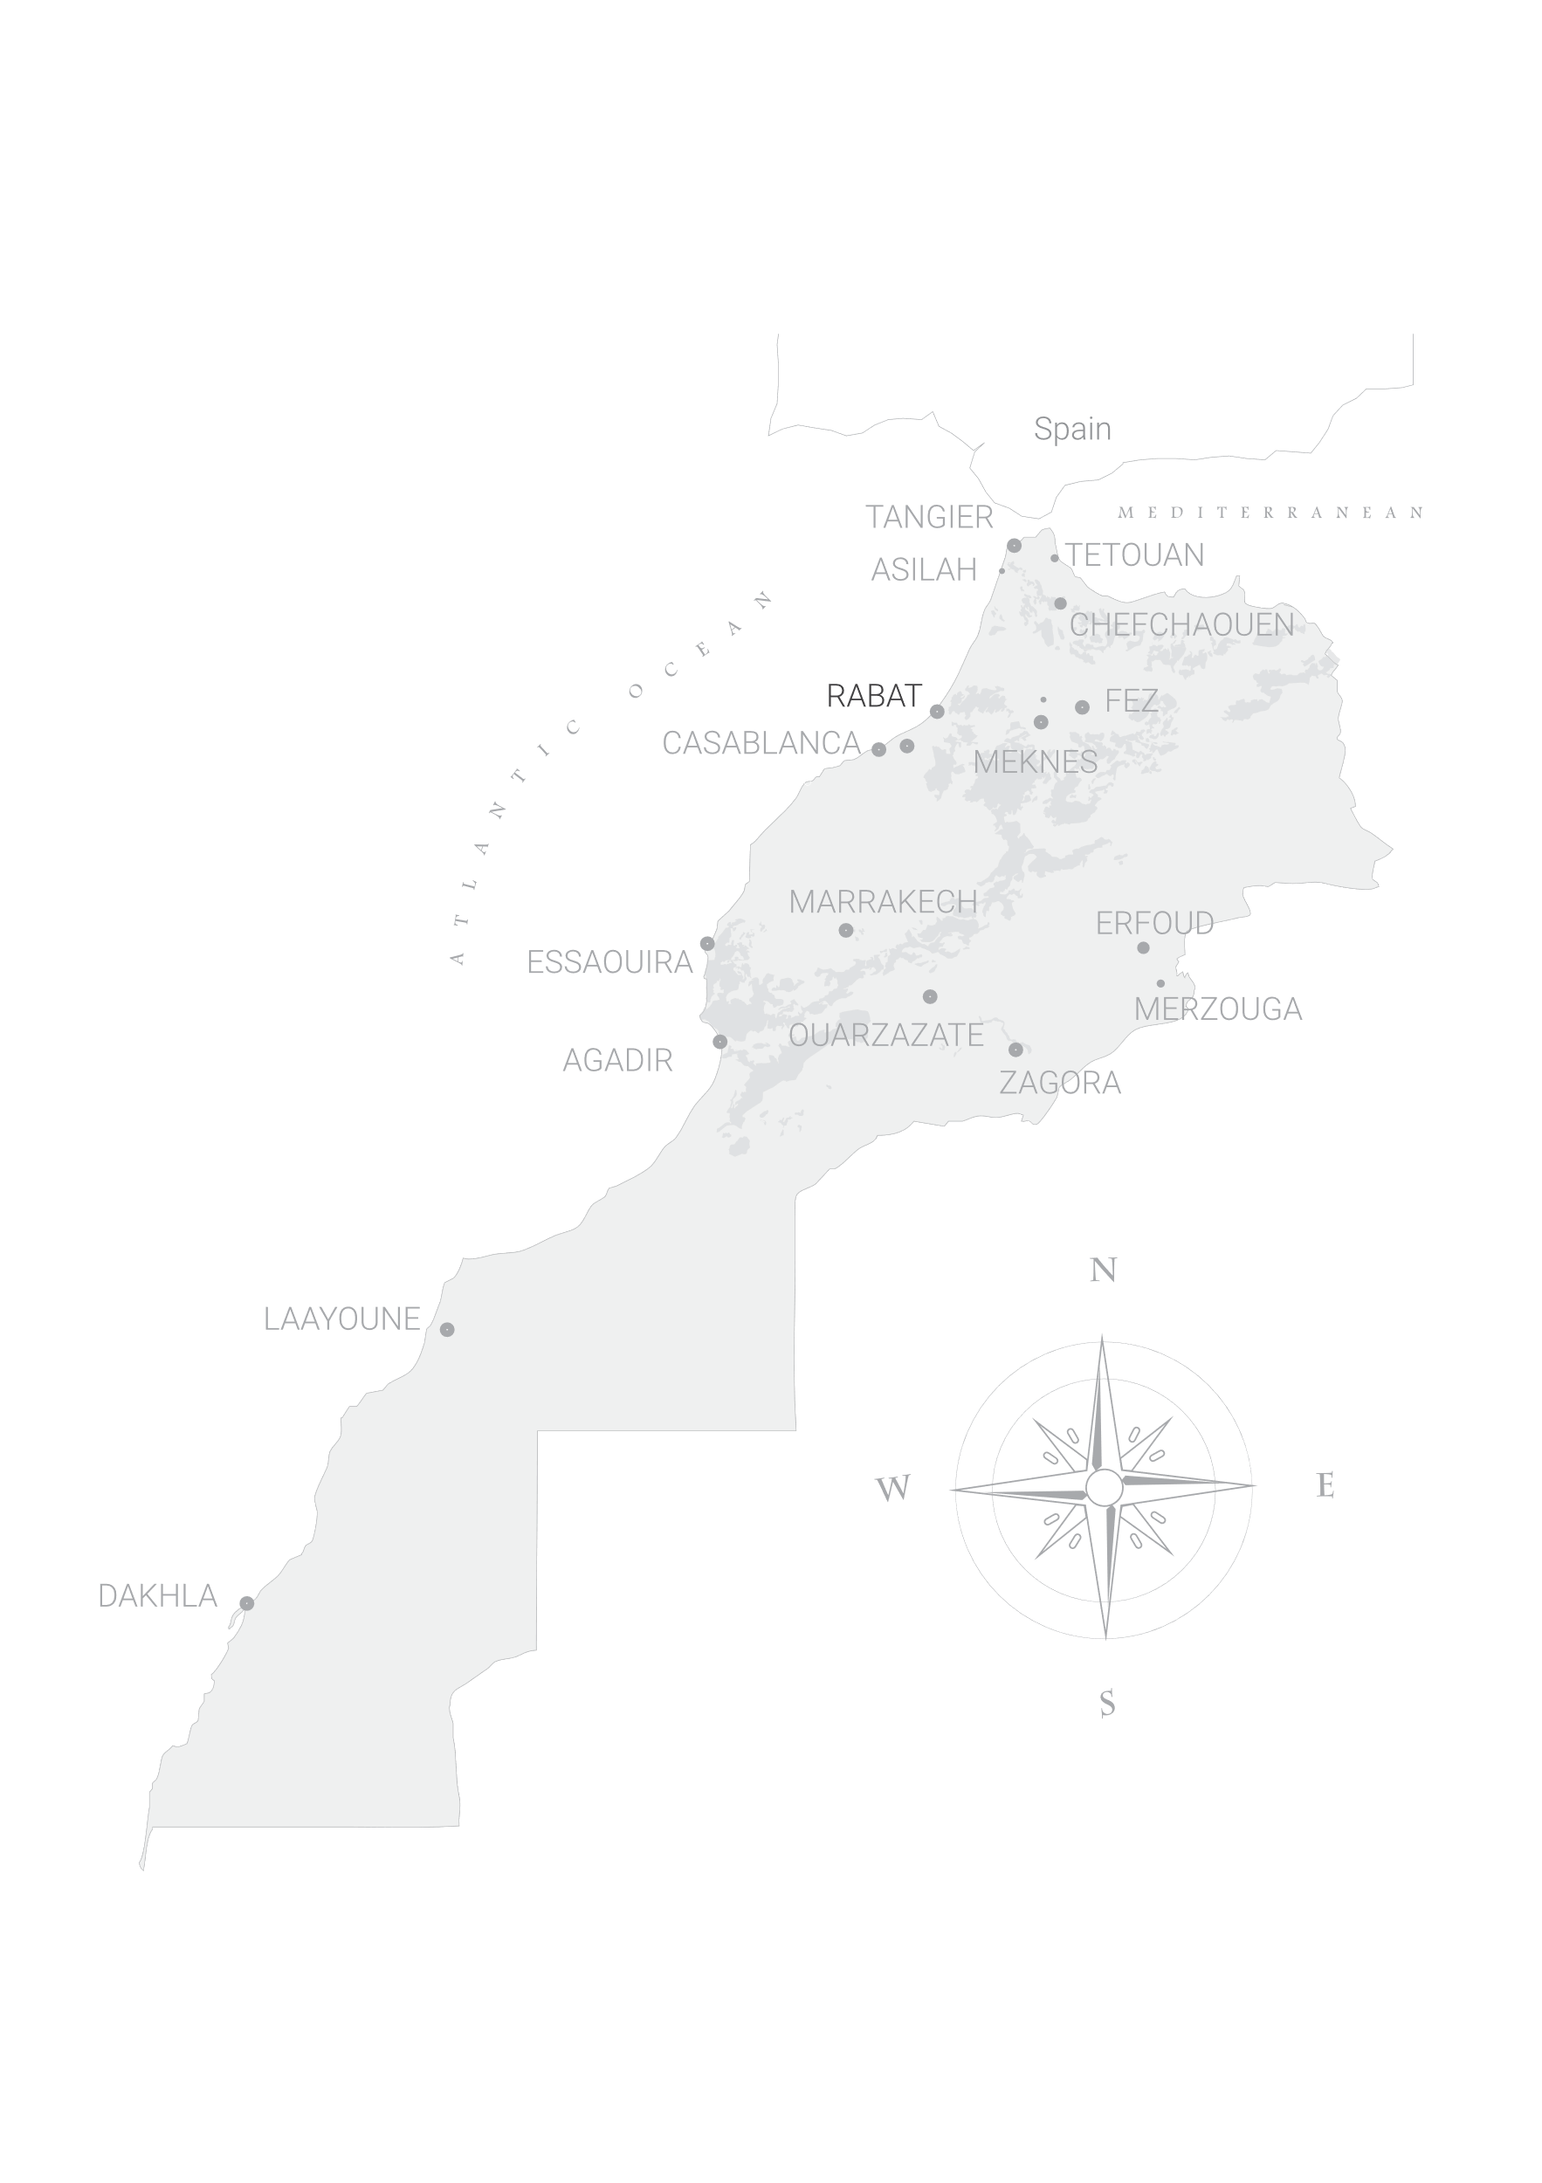
MICE Destination : Morocco | Situation
Reaching
Morocco
LONDON  3h
NEW YORK  7h
MADRID  1h
ROMA  3h
BEIJING 13h*
TOKYO 22h
DUBAI  7h
ACCRA  4h
A privileged intersection
SAO PAOLO  10h
www.fivetravel.ma
Notes:
Situation a
13 hours direct flight duration Beijing-Casablanca thanks to The Boing 787-9 Dreamliner

Slide 6
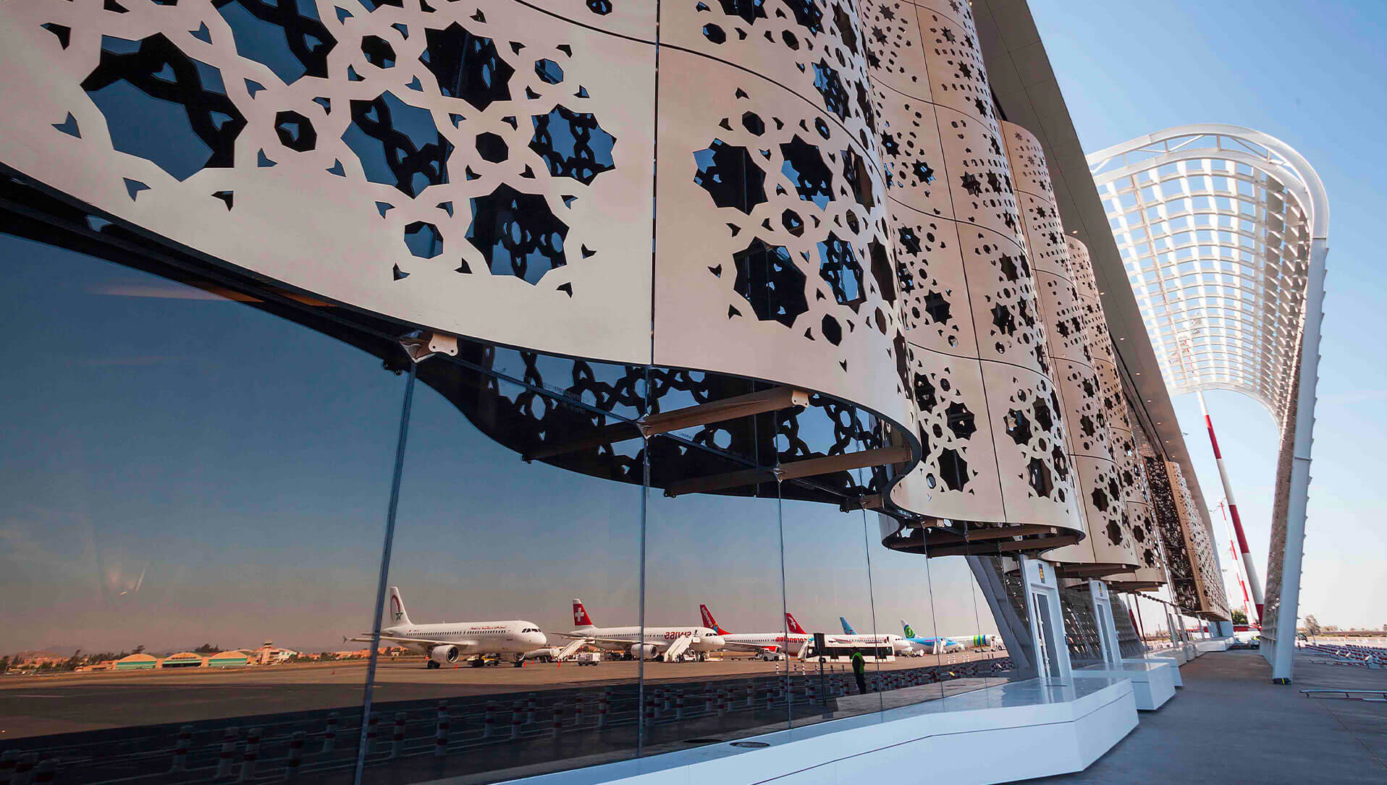


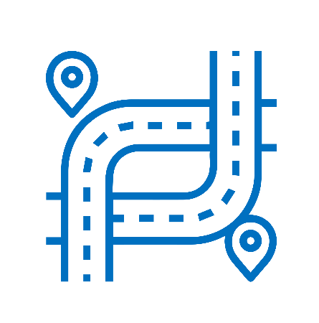
MICE Destination : Morocco | Infrastructure
Morocco
A World Class
Infrastructure
18 Airports
1st
By Five Dragons’ Group
1st in Africa
In terms of accredited ones
High speed Train
in Africa
1808 km Highways
45 240 km Asphalted Roads
www.fivetravel.ma

Slide 7

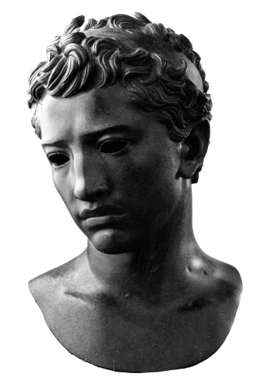



MICE Destination : Morocco | its Culture
Morocco
A kingdom of
Hospitality
Thanks to
Berber origins
Its vibrant
African influences
Cultural
European influences
oriental influences
Diversity
Juba II was the berber King of Mauretania Tingitania. Aside from his very successful reign, he was a highly respected scholar and author. His first wife was Cleopatra Selene II
Population 36 525 460
www.fivetravel.ma
Notes:
A kingdom of stability, with a vibrant cultural diversity
A mix of african, oriental and european influences
With berber, arab and muslim and jewish heritage
A kingdom where you can perfect your swing
Embarking in a journey to the sahara
The african holywood

Slide 8
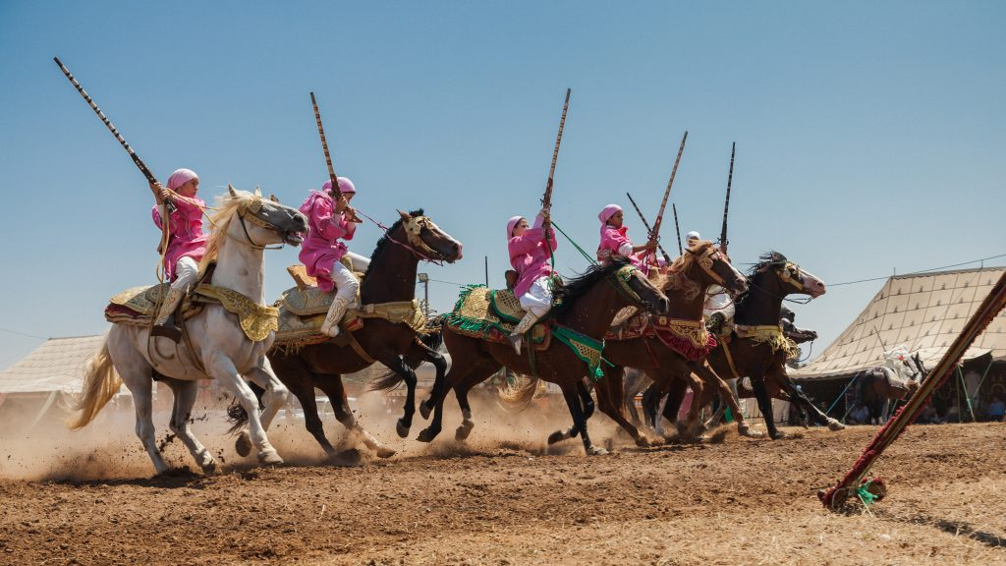


MICE Destination : Morocco | Culture
Morocco
A kingdom of Heritage
By Five Dragons’ Group
www.fivetravel.ma

Slide 9




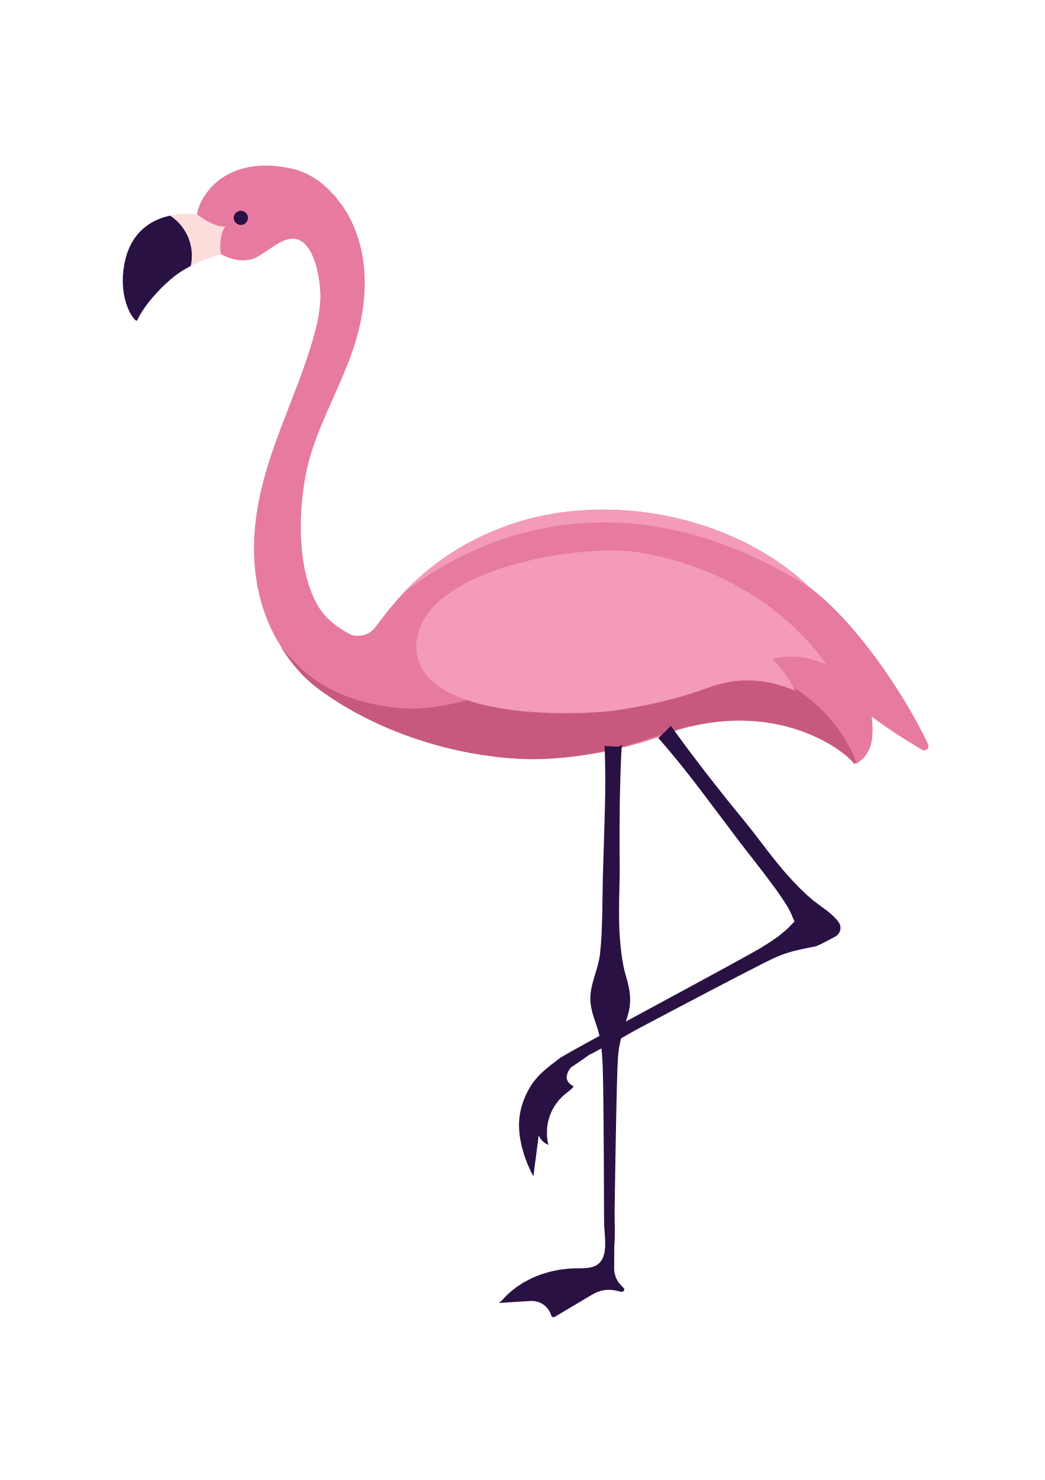



MICE Destination : Morocco | Landscape
Morocco
A Land of
Natural Variety
Biodiversity
Sea
Mountains
Plaines
24,000 animal species
7,000 vegetal species
Desert
www.fivetravel.ma
Notes:
Moroccan biodiversity includes more than 24,000 animal species and 7,000 vegetal species, with rates of endemism particularly high among Mediterranean countries (20% for vascular plants, 11% for fauna). Forest and marine ecosystems are especially rich.

Slide 10
MICE Destination : Morocco | Landscape
Selected
Cities
Casablanca
Essaouira
Marrakech
www.fivetravel.ma
Notes:
Moroccan biodiversity includes more than 24,000 animal species and 7,000 vegetal species, with rates of endemism particularly high among Mediterranean countries (20% for vascular plants, 11% for fauna). Forest and marine ecosystems are especially rich.

Slide 11







MICE Destination : Morocco | Cities
Casablanca
An International Hub Airport
9 732 044 passengers
1st in Morocco
Business travel
Destination
MICE
Destination
Departure point of most tours
Sightseeing
3 hours to 2 days
www.fivetravel.ma
Notes:
An International Airport as a Hub
9 732 044 Million passengers 2019 statistics
Business Destination
Good Hotel infrastructure
Meetings and conferences Halls
Start point of Many Tour Programs
Sightseeing might be done from 3hours to 2 days
Main attraction is Greart Mosque Hassan II, Mohammed V square and Art deco, Habous quarter, Catholique church

Slide 12
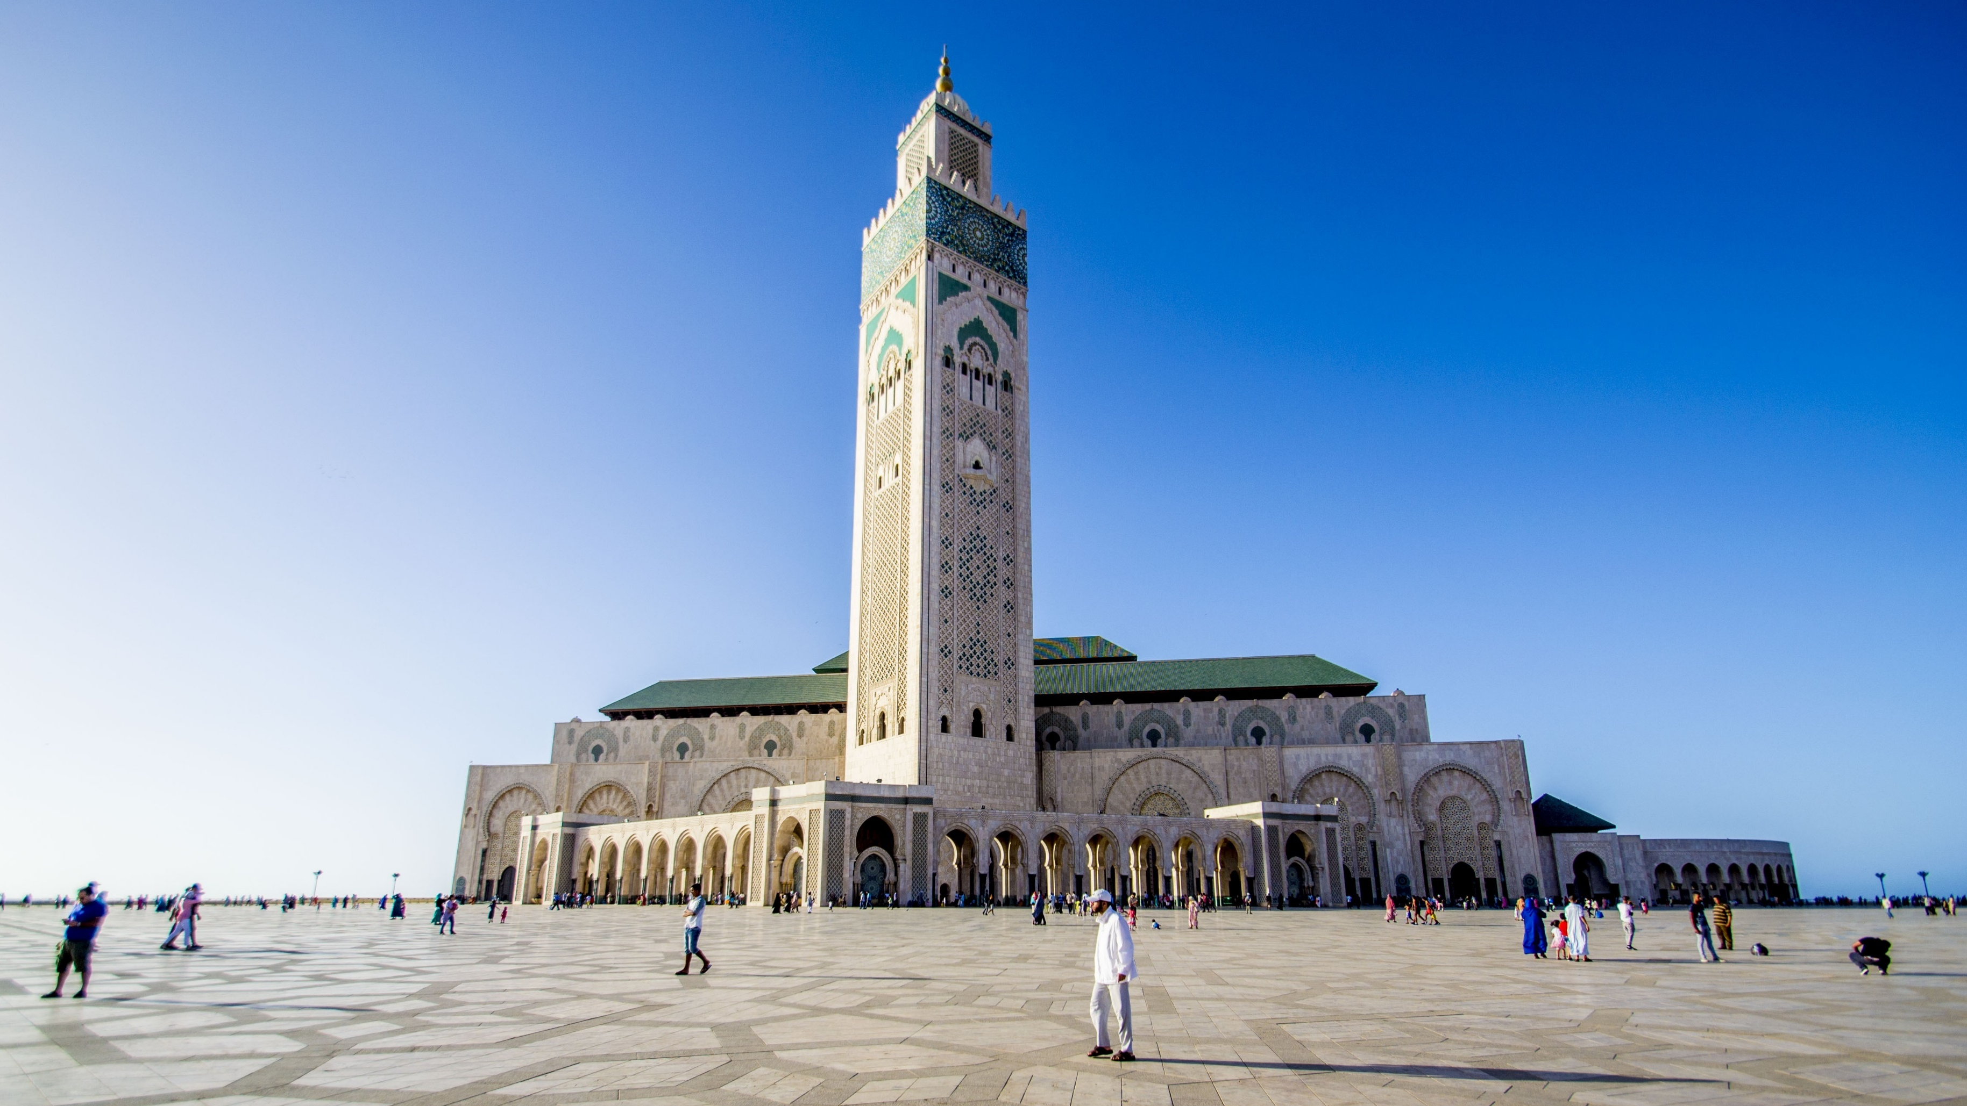

MICE Destination : Morocco | Cities
Casablanca
Main Assets
By Five Dragons’ Group
Mosque Hassan II
www.fivetravel.ma

Slide 13
MICE Destination : Morocco | Cities
Marrakech’s
Main Assets
An International Airport
Over 5 Million passengers
Departure point of most tours
1st MICE and International EVENTs Destination
Visits
1 day and more
www.fivetravel.ma
Notes:
International Airport
1st Destination by excellence for
Conference & Congress
Cultural discovery
Activities
Adventure & Sport
Long stays
A
Also a start point of many tours
we have handpicked and tested From its Outstanding Touristic infrastructure, many hotels.
Very renown for Unesco World Heritage Jemaa El Fna, Several Monuments from 12th century and the Majorelle Garden

Slide 14

MICE Destination : Morocco | Cities
Marrakech’s
Main Assets
Morocco’s
Hotel Beds Capacities Overview
www.fivetravel.ma

Slide 15
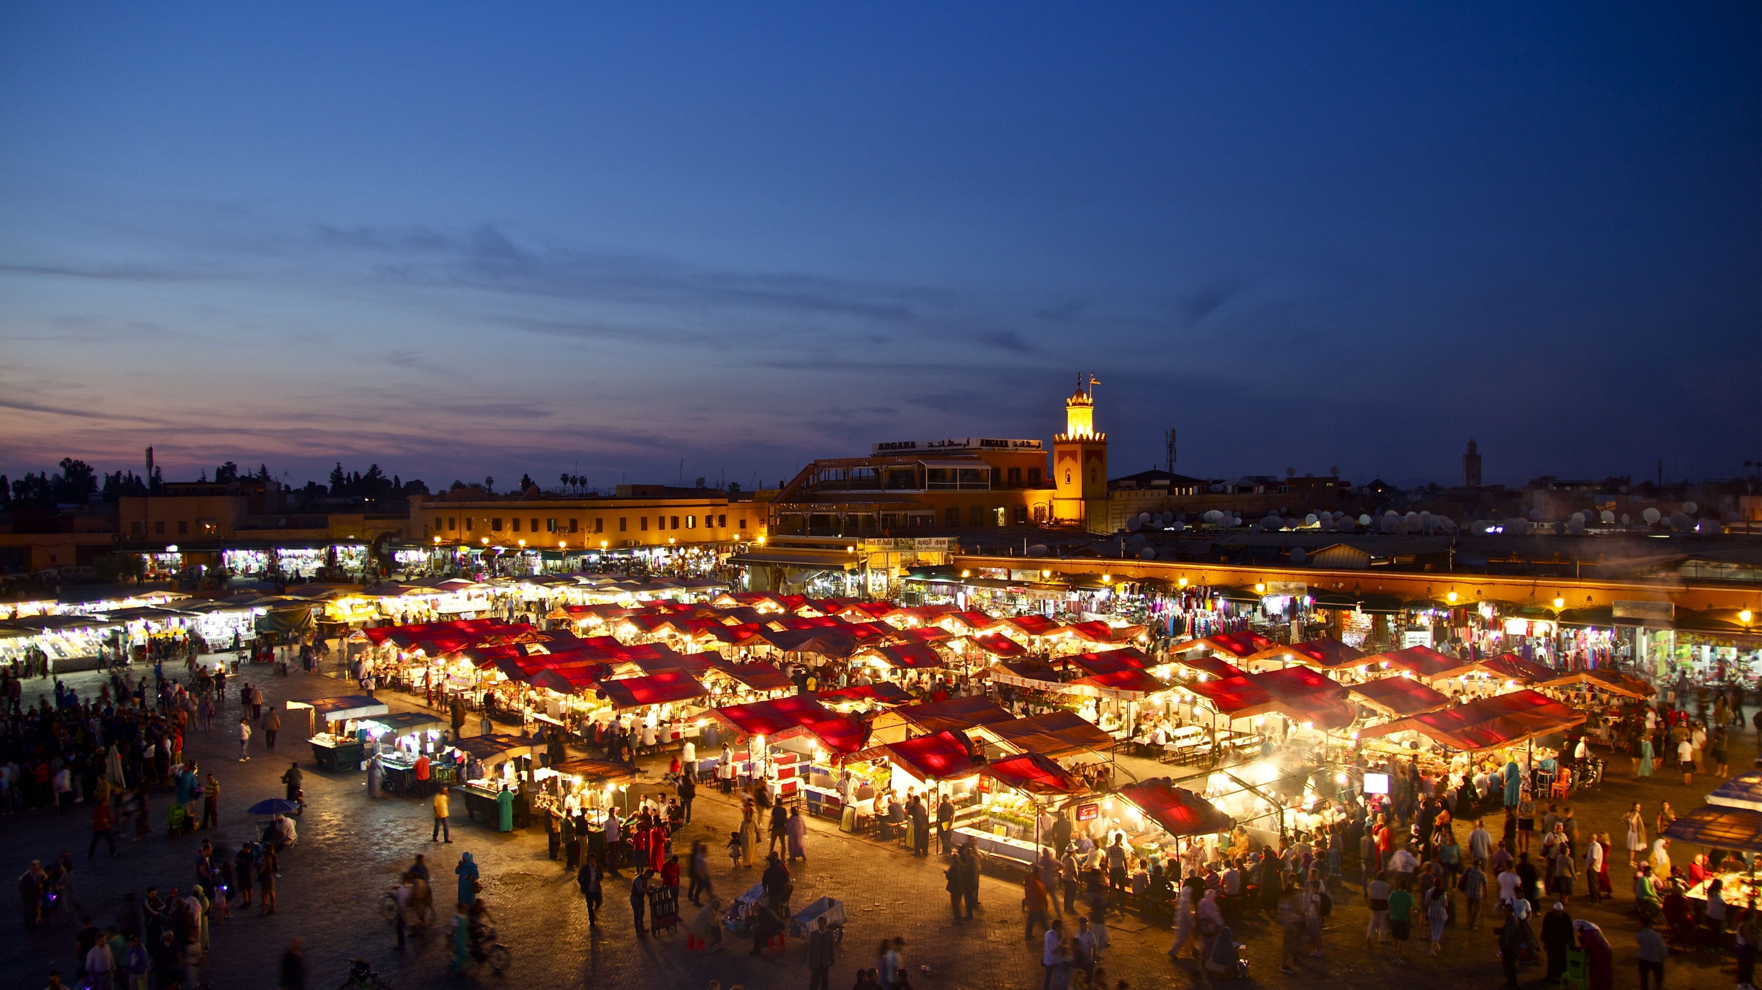
MICE Destination : Morocco | Cities
Marrakech’s
Main Assets
By Five Dragons’ Group
Jemaa El Fna
UNESCO World Heritage
www.fivetravel.ma

Slide 16
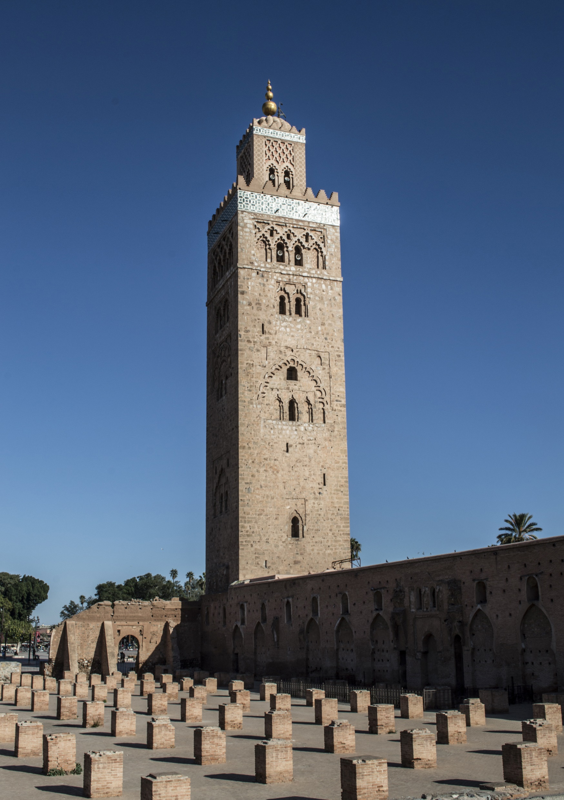
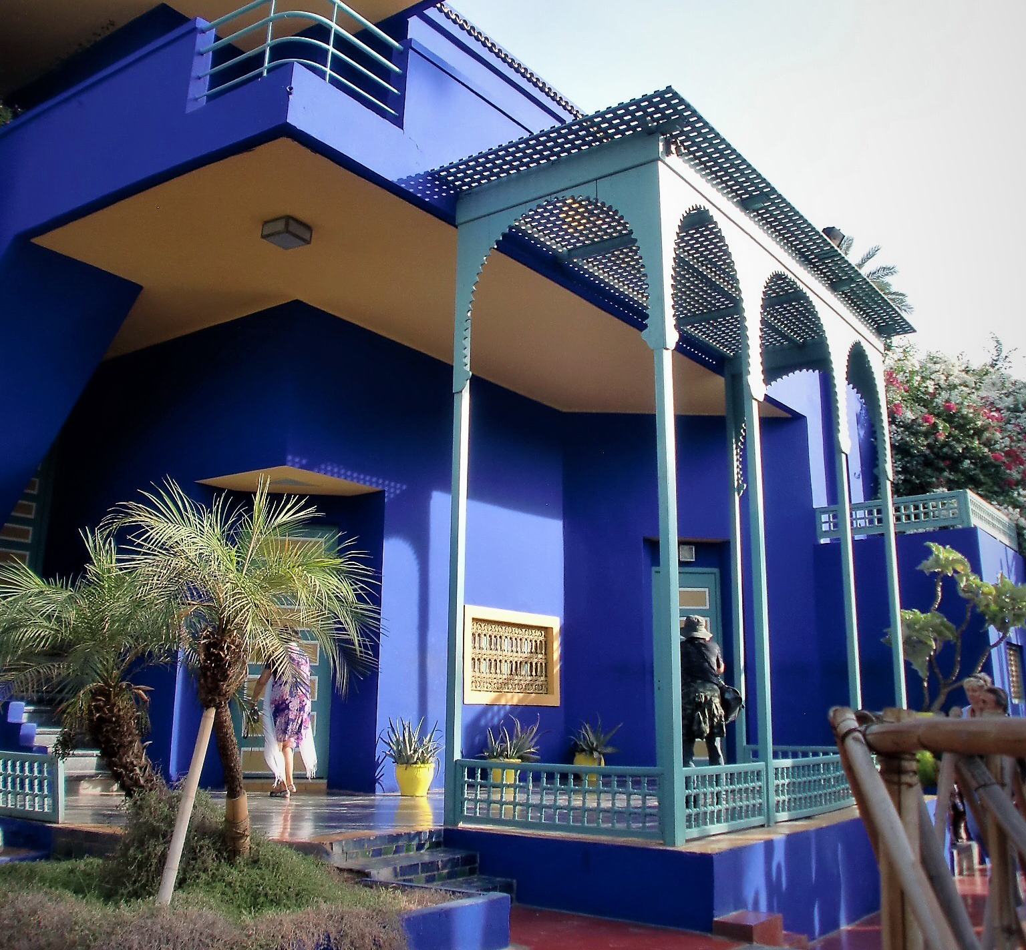
MICE Destination : Morocco | Cities
Marrakech’s
Main Assets
By Five Dragons’ Group
Koutoubia Mosque
Majorelle Garden
www.fivetravel.ma

Slide 17

OUALIDIA
EL JADIDA
SAFI
ESSAOUIRA
AGADIR
Atlantic
Cities
www.fivetravel.ma
Notes:
A diversity that will welcome you back to morocco with positive vibes

Slide 18
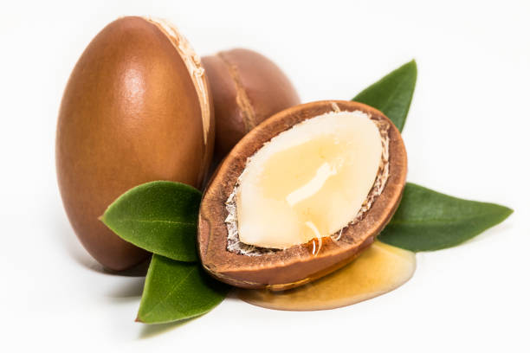


MICE Destination : Morocco | Cities
Essaouira’s
Other Assets
An International Airport
Eco Lodges
Argan Forests
Tourism
For Sustainable Development Goals
www.fivetravel.ma
Notes:
International Airport
1st Destination by excellence for
Conference & Congress
Cultural discovery
Activities
Adventure & Sport
Long stays
A
Also a start point of many tours
we have handpicked and tested From its Outstanding Touristic infrastructure, many hotels.
Very renown for Unesco World Heritage Jemaa El Fna, Several Monuments from 12th century and the Majorelle Garden

Slide 19
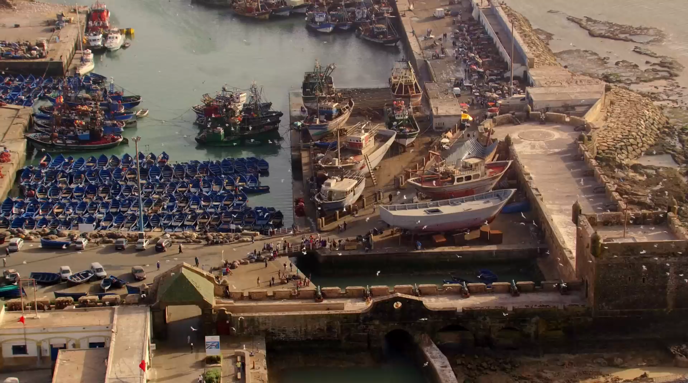
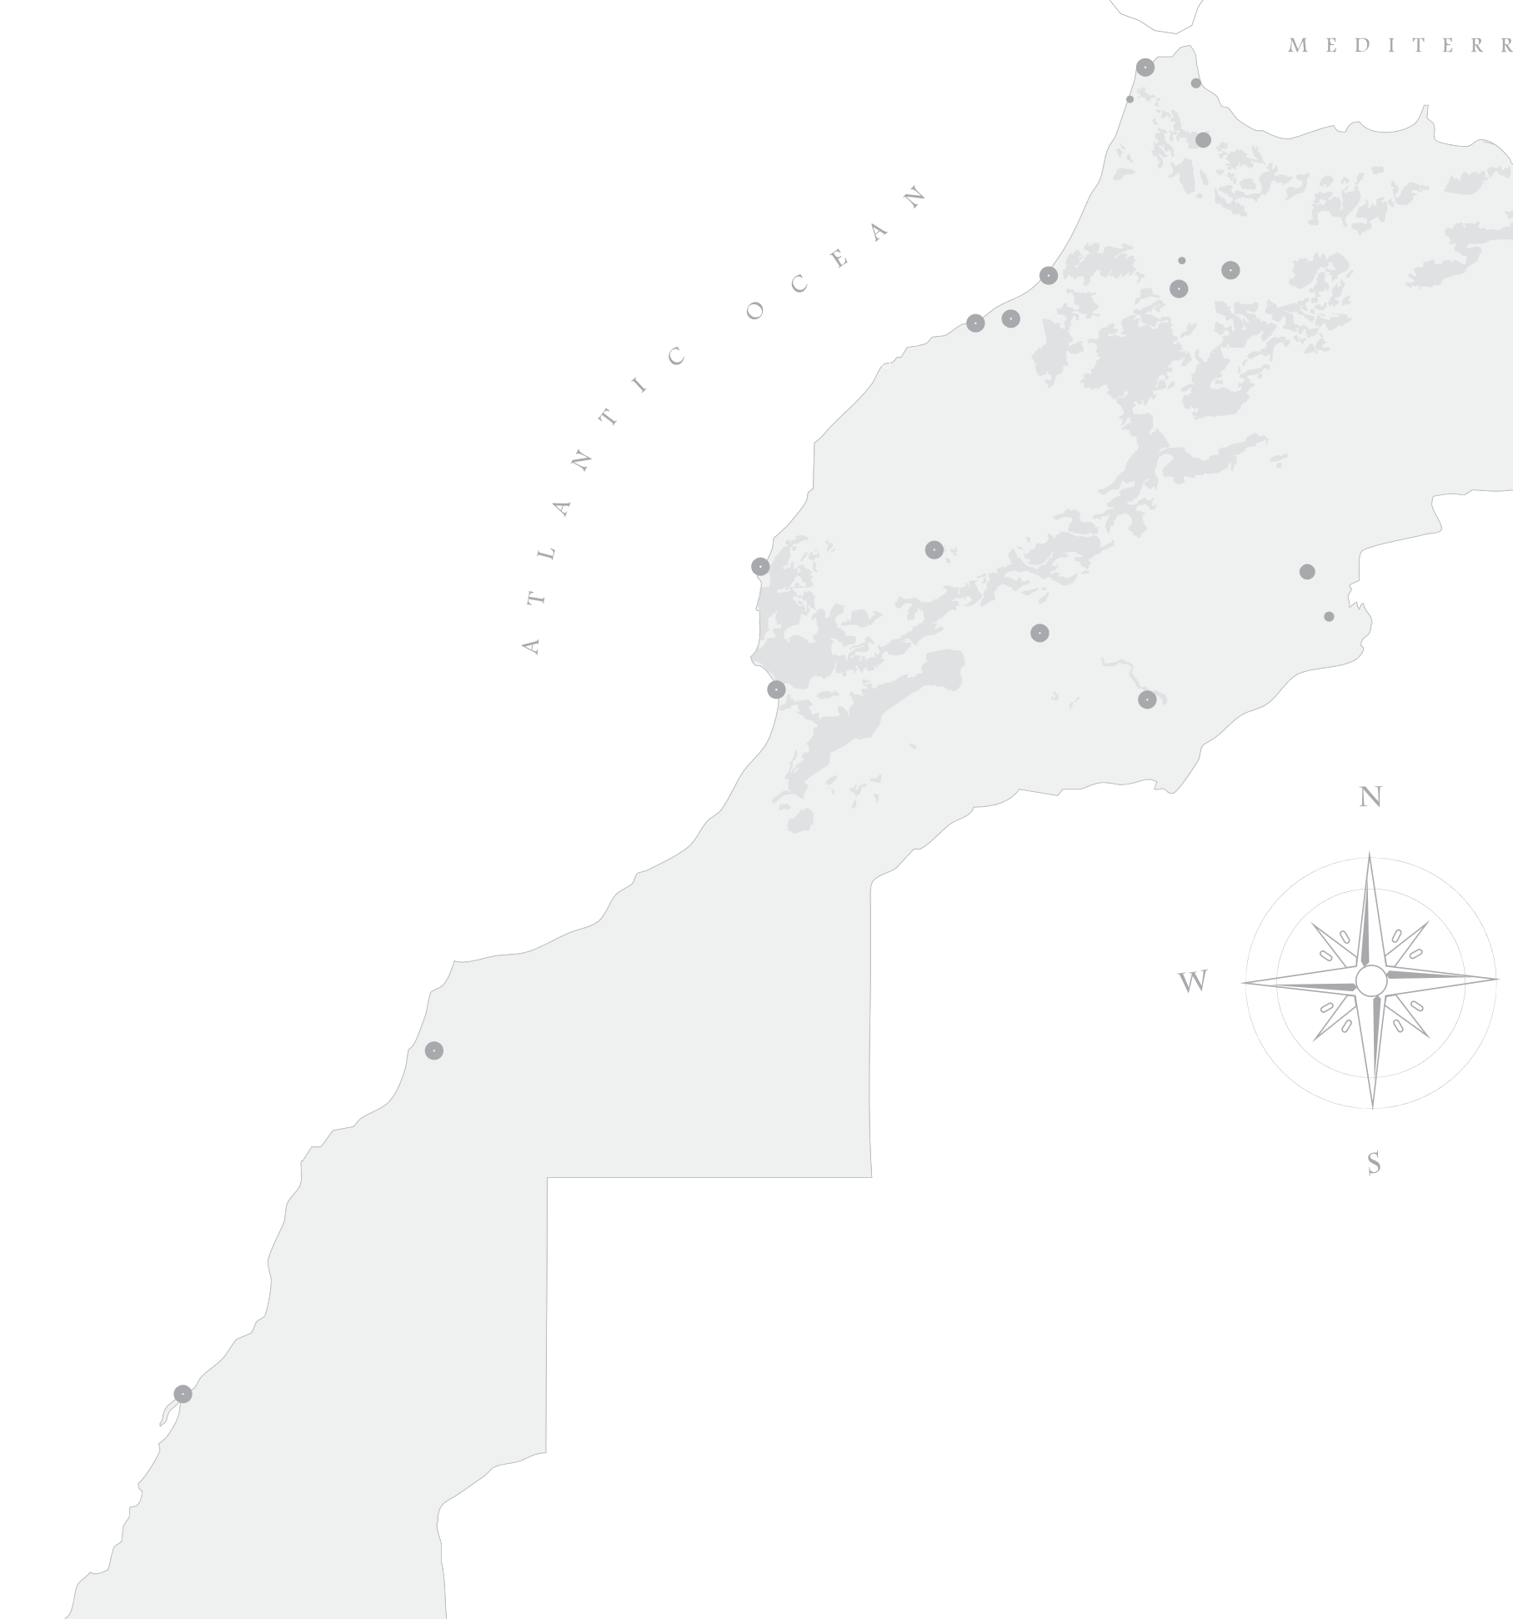




MICE Destination : Morocco | Cities
Essaouira
By Five Dragons’ Group
Hotels
6481 beds
Restaurants
TOURISM
Attractions
For Sustainable Development Goals
www.fivetravel.ma
Notes:
Lets change for the lovely dry climat of Marrakech and head to the mild ocean breeze of Essaouira
Essaouira is a lovely quite city situated by the Atlantic Ocean
The first organic winery in Morocco

Slide 20
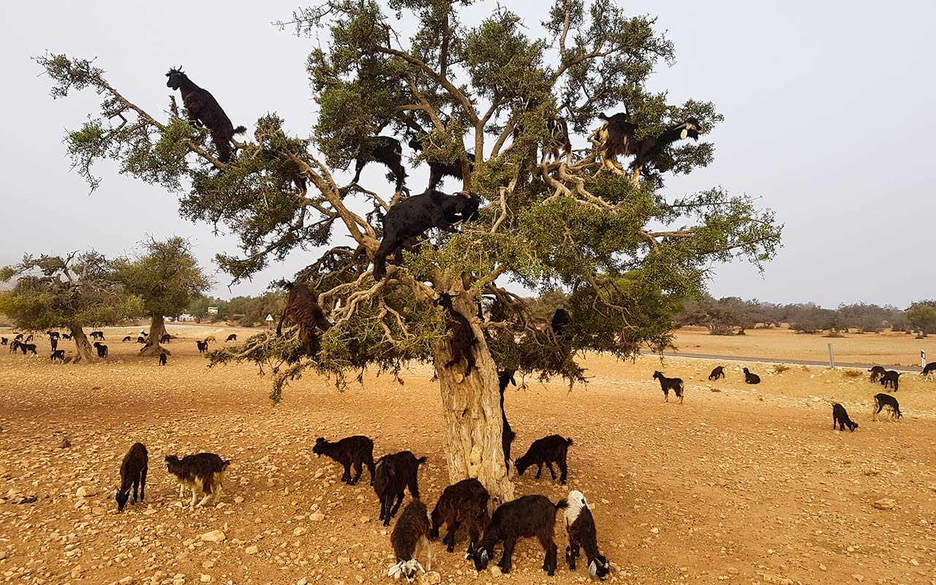
MICE Destination : Morocco | Cities
Essaouira’s
By Five Dragons’ Group
Main Assets
6481 beds
Goats
On The Tree
www.fivetravel.ma
Notes:
Lets change for the lovely dry climat of Marrakech and head to the mild ocean breeze of Essaouira
Essaouira is a lovely quite city situated by the Atlantic Ocean
The first organic winery in Morocco

Slide 21
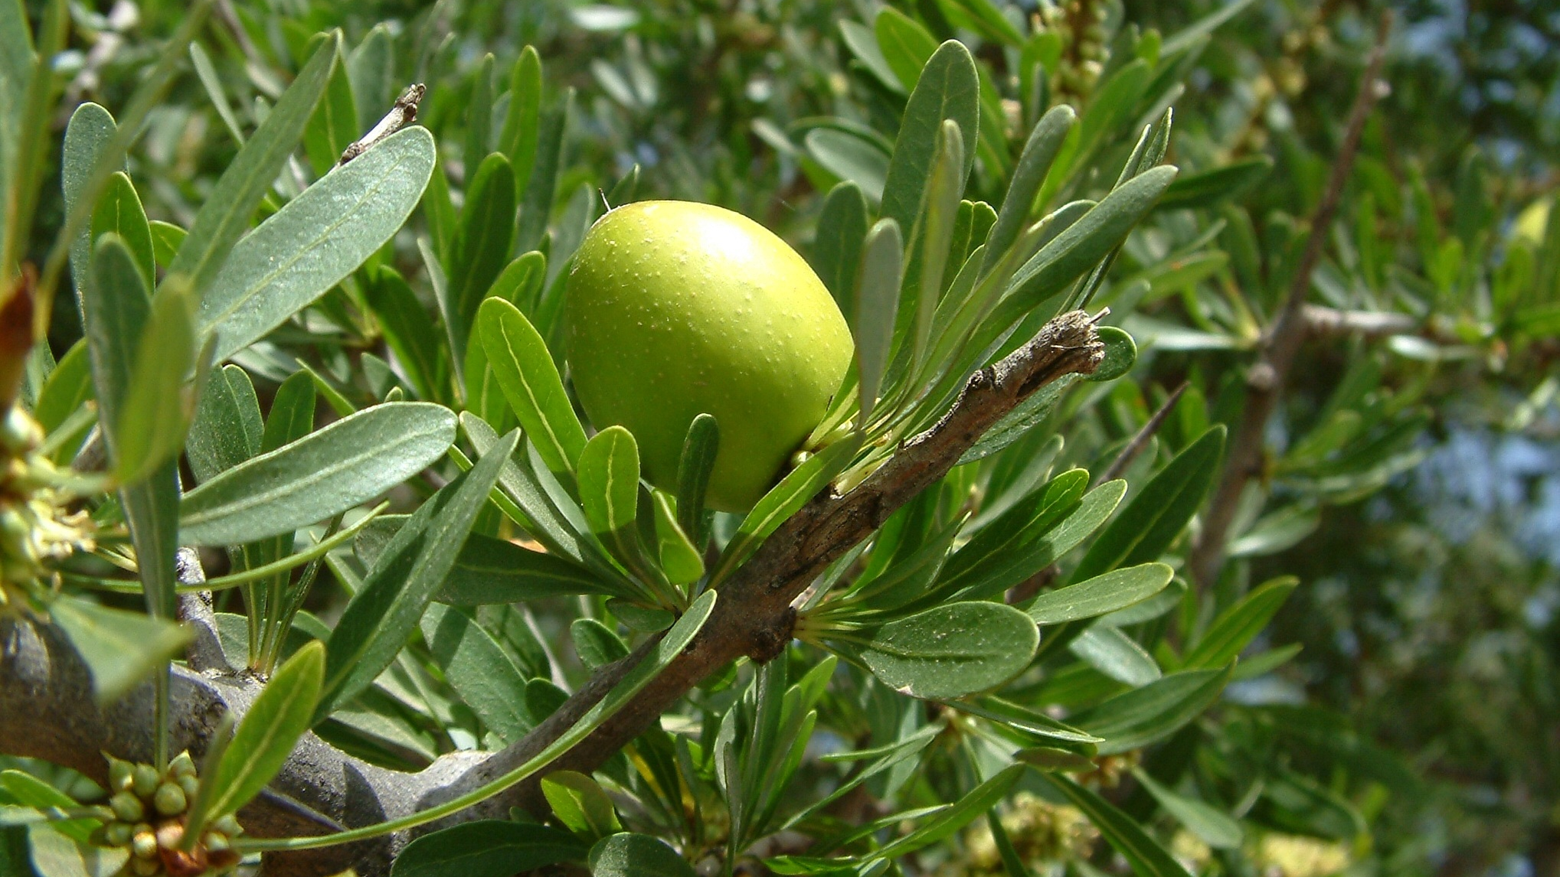
MICE Destination : Morocco | Cities
Essaouira’s
Main Assets
By Five Dragons’ Group
Argan Forests
Women Cooperatives
TOURISM
For Sustainable Development Goals
www.fivetravel.ma
Notes:
Ecolodges

Slide 22
Conferences
Meetings
MICE
Events
Incentives
www.fivetravel.ma
Notes:
A kingdom of stability, with a vibrant cultural diversity
A mix of african, oriental and european influences
With berber, arab and muslim and jewish heritage
A kingdom where you can perfect your swing
Embarking in a journey to the sahara
The african holywood

Slide 23

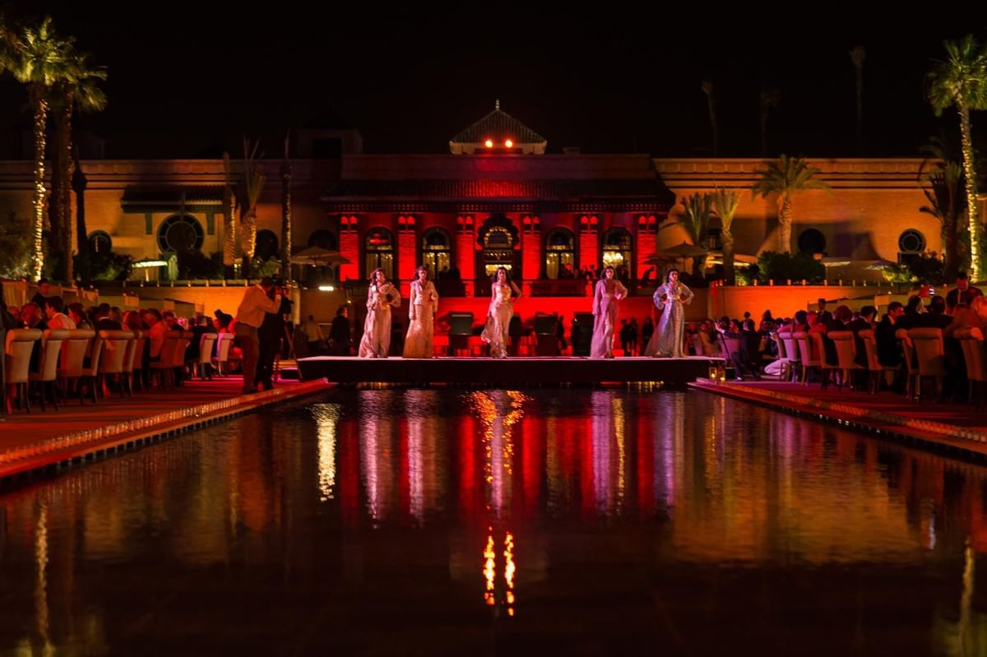

MICE Destination : Morocco | Our Services
Meet,…
for encounters that inspire big ideas & experiences
www.fivetravel.ma
Notes:
An International Airport as a Hub
9 732 044 Million passengers 2019 statistics
Business Destination
Good Hotel infrastructure
Meetings and conferences Halls
Start point of Many Tour Programs
Sightseeing might be done from 3hours to 2 days
Main attraction is Greart Mosque Hassan II, Mohammed V square and Art deco, Habous quarter, Catholique church

Slide 24
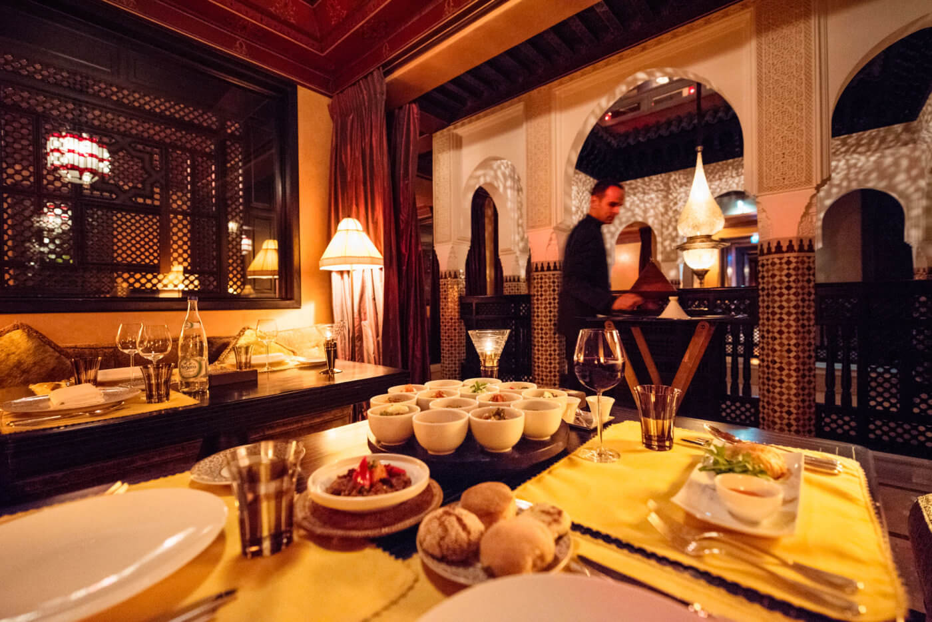
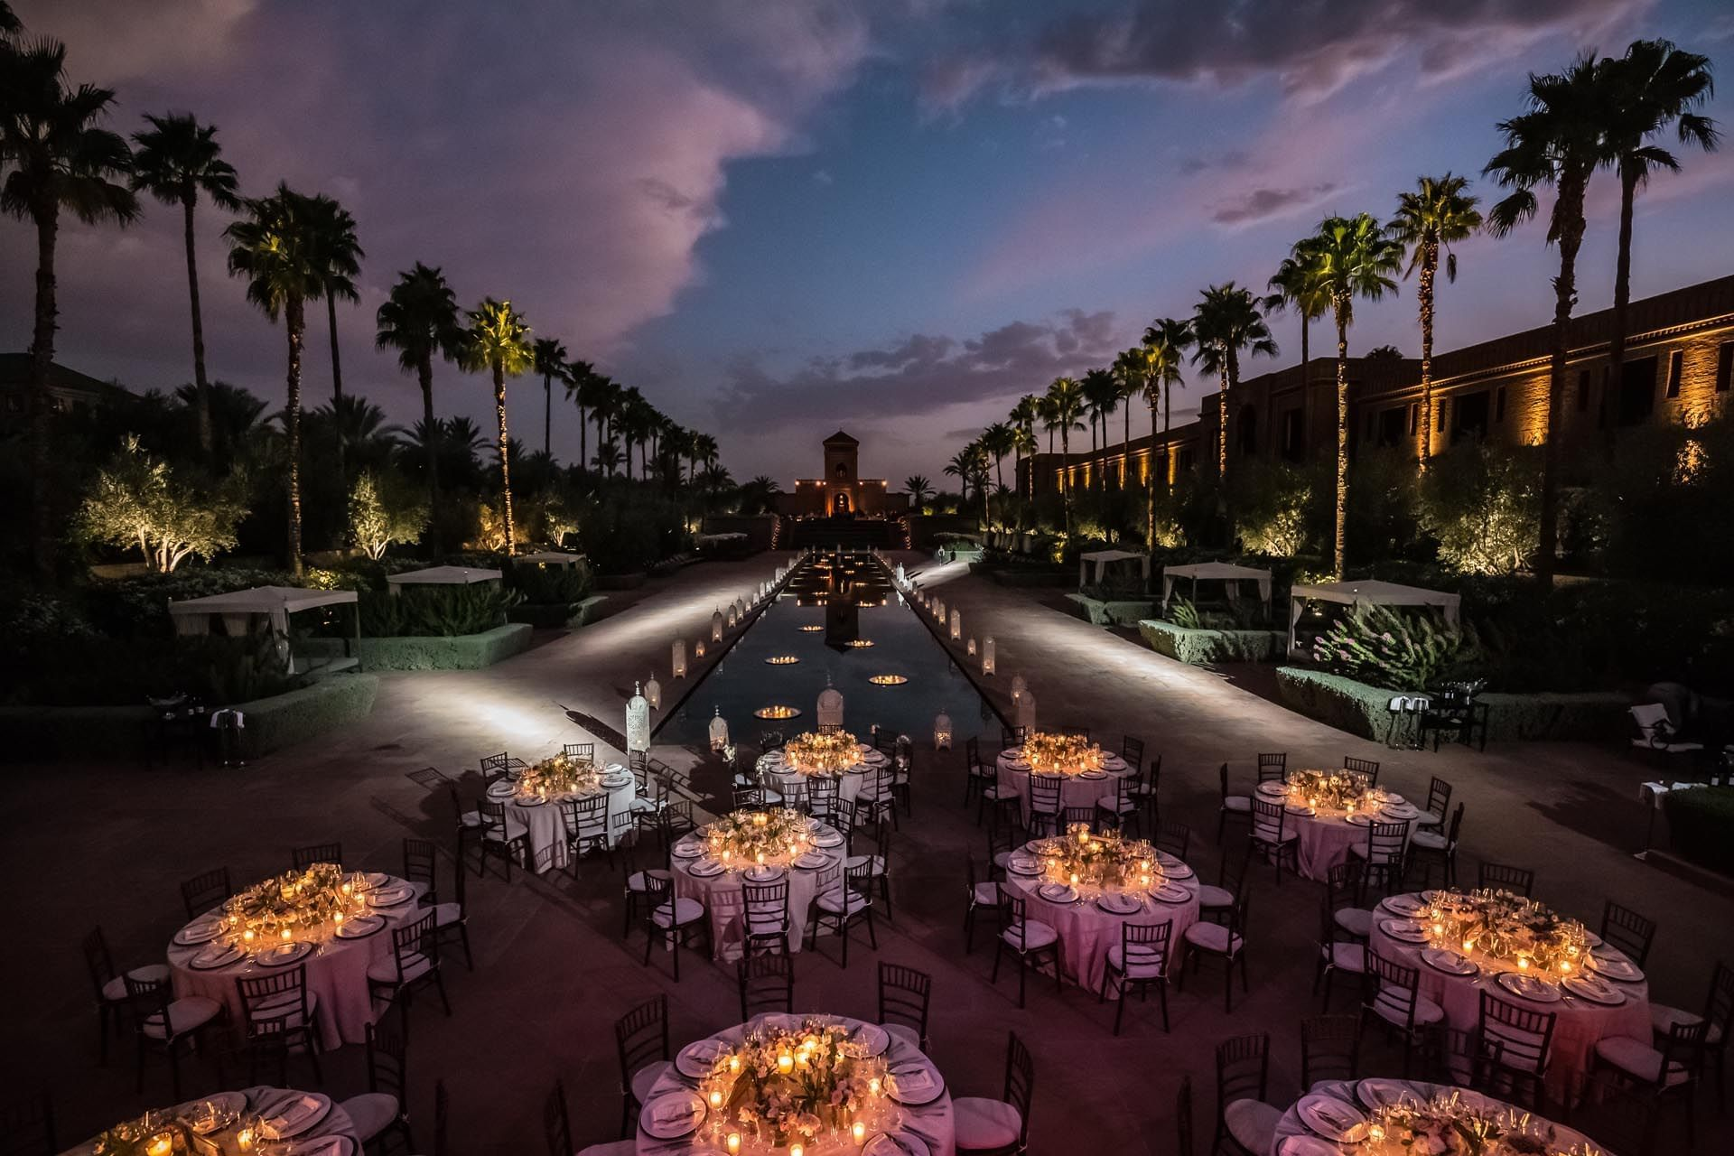
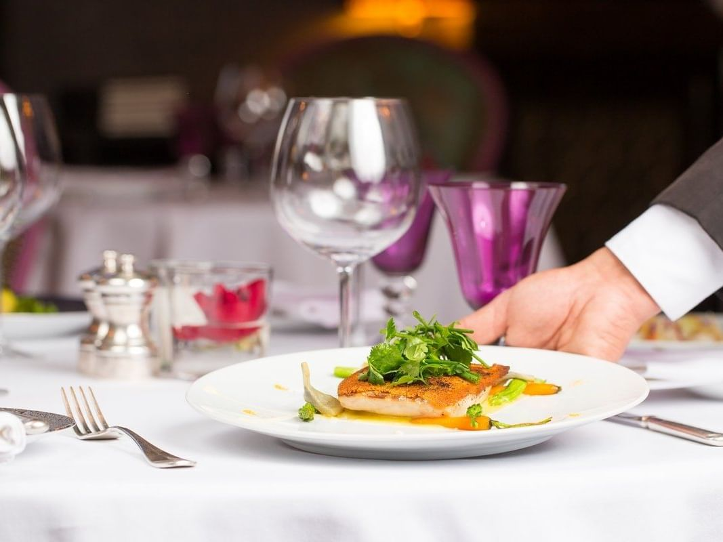
MICE Destination : Morocco | Our Services
Eat,…
tasting a harmoniously confected culinary dishes
www.fivetravel.ma
Notes:
An International Airport as a Hub
9 732 044 Million passengers 2019 statistics
Business Destination
Good Hotel infrastructure
Meetings and conferences Halls
Start point of Many Tour Programs
Sightseeing might be done from 3hours to 2 days
Main attraction is Greart Mosque Hassan II, Mohammed V square and Art deco, Habous quarter, Catholique church

Slide 25
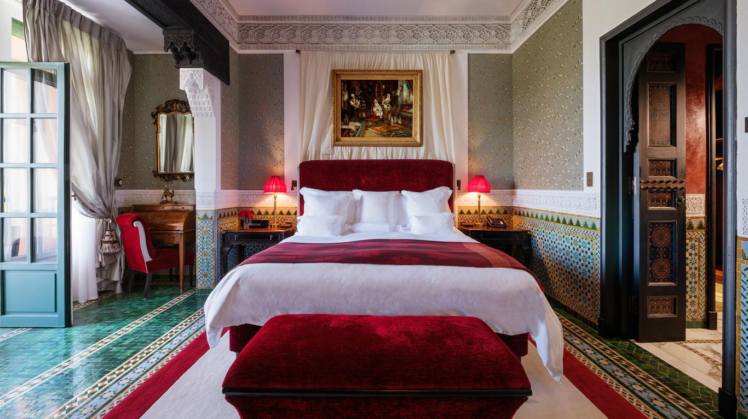
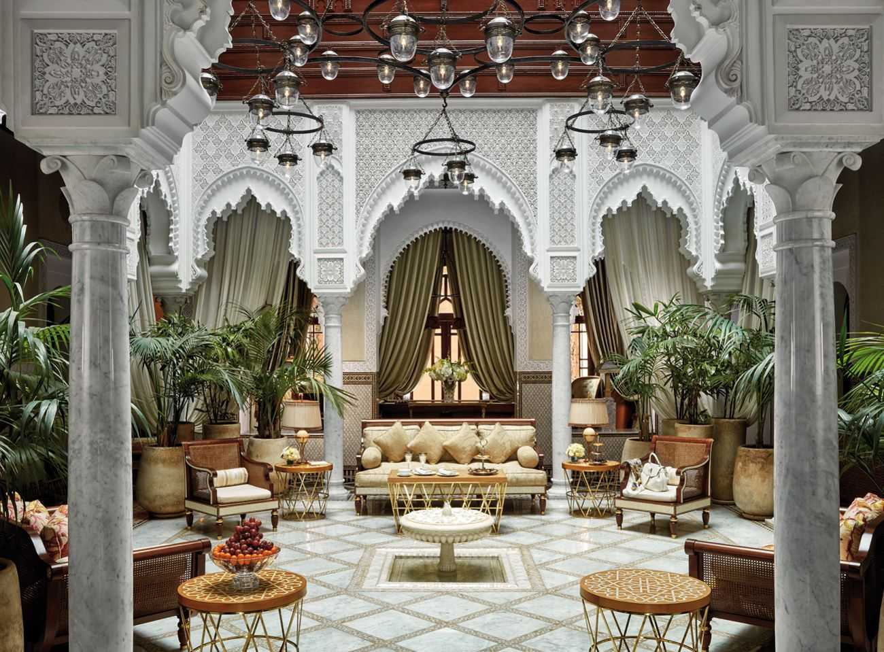
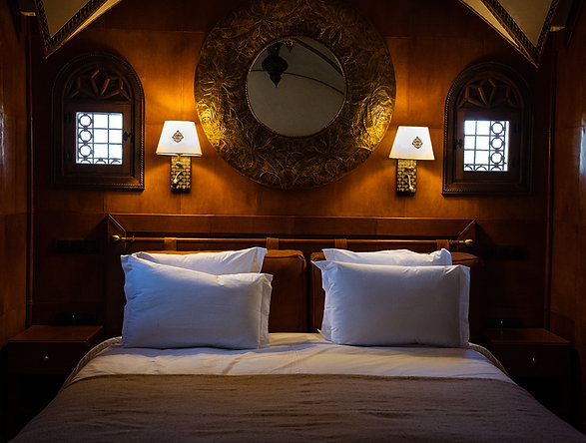
MICE Destination : Morocco | Our Services
Stay,…
feeling the uniqueness of moroccan design & welfare
www.fivetravel.ma
Notes:
An International Airport as a Hub
9 732 044 Million passengers 2019 statistics
Business Destination
Good Hotel infrastructure
Meetings and conferences Halls
Start point of Many Tour Programs
Sightseeing might be done from 3hours to 2 days
Main attraction is Greart Mosque Hassan II, Mohammed V square and Art deco, Habous quarter, Catholique church

Slide 26
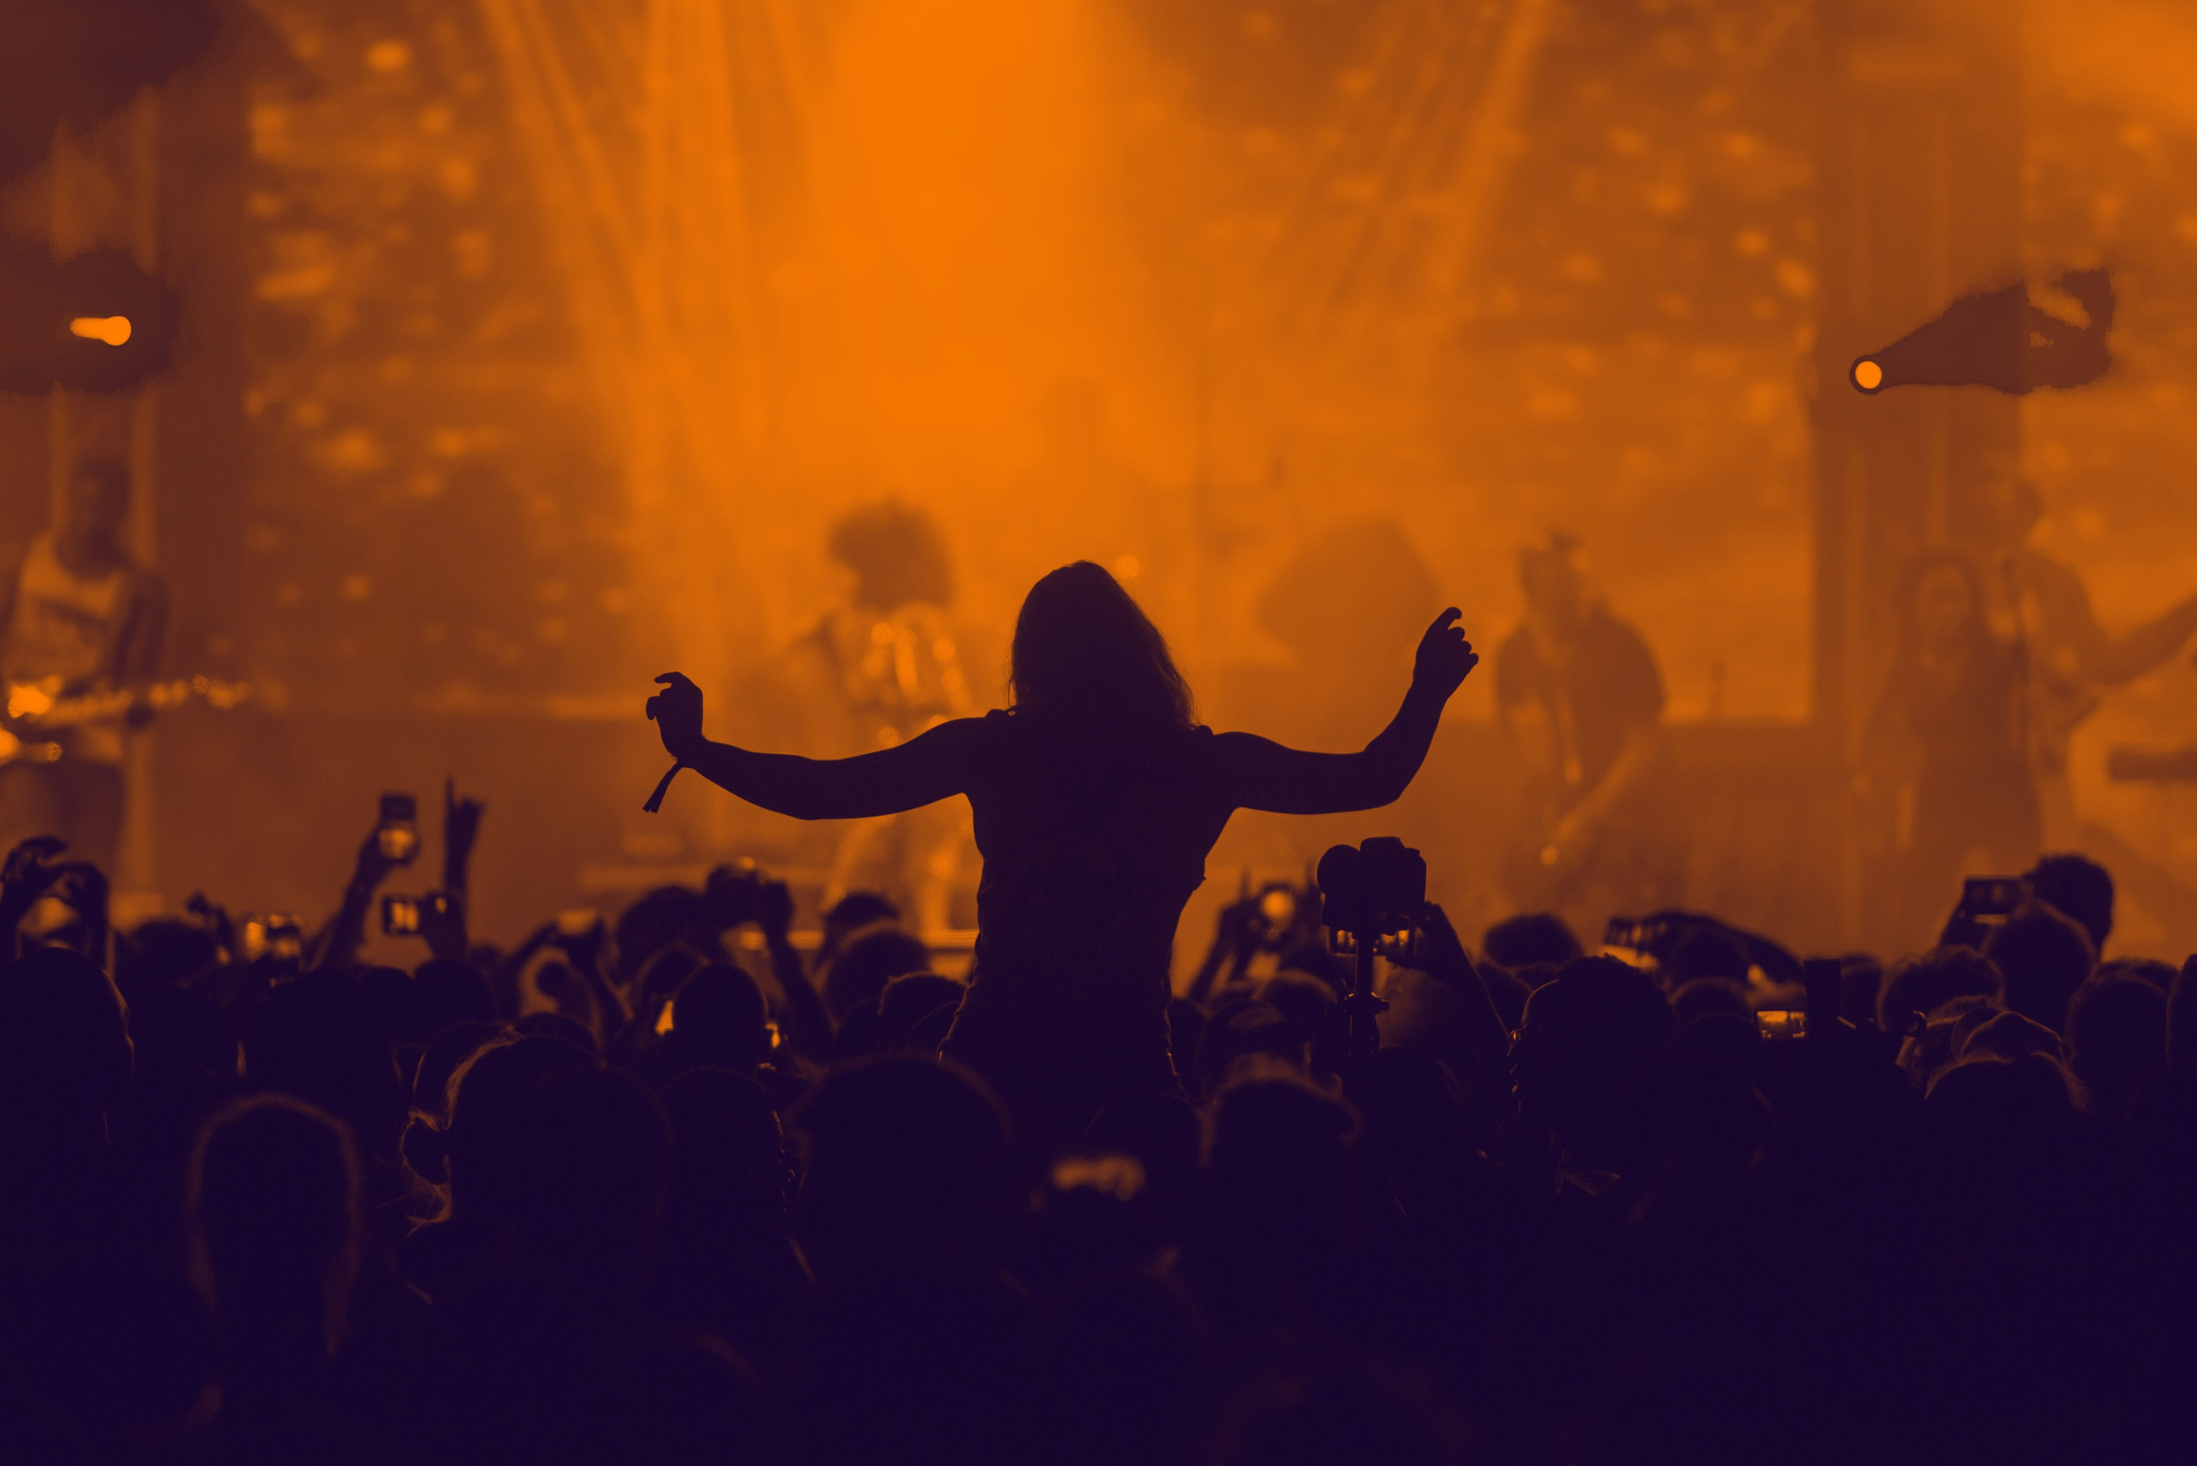

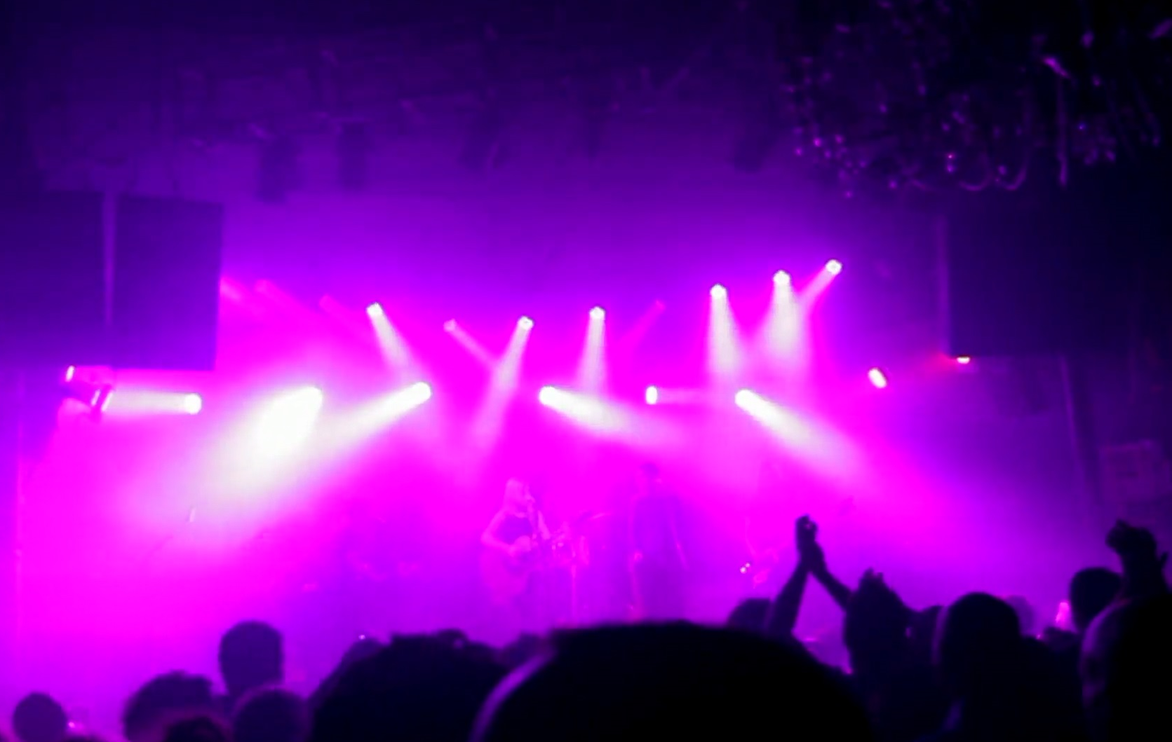
MICE Destination : Morocco | Our Services
Play,…
move to the rhythm of enchanting atmospheres
www.fivetravel.ma
Notes:
An International Airport as a Hub
9 732 044 Million passengers 2019 statistics
Business Destination
Good Hotel infrastructure
Meetings and conferences Halls
Start point of Many Tour Programs
Sightseeing might be done from 3hours to 2 days
Main attraction is Greart Mosque Hassan II, Mohammed V square and Art deco, Habous quarter, Catholique church

Slide 27

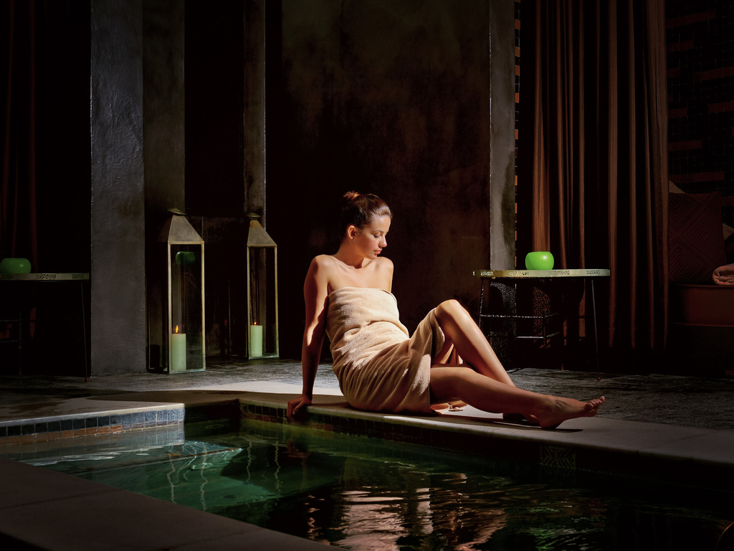
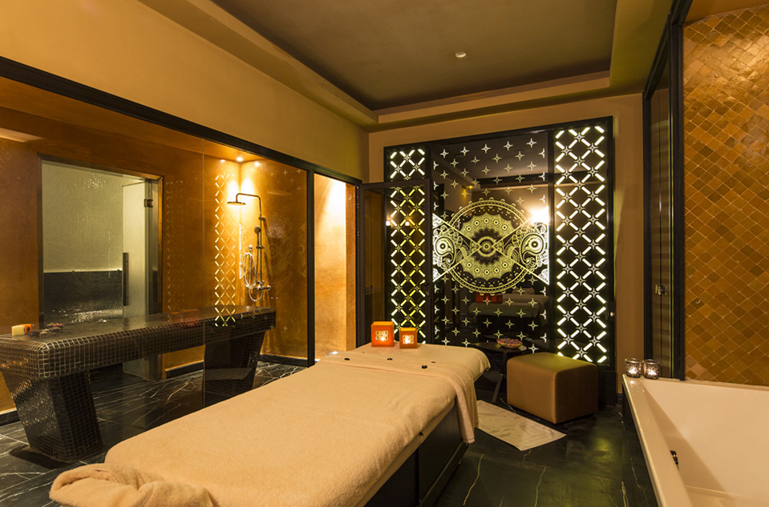
MICE Destination : Morocco | Our Services
Relax,…
dive deep into the peaceful self, indulging your senses
www.fivetravel.ma
Notes:
An International Airport as a Hub
9 732 044 Million passengers 2019 statistics
Business Destination
Good Hotel infrastructure
Meetings and conferences Halls
Start point of Many Tour Programs
Sightseeing might be done from 3hours to 2 days
Main attraction is Greart Mosque Hassan II, Mohammed V square and Art deco, Habous quarter, Catholique church

Slide 28
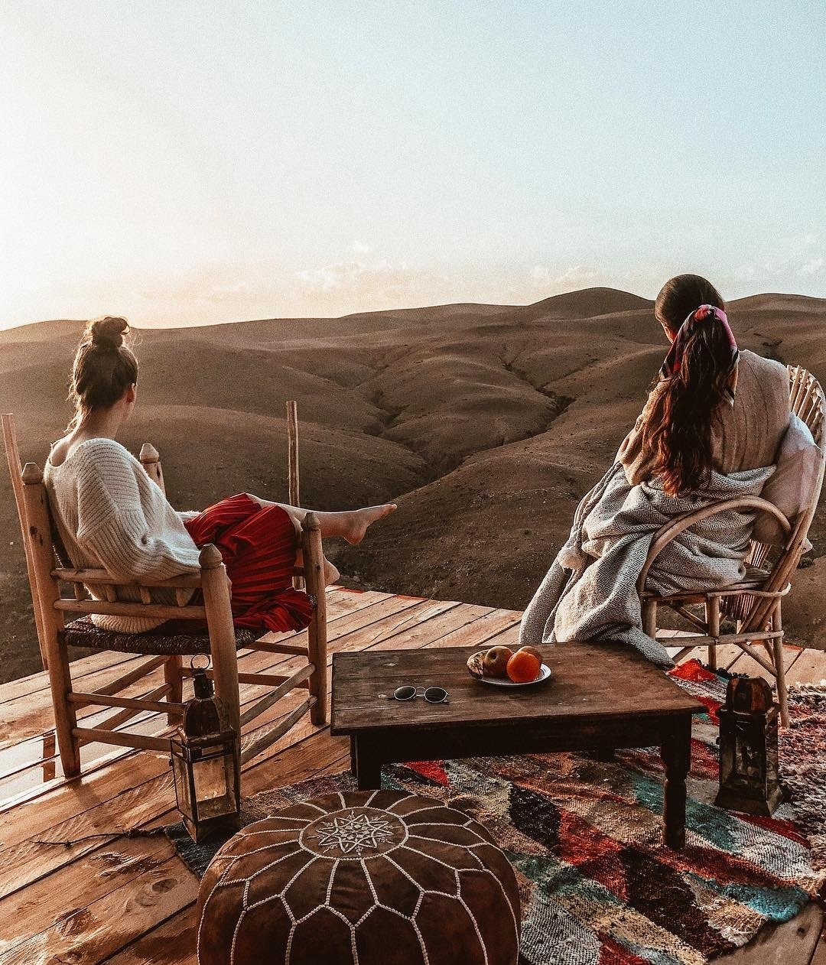
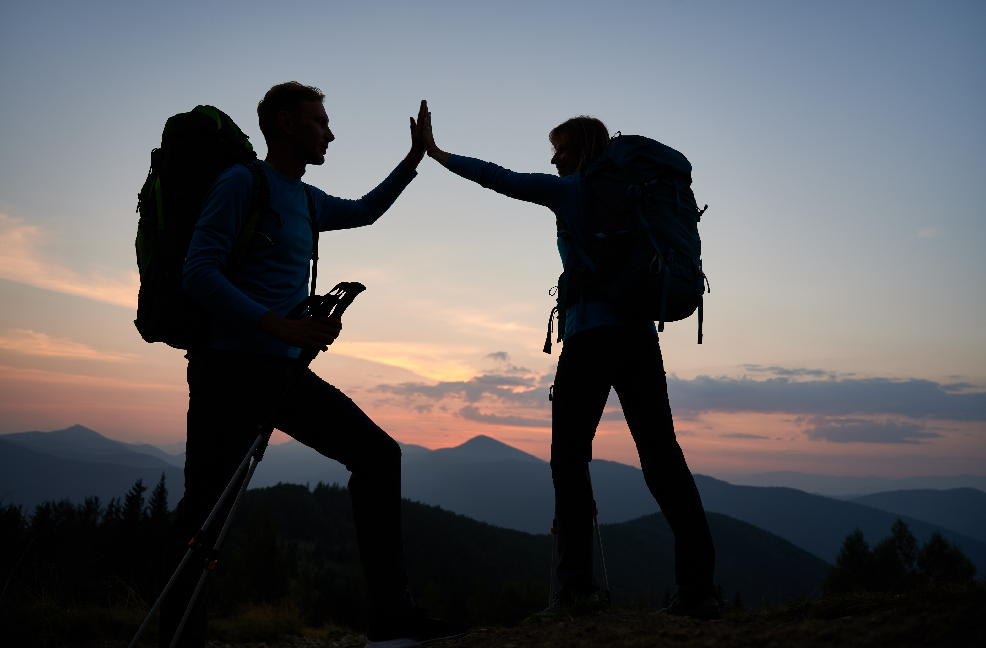
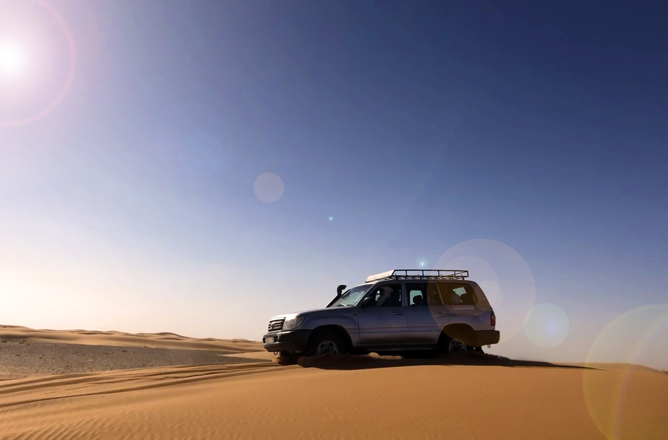
MICE Destination : Morocco | Our Services
Explore,…
myriad rich diversity of Morocco’s land & culture
www.fivetravel.ma
Notes:
An International Airport as a Hub
9 732 044 Million passengers 2019 statistics
Business Destination
Good Hotel infrastructure
Meetings and conferences Halls
Start point of Many Tour Programs
Sightseeing might be done from 3hours to 2 days
Main attraction is Greart Mosque Hassan II, Mohammed V square and Art deco, Habous quarter, Catholique church

Slide 29








MICE Destination : Morocco | Our Services
Some
Immersive Activities
Hot Air Ballooning
Argan Oil Extracting experience
Organic Wineries near Essaouira
Old Car Museum and Driving experience
Traditional Caftan Fashion Show
Cooking Class
Calligraphy Workshop
Camel Riding with nomad Dress Tea ceremony under nomad tents
www.fivetravel.ma

Slide 30
About Us
Casablanca, Morocco
Head Offices 2nd + 3rd Floor
www.fivetravel.ma

Slide 31



Our Mission …
Contribute to memorable Tours & Events
Through Immersive experience.
Simplify and ease the workload of our B2B
partners to manage their Morocco
destination,…
focus more on the human approach
towards the travelling experience.
www.fivetravel.ma

Slide 32

When great ideas are discussed by competent and passionate people, a whole range of opportunities offers itself.
25 Years
more than
History
2009
The 25 year experience background of the team gathered in our company will certainly enable us meet your expectations.
Stratageme
EVENTS MANAGEMENT
COMPANY & Advertising using the latest programing technologies
the spark...
Five Dragons company was founded
Operation processes Automation
Exclusive Launching
Agents Collaborative Interface (B2B)
Start ISO Quality Management Mr Aziz El Hajji as CEO
Malasia,
Indonesia, China
& Hong kong Market
Creation of
Five Travel Brand creation of Hotello.ma
Networking ... Potentiel contracting
Tour Apps Development
Five Dragons’ Liner Transportation company Founded
MICE Services
2017
Recruit of Talented and pationate team, commited to the vision of the company.
2018
Implementing a details oriented quality management We took the challenge of assisting our partners for Award competition.
2019
Partnership with Stratageme an Event Management
2020
2021
Mr Aziz El Hajji Joines the company as CEO of Five Travel amiid of challenging time.
2022
Enhancing Parntership with suppliers
Exclusive Tours development
Volume of 1054 overnights before the pandemy outbreak
Though we kept a positif attitude
Training sessions for Staff
B2C Hotels booking platform hotello.ma
company, for the sake of
Affiliation with FNAVM (Federation of Moroccan Travel Agencies)
perfection in term of MICE management
Inspections Tours and services testing for better Product Developement
Affiliation with CCIM (italian Chamber of Commerce in Morocco)
www.fivetravel.ma

Slide 33
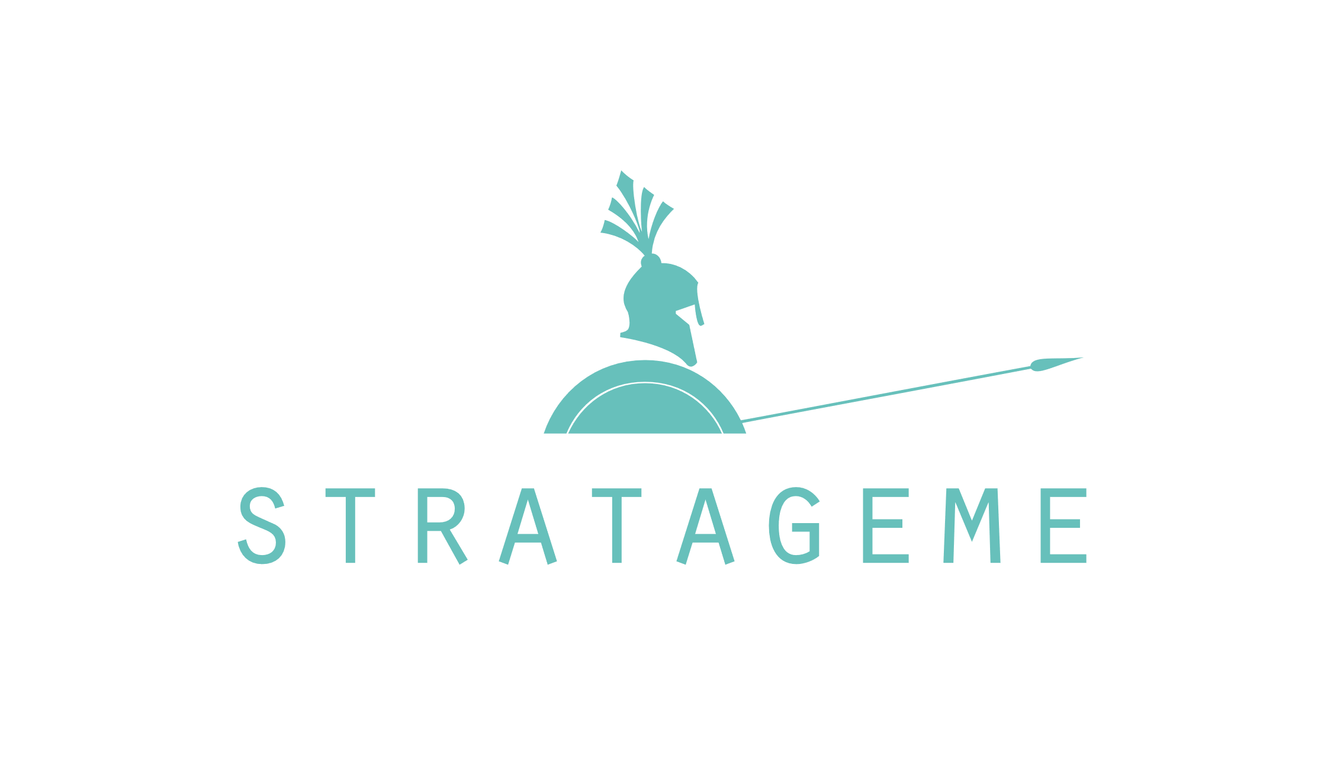

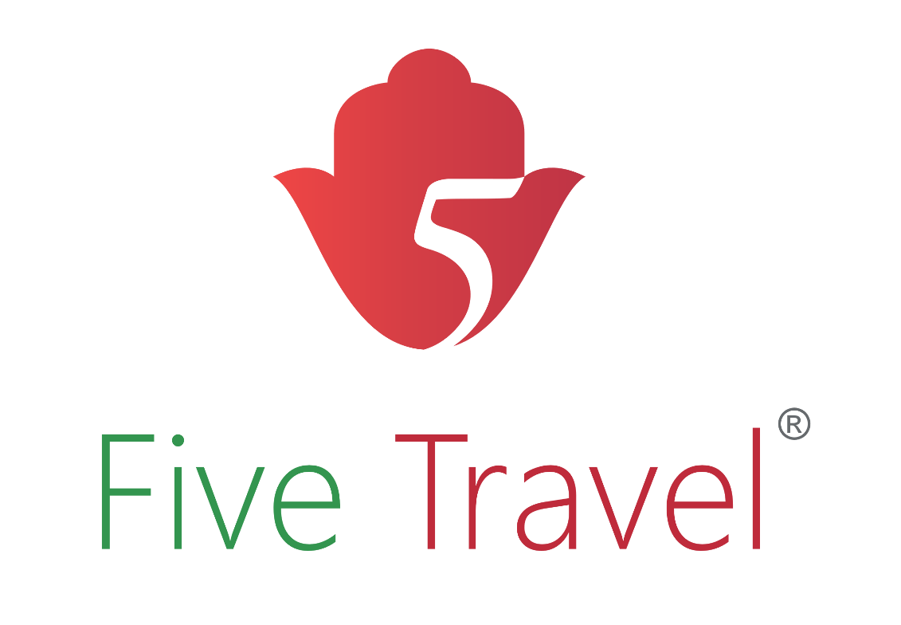
Transportation
Management
Event
Management
Travel
Management
www.fivetravel.ma

Slide 34







Divisions Symbiosis
IT
Development
Division
Operation Division
Best
Client’s
Travel
Experience
Sales
&Marketing Division
Transport
Department
Financial
Division
Contracting
& Quality
Division
www.fivetravel.ma
Notes:
Trough all our divisions
We put all our attention toward a
Best Client’s Travel Experience

Slide 35
Divisions Symbiosis
Transport
Department
Five Dragons’ Liner
Is Our own Transportation Company, part of
Five Dragons’ Group.
www.fivetravel.ma
Notes:
To be more

Slide 36
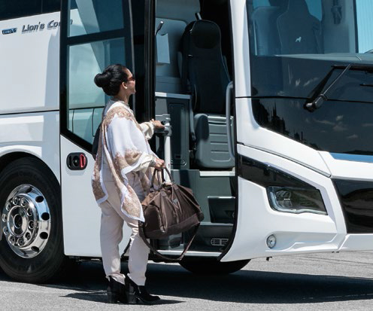
Own dedicated Transportation Company
48 seater Motorcoaches
30 seater Motorcoaches
14 seater Vans
06 seater Minivans
Five Dragons’ Liner
www.fivetravel.ma
Notes:
Strong partnership with carefully selected transportation companies
15 vehicules 48 ss
10 vehicules 30 ss
30 vehicules 14 ss
35 vehicules 06 ss

Slide 37
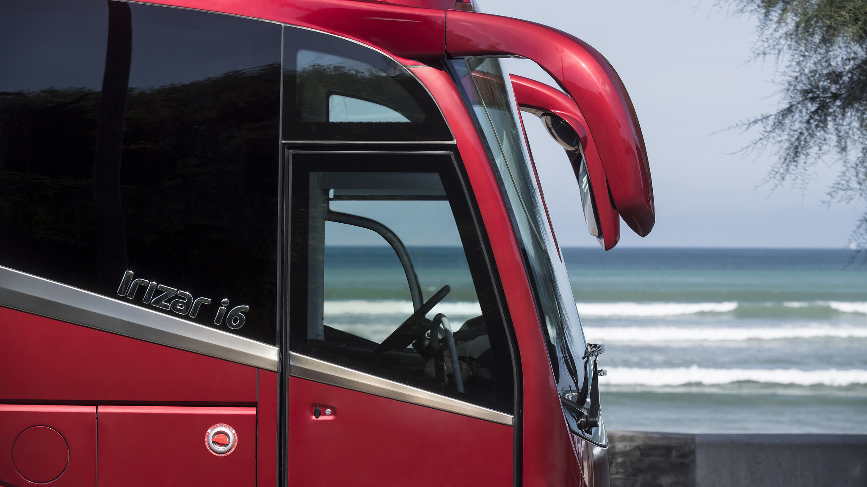

Strong partnership…
www.fivetravel.ma
Notes:
Strong partnership with carefully selected transportation companies
15 vehicules 48 ss
10 vehicules 30 ss
30 vehicules 14 ss
35 vehicules 06 ss

Slide 38
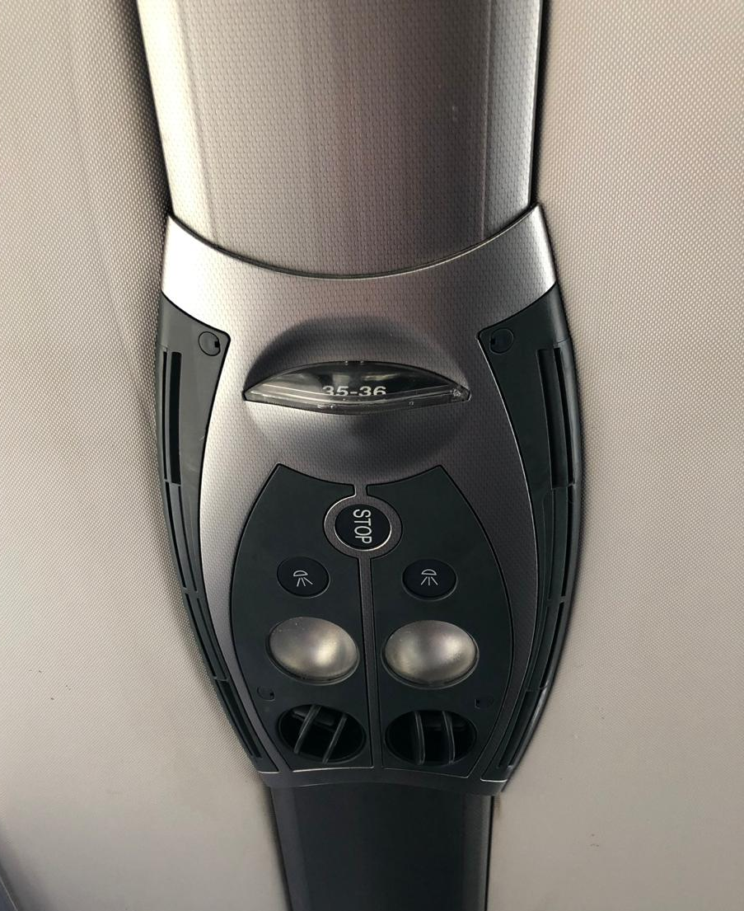


& Safety.
www.fivetravel.ma
Notes:
Strong partnership with carefully selected transportation companies
15 vehicules 48 ss
10 vehicules 30 ss
30 vehicules 14 ss
35 vehicules 06 ss

Slide 39


4 Wheel Drive,…
www.fivetravel.ma

Slide 40

to experience Adventure,…
www.fivetravel.ma

Slide 41

Under best conditions.
www.fivetravel.ma

Slide 42
We could give you many
reasons to choose us,
but we will simply tell you
that we are searching for a
fruitful long-term
partnership,
and let you find out that you
were right to
choose us!
Thank you!...
www.fivetravel.ma

Slide 43







Travel Agency
Scan,
to keep in touch!
www.fivetravel.ma

