Slide 1
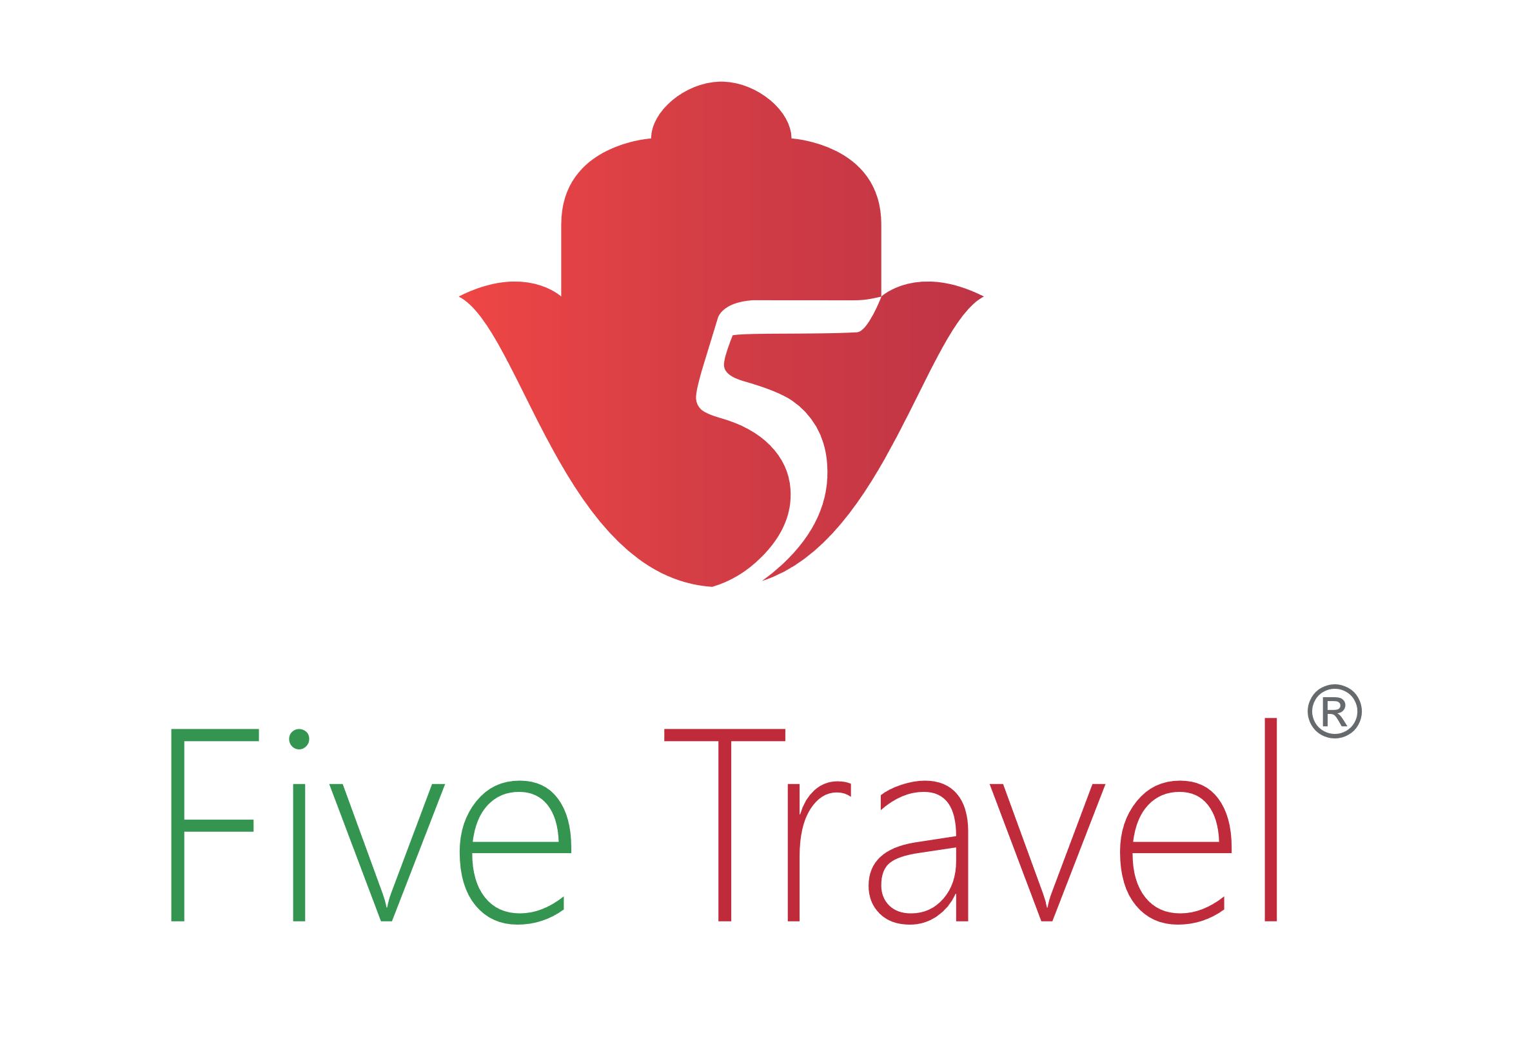
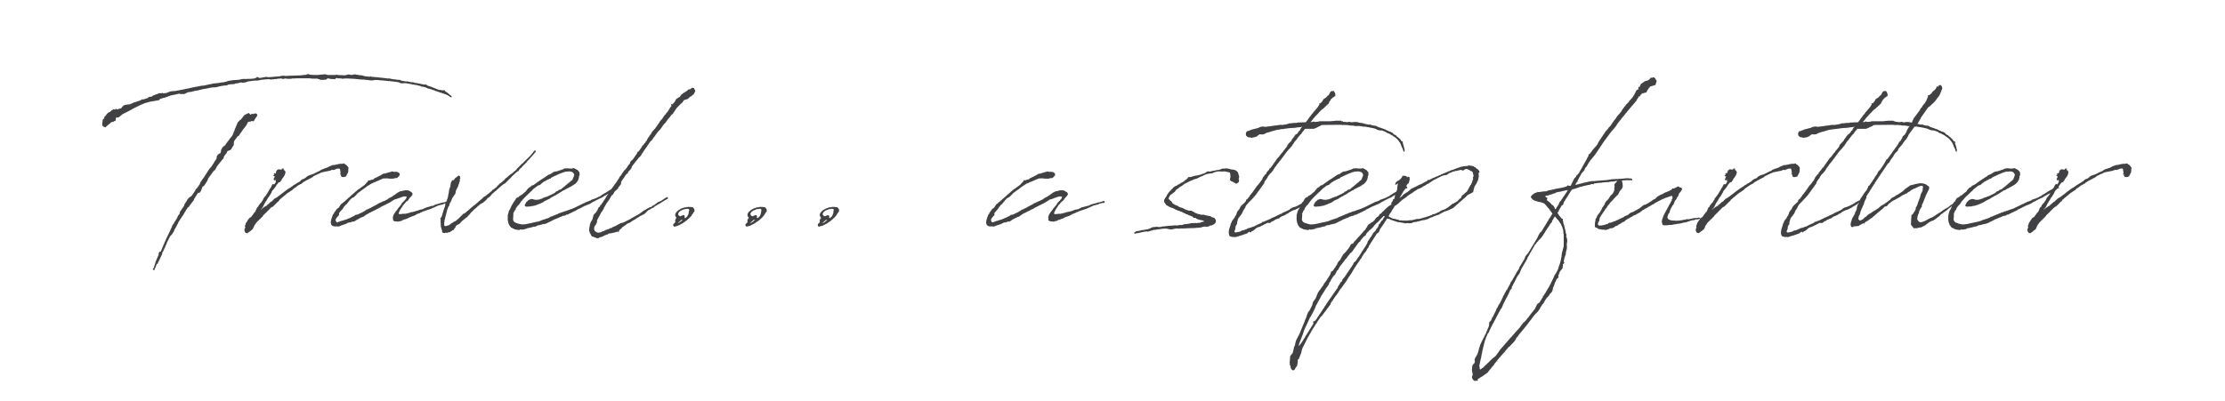
By Five Dragons’ Group

Slide 2




What’s New
Hotels
www.fivetravel.ma
Notes:
Simplify and ease the workload of our B2B partners to manage their Morocco destination,
in order to focus more on the human approach towards the travelling experience.
After this challenging crisis we need to consolidate our entities, trough innovation under human approach

Slide 3
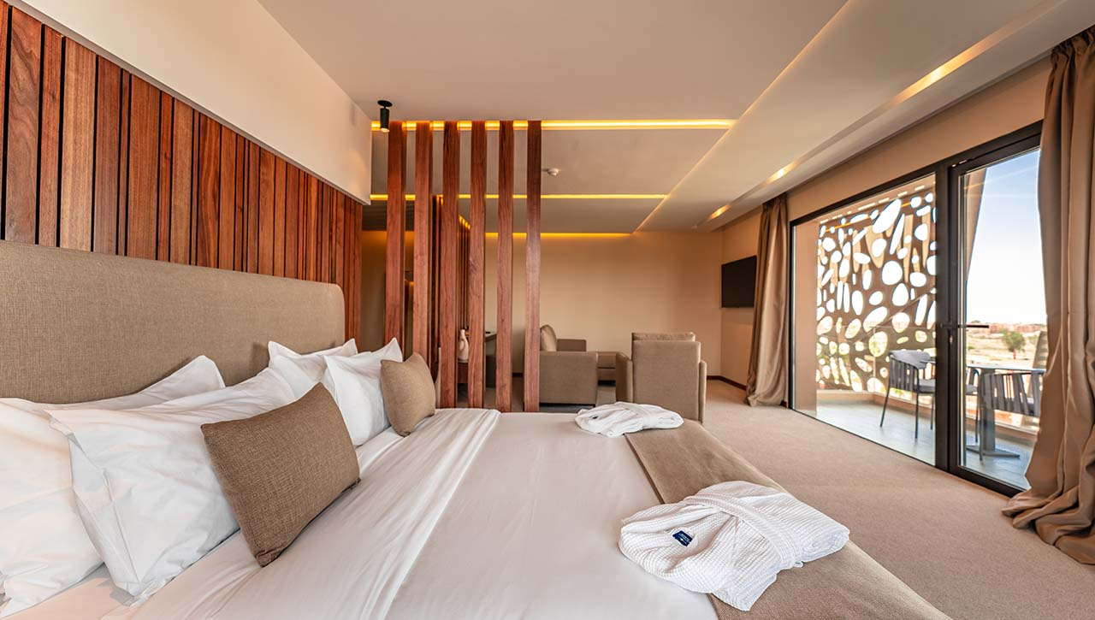
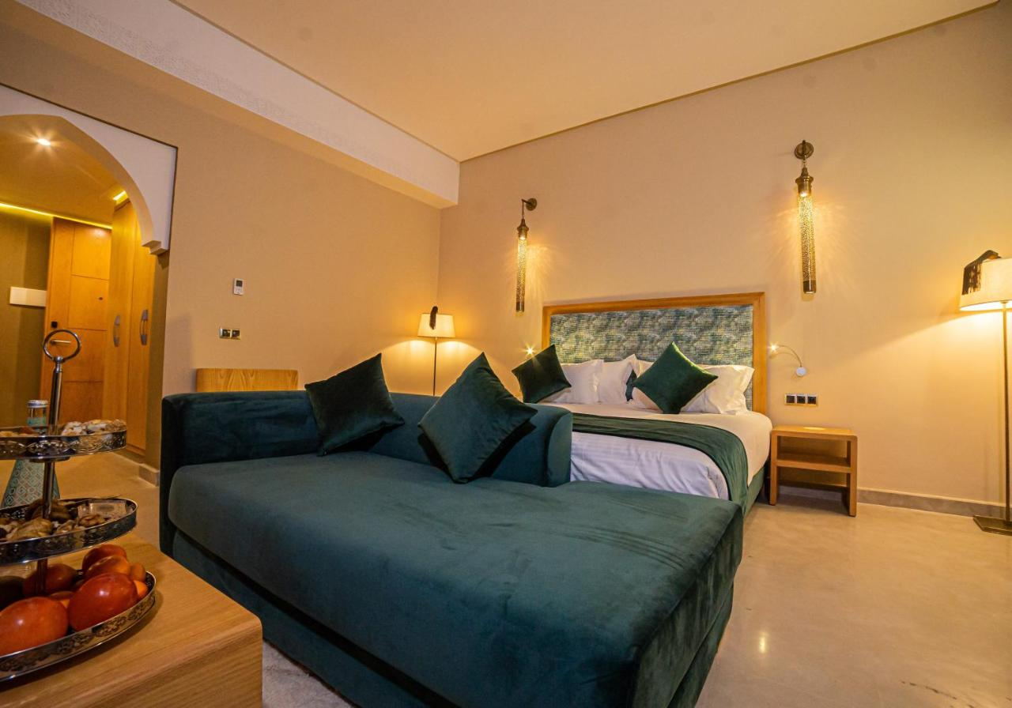
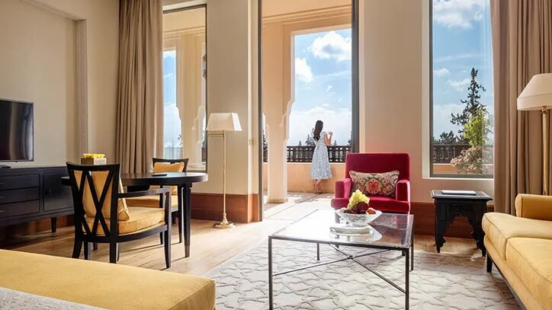
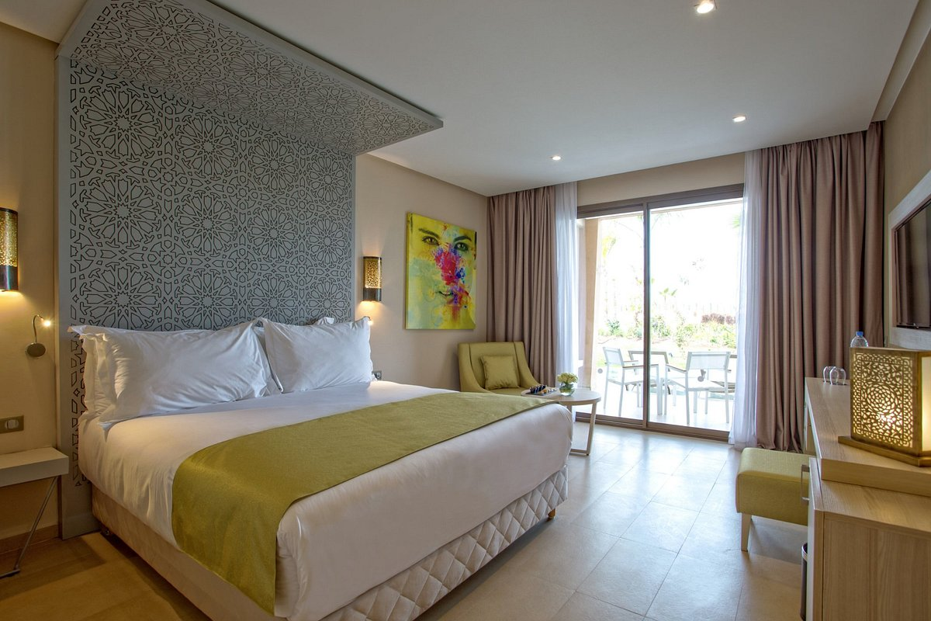
What’s New
New opening
Hotels
In Marrakech…
Longue Vie Hotels 4*
Sumahan Suites & Spa, 5*
The oberoi Marrakech 5*
Be Live Hotels
4* & 5*
www.longueviehotels.com/en/
www.sumahansuites.com/en/
www.oberoihotels.com/hotels-in-morocco-marrakech/
www.belivehotels.com/en/hotels-marrakech/
Be Live Experience Marrakech Palmeraie
Be Live Collection Marrakech Adults-only
www.fivetravel.ma
Notes:
Simplify and ease the workload of our B2B partners to manage their Morocco destination,
in order to focus more on the human approach towards the travelling experience.
After this challenging crisis we need to consolidate our entities, trough innovation under human approach

Slide 4
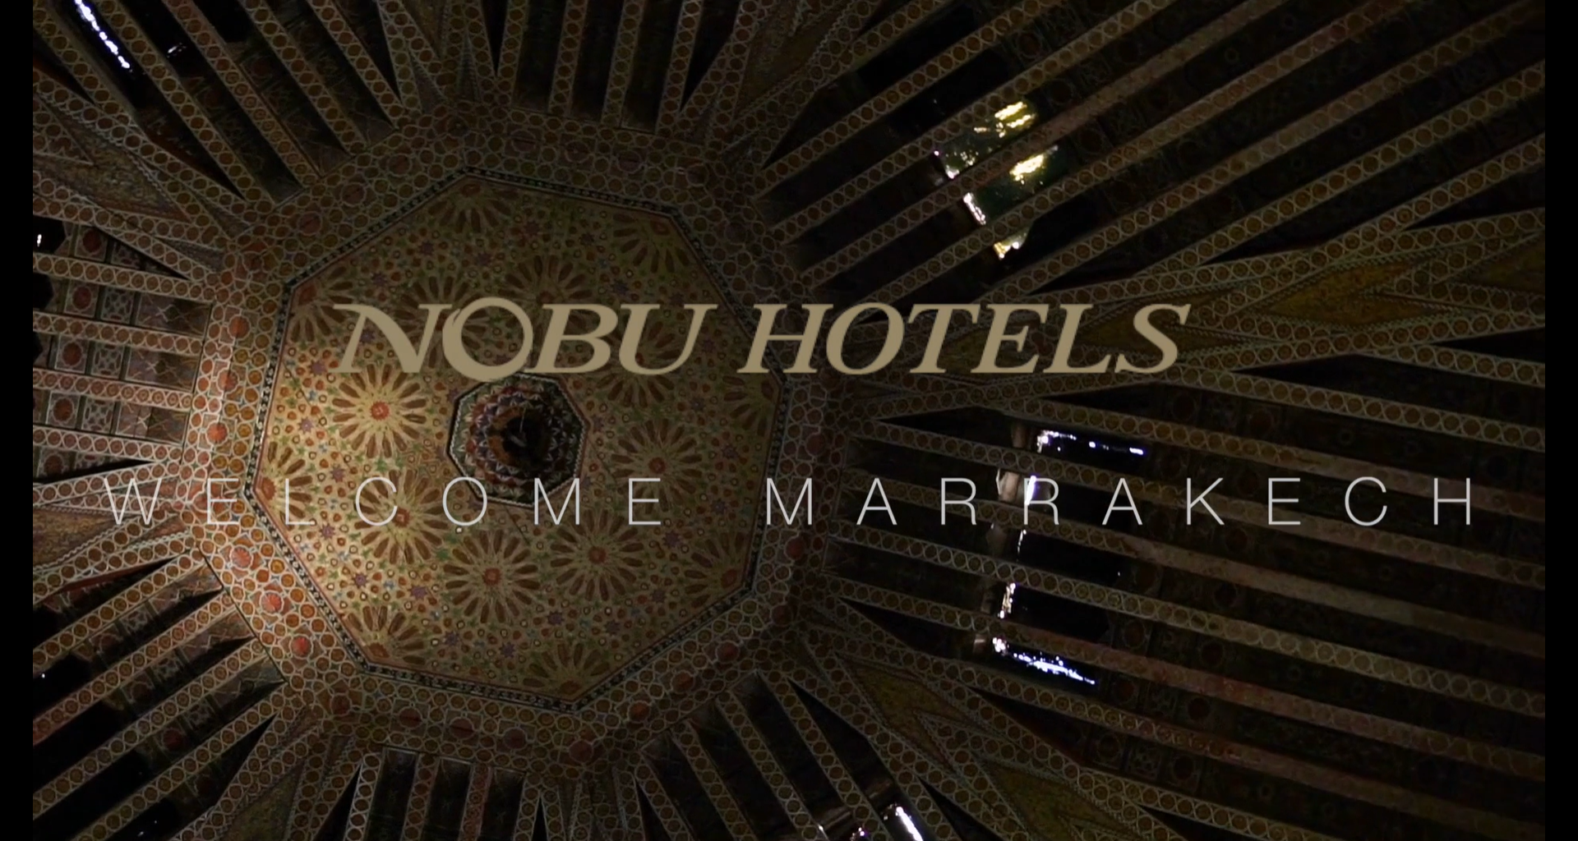

What’s New
New opening
Hotels
In Marrakech…
Nobu Hotel Collection
Robert De Niro, Japanese celebrity chef Nobu Matsuhisa, and American producer Meir Teper are the founders of Nobu Hospitality
https://www.nobuhotels.com/hotel-collection/marrakech/
www.fivetravel.ma
Notes:
Simplify and ease the workload of our B2B partners to manage their Morocco destination,
in order to focus more on the human approach towards the travelling experience.
After this challenging crisis we need to consolidate our entities, trough innovation under human approach

Slide 5
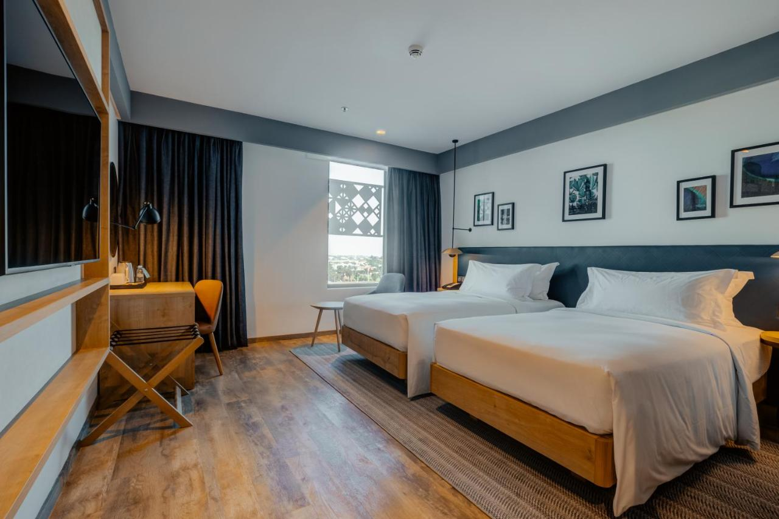
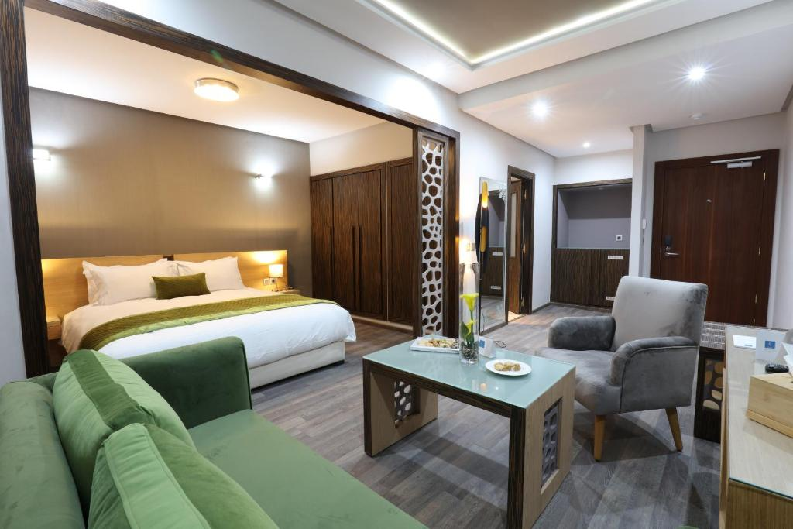
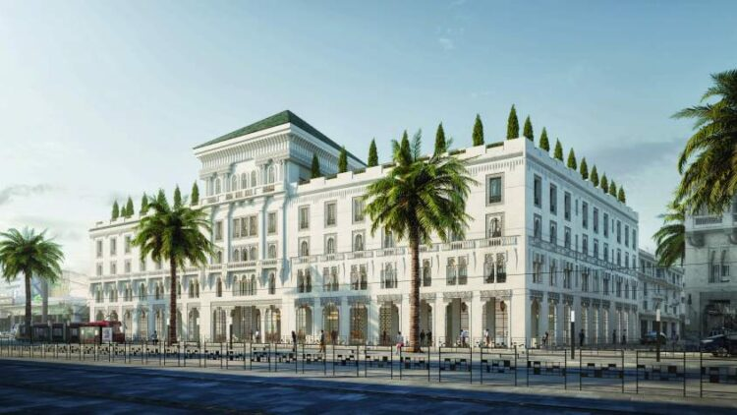
What’s New
New opening
Hotels
In Casablanca…
Hilton Garden Inn 4*
Silver Suites Hotel & Spa, 4*
Lincoln Hotel by Radisson Blue
The Lincoln Hotel, the oldest hotel in Casablanca and a prime example of the citys Art Deco heritage, was built in 1916 by the renowned French architect, Hubert Bride. The Lincoln Hotel is a key landmark in Casablanca around which the city was originally developed.
www.hilton.com/en/hotels/casasgi-hilton-garden-inn-casablanca-sud/
https://silversuiteshotel.com/
www.hozpitalityplus.com/read-article/5682_radisson-hotel-group-announce-the-opening-of-new-hotel-lincoln-casablanca.html
www.fivetravel.ma
Notes:
Simplify and ease the workload of our B2B partners to manage their Morocco destination,
in order to focus more on the human approach towards the travelling experience.
After this challenging crisis we need to consolidate our entities, trough innovation under human approach

Slide 6
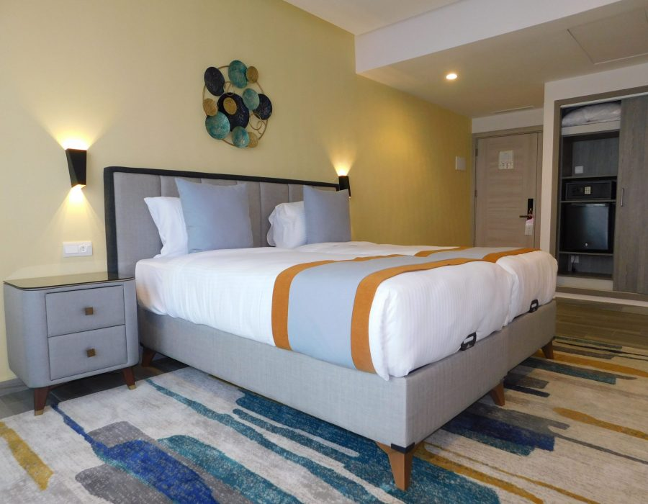
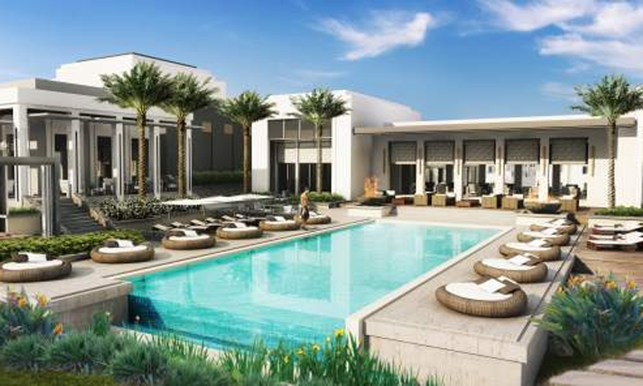
What’s New
New opening
Hotels
In Rabat…
Gardenia Boutique Hotel 4*
InterContinental Hotels and Resorts
Immohold Hospitality and IHG Hotels & Resort have signed an agreement for the introduction of the InterContinental Hotels and Resorts brand in Rabat. This 5-star luxury hotel, will include 156 rooms, 950 m² of meeting space, an exclusive spa and numerous health and fitness facilities
www.gardeniaboutiquehotel.com/
https://lematin.ma/express/2021/hotellerie-luxe-intercontinental-rabat-ouvrira-portes-2022/352682.html
www.fivetravel.ma
Notes:
Simplify and ease the workload of our B2B partners to manage their Morocco destination,
in order to focus more on the human approach towards the travelling experience.
After this challenging crisis we need to consolidate our entities, trough innovation under human approach

Slide 7
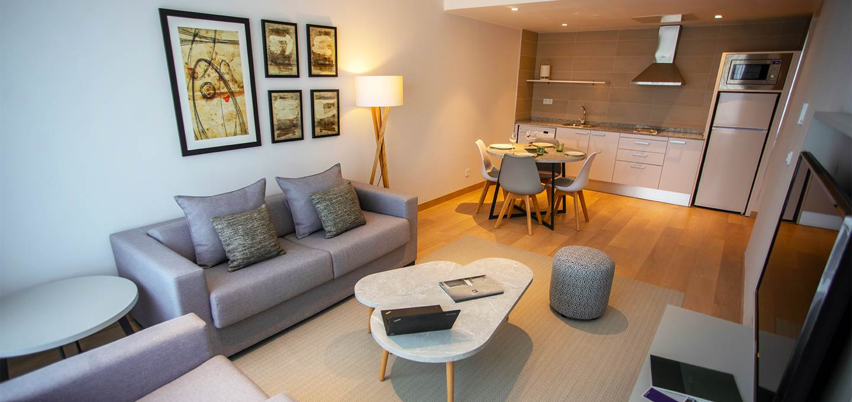
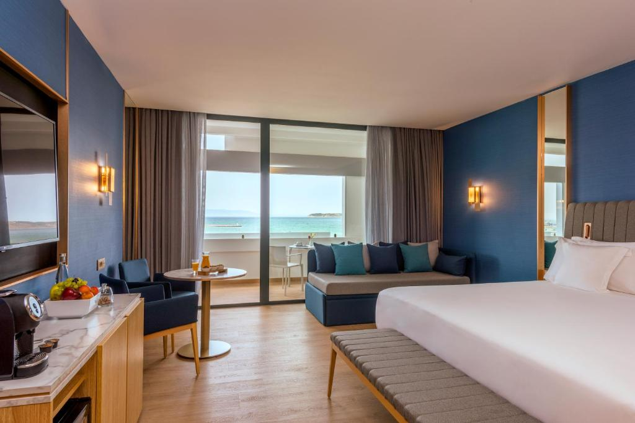
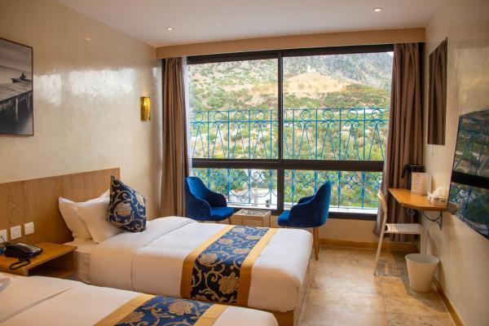
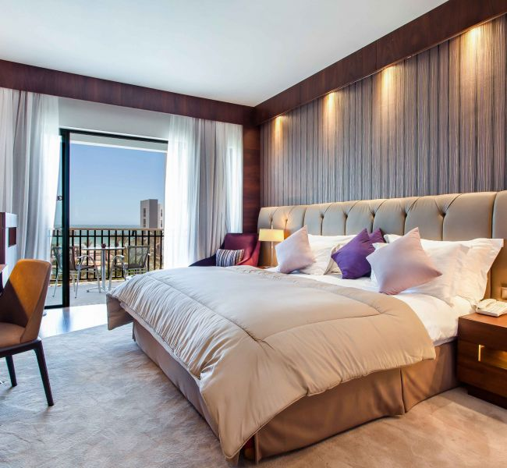
What’s New
New opening
Hotels
In Tangier…
In Chefchaouen…
In Agadir…
Pestana Tanger City Center 4*
Barceló Tangier, 5*
Vancii Hotel, 3*
Royal Atlas & Spa 5*
www.pestana.com/fr/hotel/pestana-tanger
www.barcelo.com/fr-ma/barcelo-tanger/
https://bit.ly/3unpYTa
(a shortened google link)
https://atlashotelscollection.com/fr/maroc/hotel/royal-atlas-agadir
www.fivetravel.ma
Notes:
Simplify and ease the workload of our B2B partners to manage their Morocco destination,
in order to focus more on the human approach towards the travelling experience.
After this challenging crisis we need to consolidate our entities, trough innovation under human approach

Slide 8

What’s New
Monuments
www.fivetravel.ma
Notes:
Simplify and ease the workload of our B2B partners to manage their Morocco destination,
in order to focus more on the human approach towards the travelling experience.
After this challenging crisis we need to consolidate our entities, trough innovation under human approach

Slide 9
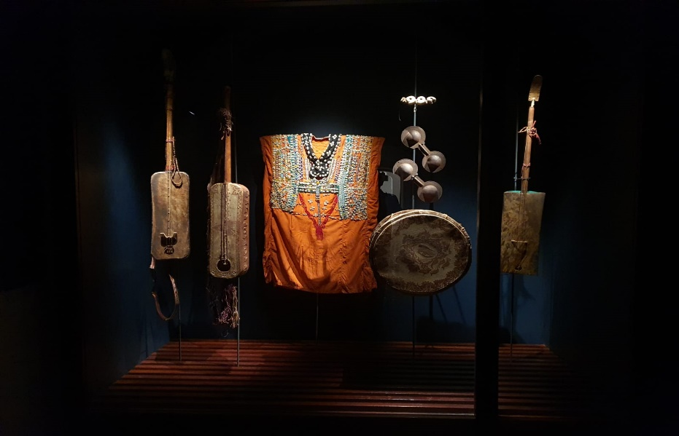
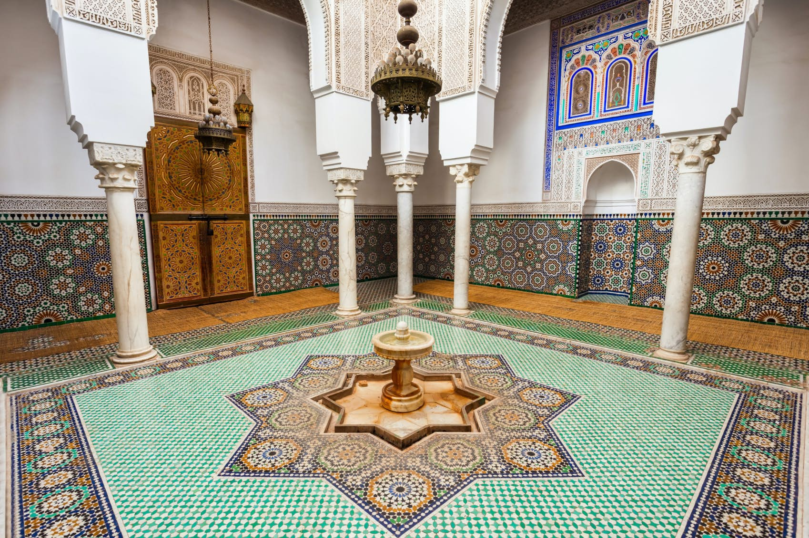
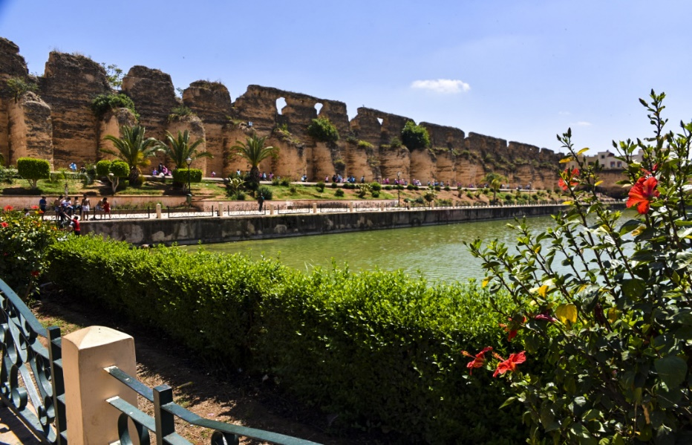
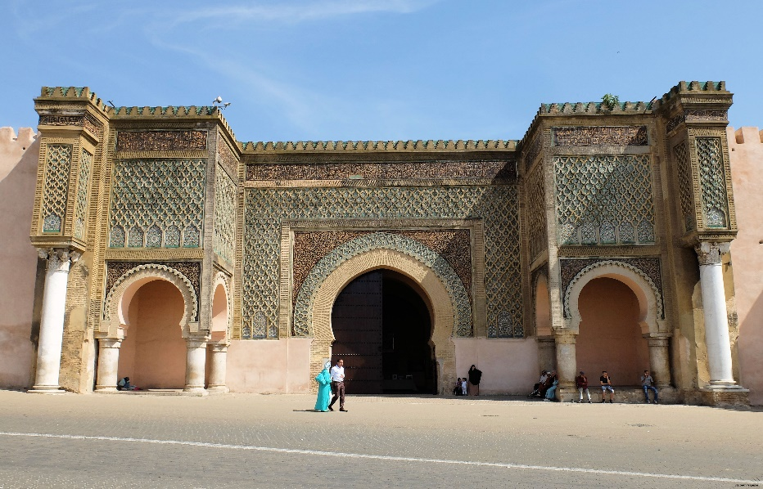

What’s New
Monuments
Updates
In Meknes…
Dar Jamaï, National Music Museum
Mausoleum Moulay Ismail
Agdal Bassin
Bab Mansour
Is under restoration until further notice
Is under restoration until further notice
www.fivetravel.ma
Notes:
Simplify and ease the workload of our B2B partners to manage their Morocco destination,
in order to focus more on the human approach towards the travelling experience.
After this challenging crisis we need to consolidate our entities, trough innovation under human approach

Slide 10
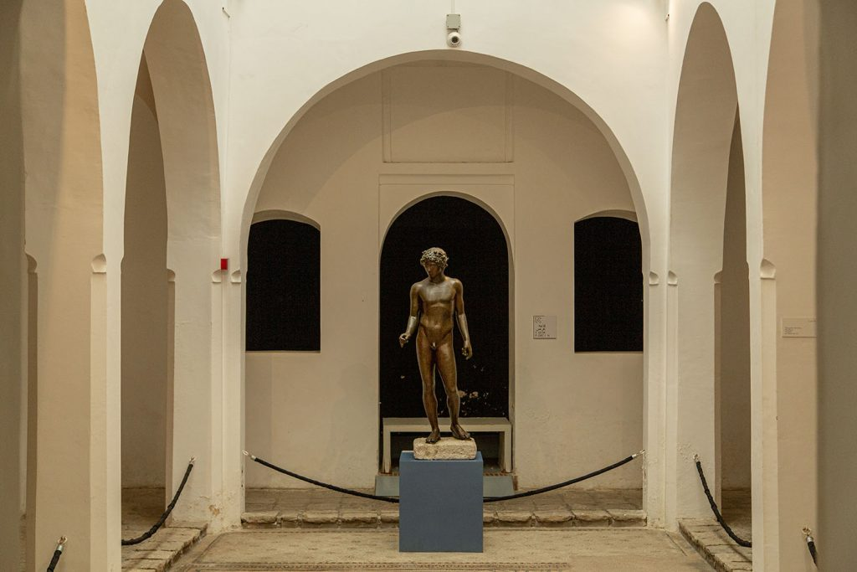
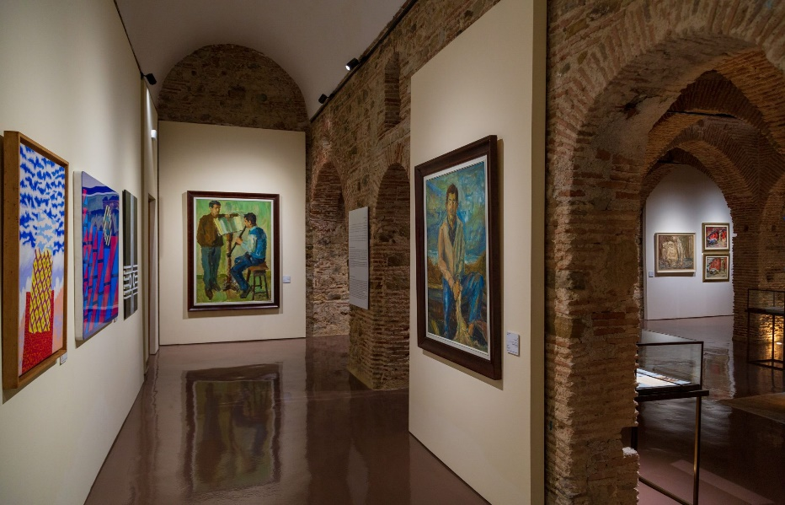
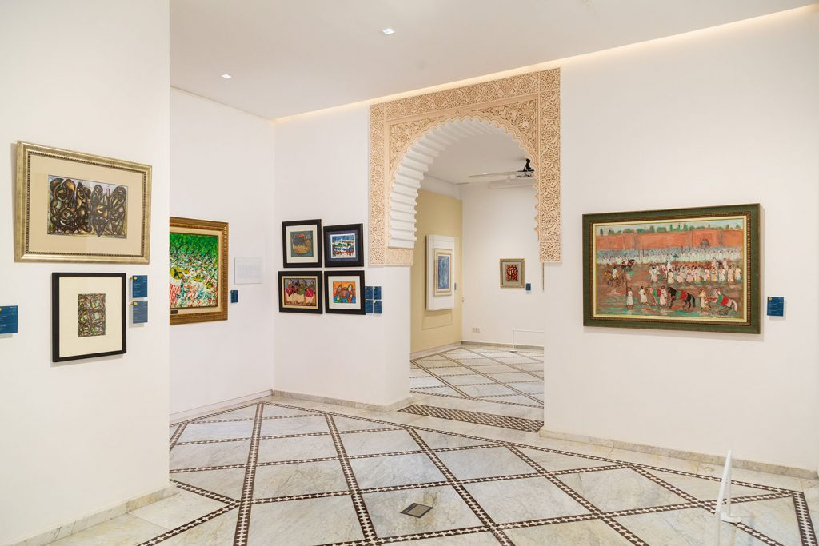
What’s New
Monuments
Updates
In Tangier…
Kasbah Museum of Mediterranean Cultures
Kasbah Museum
Contemporary Art Section
Villa Harris, Tangier Museum
https://fnm.ma/musees-ouverts/musee-la-kasbah-des-cultures-mediterraneennes-tanger/
https://fnm.ma/musees-ouverts/musee-la-kasbah-espace-dart-contemporain-tanger/
https://fnm.ma/musees-ouverts/villa-harris-musee-de-tanger/
www.fivetravel.ma
Notes:
Simplify and ease the workload of our B2B partners to manage their Morocco destination,
in order to focus more on the human approach towards the travelling experience.
After this challenging crisis we need to consolidate our entities, trough innovation under human approach

Slide 11
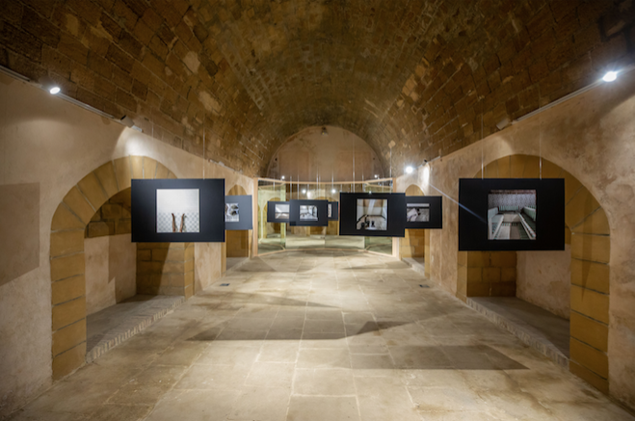
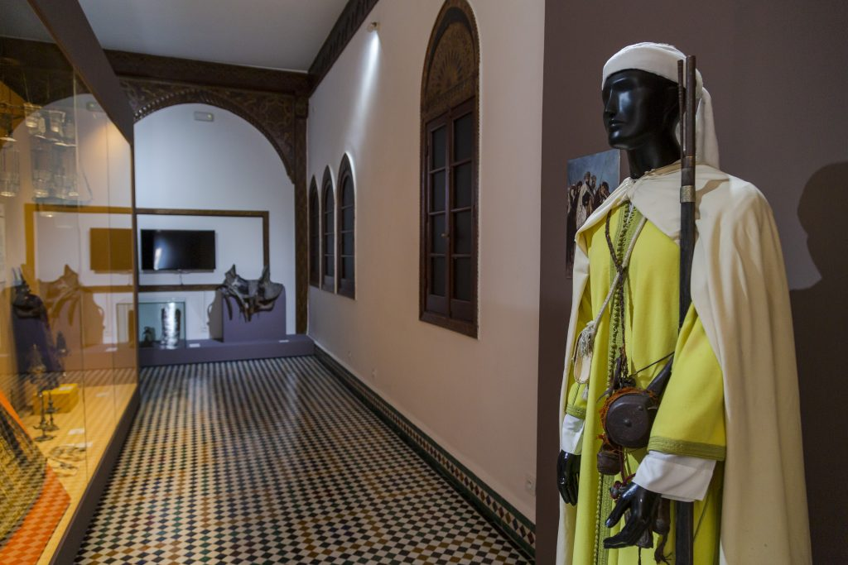
What’s New
Monuments
Updates
In Rabat…
In Tetouan…
National Museum Of Photography
Bab El Oqla Museum
https://fnm.ma/musees-ouverts/musee-national-de-la-photographie/
https://fnm.ma/musees-ouverts/musee-bab-el-oqla-tetouan/
www.fivetravel.ma
Notes:
Simplify and ease the workload of our B2B partners to manage their Morocco destination,
in order to focus more on the human approach towards the travelling experience.
After this challenging crisis we need to consolidate our entities, trough innovation under human approach

