Slide 1


By Five Dragons’ Group

Slide 2
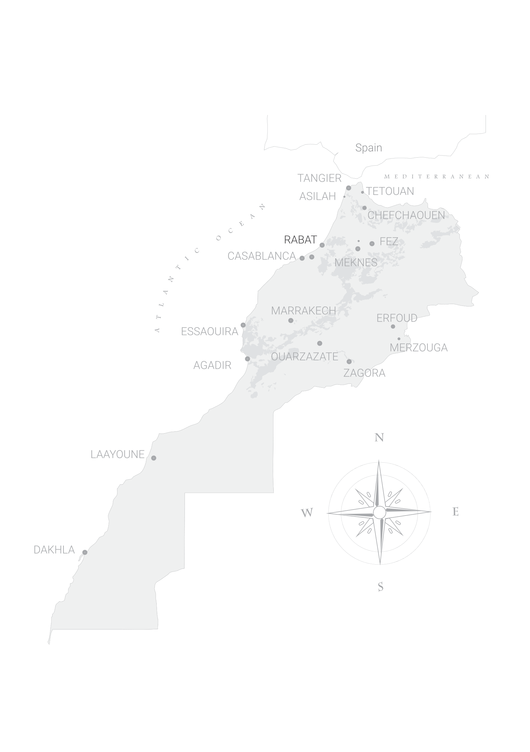



TANGIER
TETOUANE
ASILAH
CHEFCHAOUEN
Northern
Morocco
www.fivetravel.ma
Notes:
A diversity that will welcome you back to morocco with positive vibes

Slide 3


ERFOUD
Desert
& Oasis of
Morocco
OUARZAZATE
MERZOUGA
ZAGORA
LAAYOUNE
DAKHLA
www.fivetravel.ma
Notes:
A diversity that will welcome you back to morocco with positive vibes

Slide 4

OUALIDIA
EL JADIDA
SAFI
ESSAOUIRA
Atlantic
Cities
AGADIR
www.fivetravel.ma
Notes:
A diversity that will welcome you back to morocco with positive vibes

Slide 5

RABAT
FEZ
CASABLANCA
MEKNES
MARRAKECH
Casablanca
& The
Imperial
Cities
www.fivetravel.ma
Notes:
A diversity that will welcome you back to morocco with positive vibes

Slide 6





Spain
TANGIER
TETOUAN
Combined
Spain
& Morocco
CHEFCHAOUEN
RABAT
FEZ
CASABLANCA
CASABLANCA
MEKNES
Duration
3D4N to 5D6N
www.fivetravel.ma
Notes:
A diversity that will welcome you back to morocco with positive vibes

Slide 7



TANGIER
TETOUAN
Grand Tour
of Morocco
    Casablanca
    Arrival & Departure
CHEFCHAOUEN
RABAT
FEZ
CASABLANCA
MEKNES
MARRAKECH
ESSAOUIRA
Duration
9D10N to 13D14N
MERZOUGA
OUARZAZATE
www.fivetravel.ma
Notes:
A diversity that will welcome you back to morocco with positive vibes

Slide 8


TANGIER
TETOUAN
Grand Tour
of Morocco
    Casablanca Arrival
    &
    Marrakech Departure
CHEFCHAOUEN
RABAT
FEZ
CASABLANCA
MEKNES
MARRAKECH
ESSAOUIRA
Duration
9D10N to 13D14N
MERZOUGA
OUARZAZATE
www.fivetravel.ma
Notes:
A diversity that will welcome you back to morocco with positive vibes

Slide 9
Imperial Cities
of Morocco
VOLUBILIS
RABAT
FEZ
CASABLANCA
MEKNES
MARRAKECH
ESSAOUIRA
Duration
5D6N to 7D8N
www.fivetravel.ma
Notes:
A diversity that will welcome you back to morocco with positive vibes

Slide 10

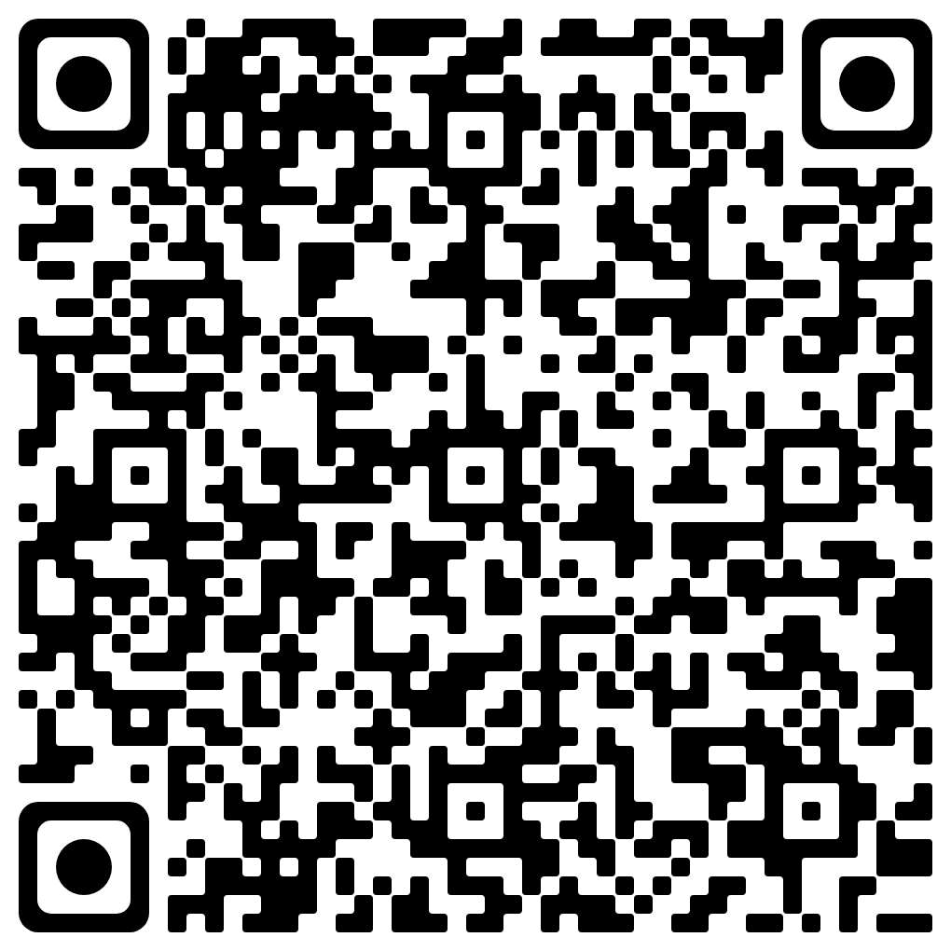



By Five Dragons’ Group
Scan,
to keep in touch!

