Slide 1

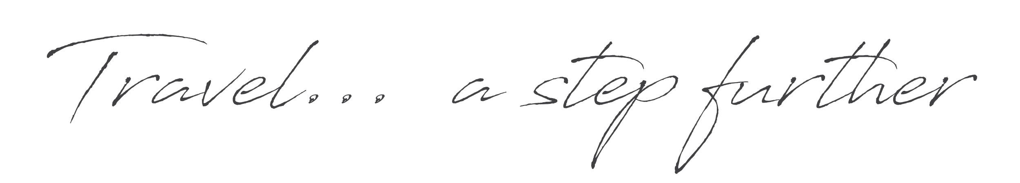
By Five Dragons’ Group

Slide 2


Conferences
Meetings
MICE
Events
Incentives
www.fivetravel.ma
Notes:
A kingdom of stability, with a vibrant cultural diversity
A mix of african, oriental and european influences
With berber, arab and muslim and jewish heritage
A kingdom where you can perfect your swing
Embarking in a journey to the sahara
The african holywood

Slide 3

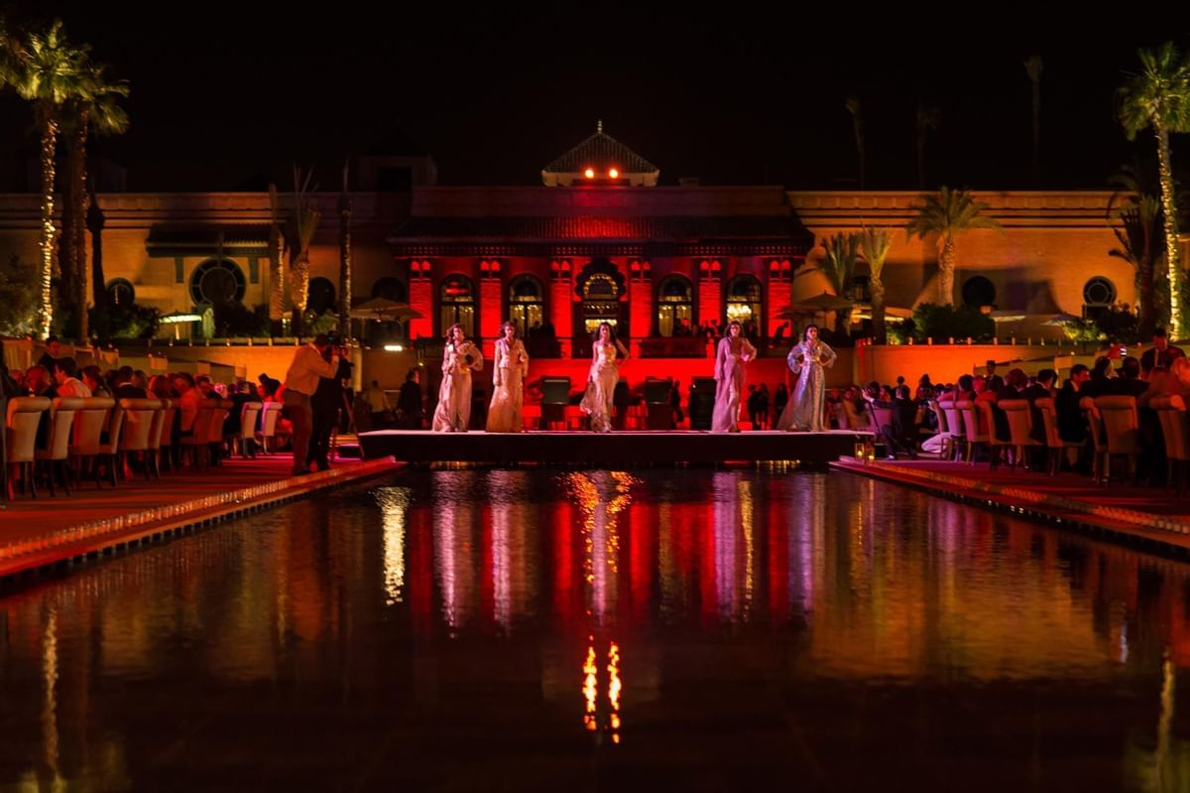
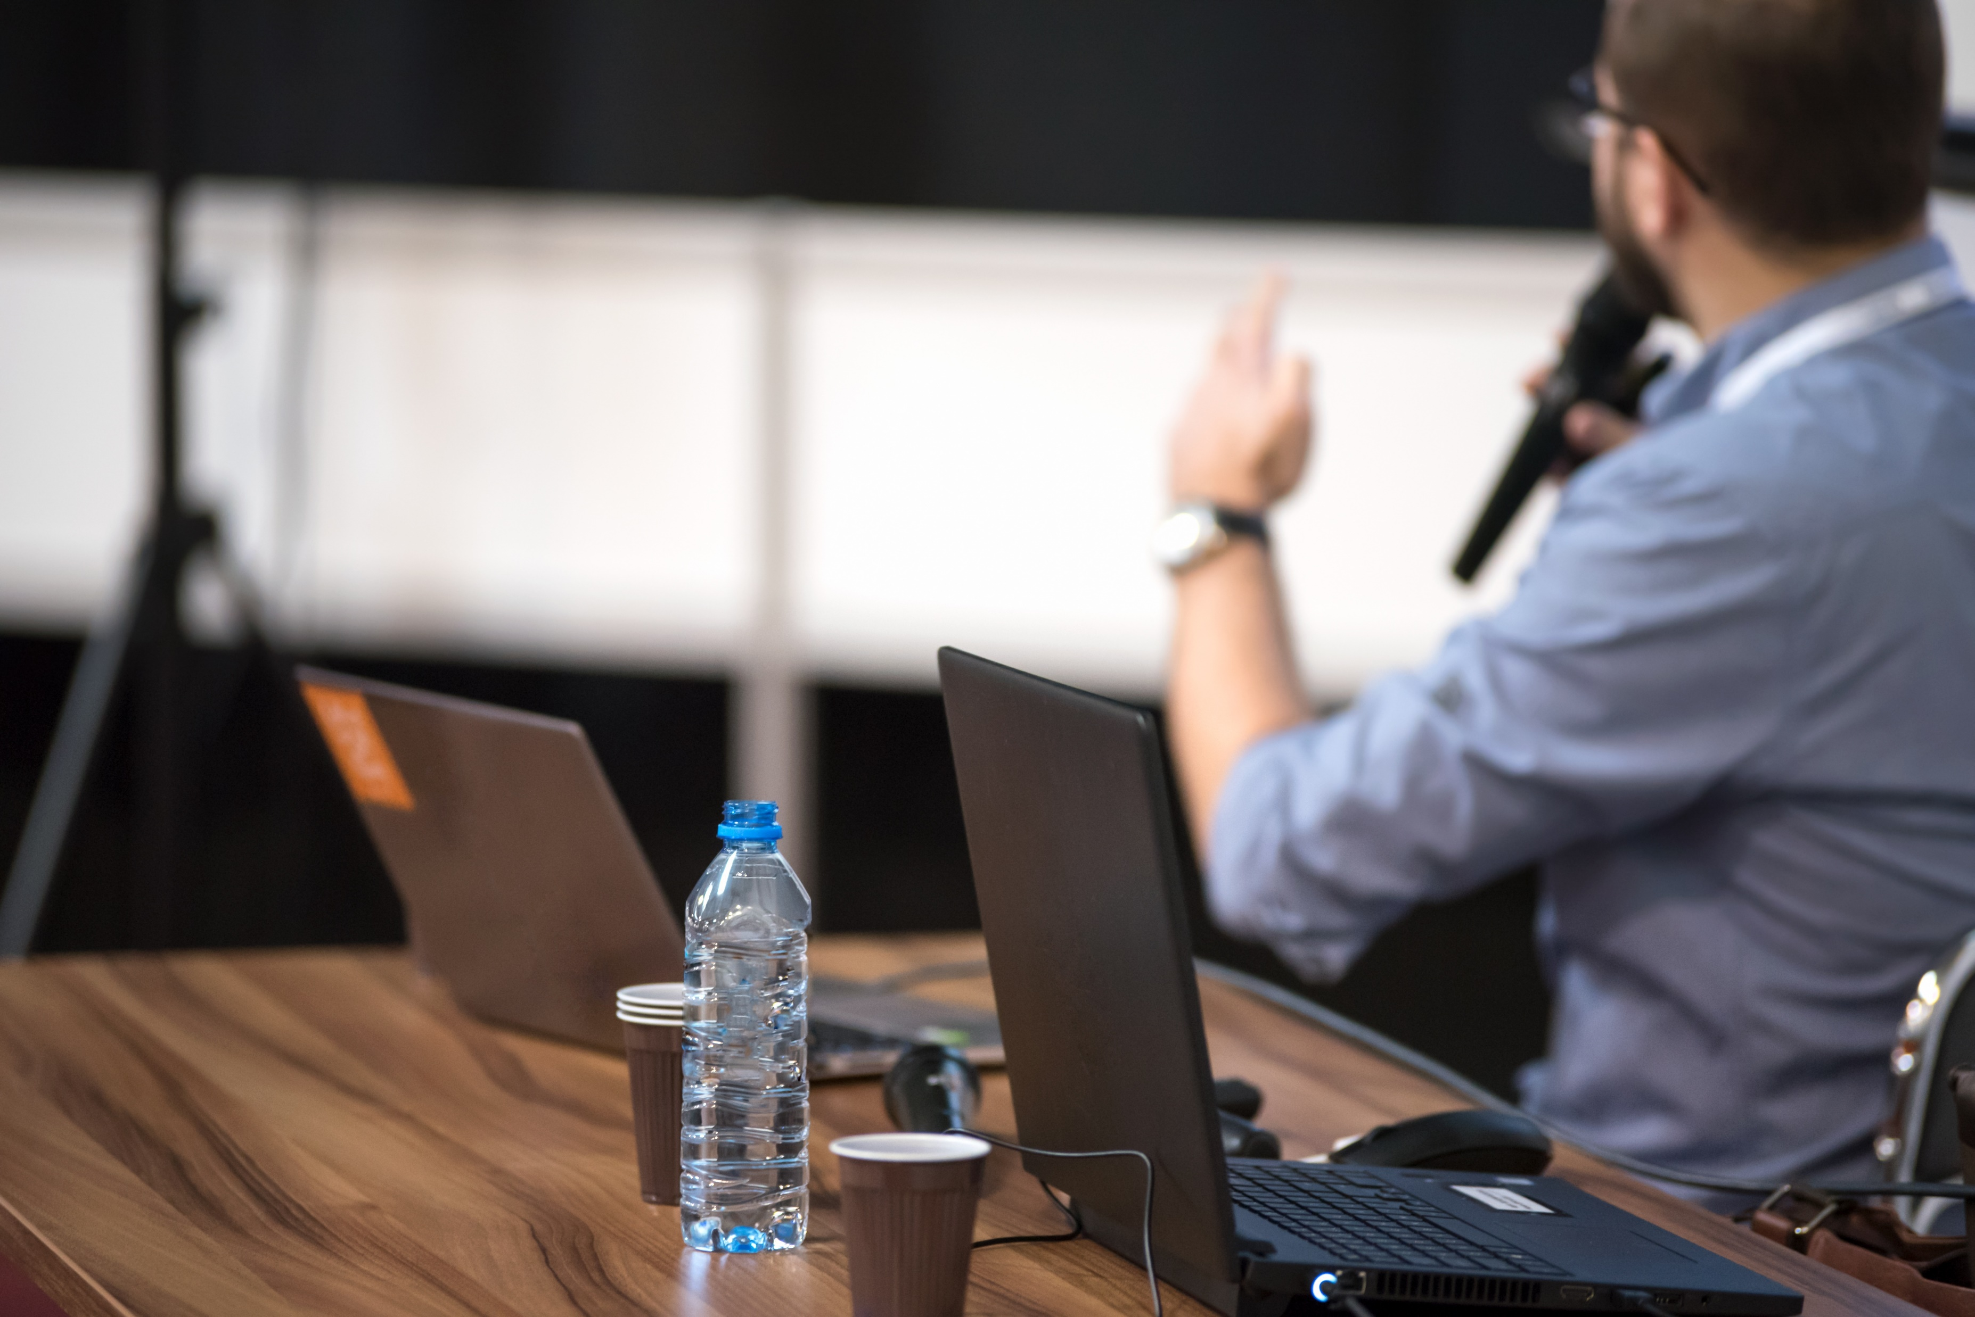
MICE Destination : Morocco | Our Services
Meet,…
for encounters that inspire big ideas & experiences
www.fivetravel.ma
Notes:
An International Airport as a Hub
9 732 044 Million passengers 2019 statistics
Business Destination
Good Hotel infrastructure
Meetings and conferences Halls
Start point of Many Tour Programs
Sightseeing might be done from 3hours to 2 days
Main attraction is Greart Mosque Hassan II, Mohammed V square and Art deco, Habous quarter, Catholique church

Slide 4
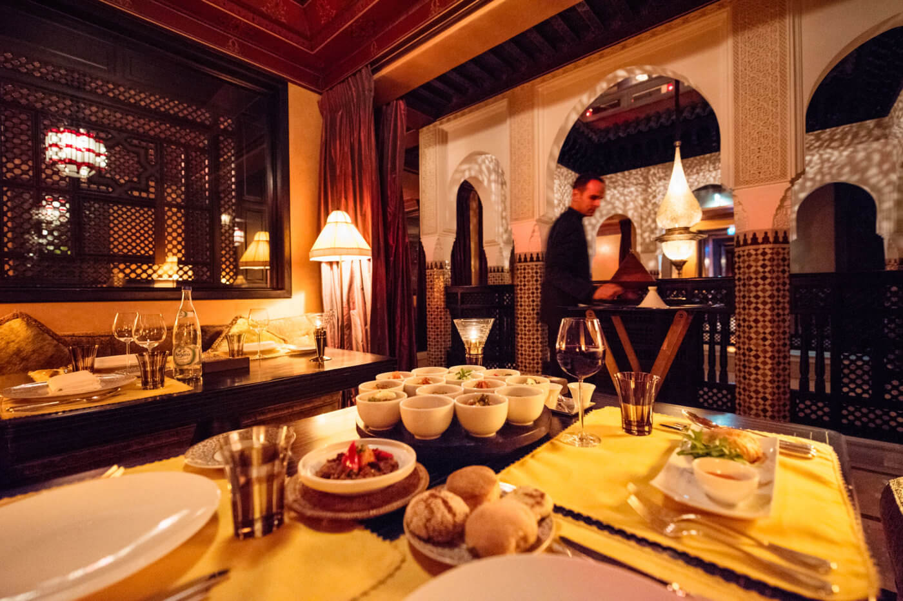
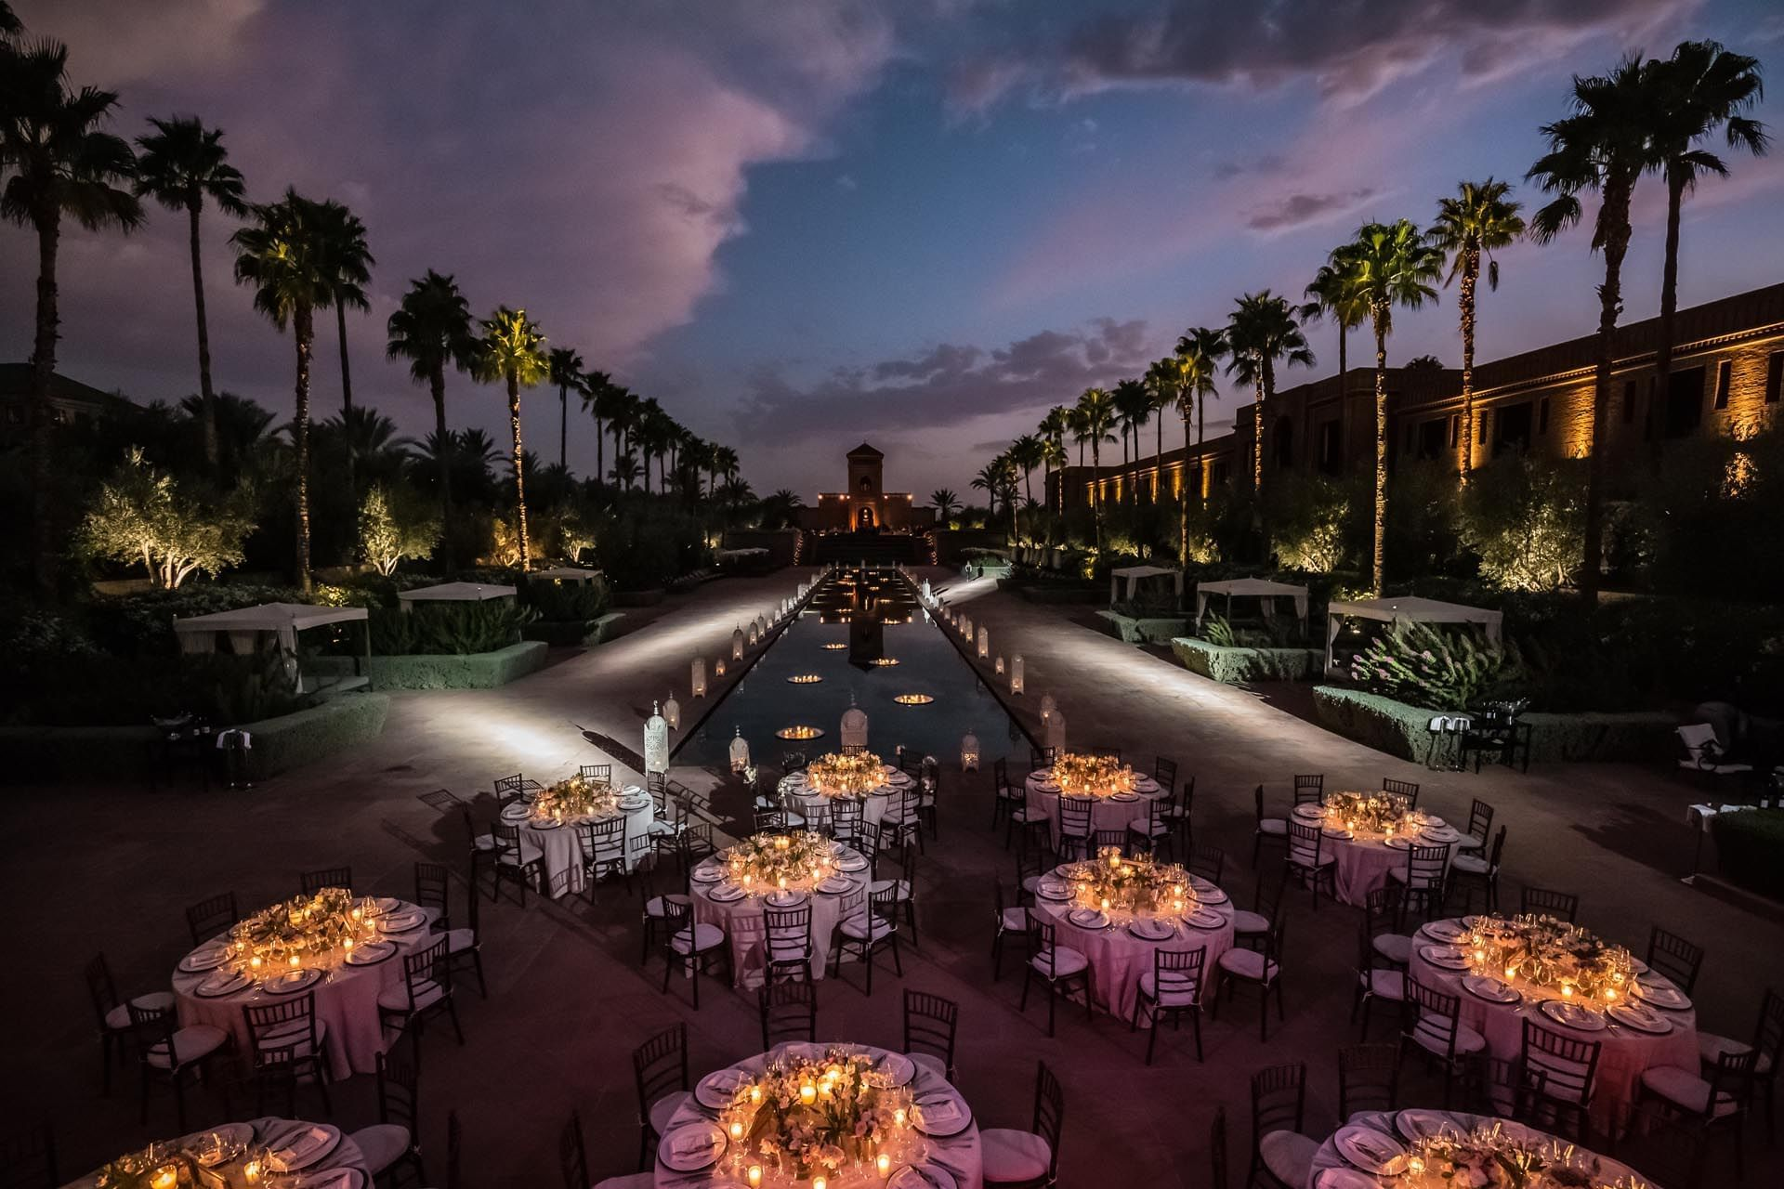
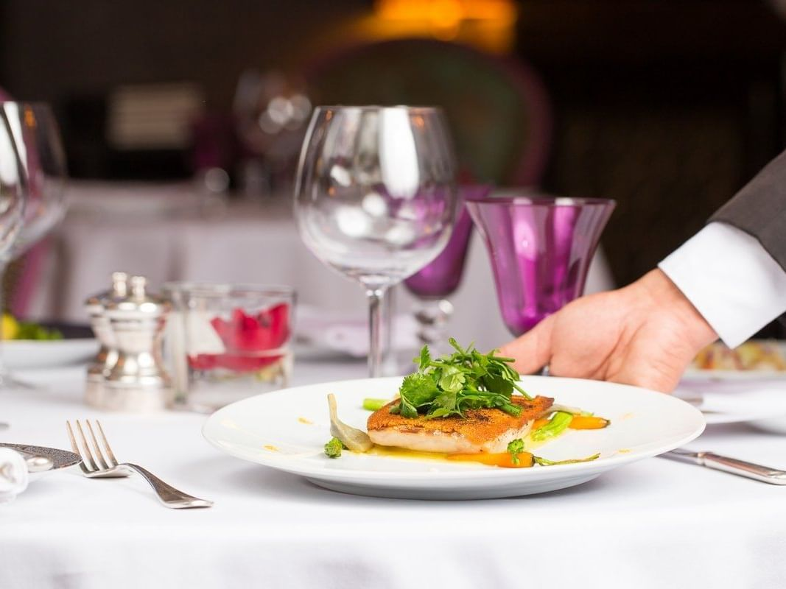
MICE Destination : Morocco | Our Services
Eat,…
tasting a harmoniously confected culinary dishes
www.fivetravel.ma
Notes:
An International Airport as a Hub
9 732 044 Million passengers 2019 statistics
Business Destination
Good Hotel infrastructure
Meetings and conferences Halls
Start point of Many Tour Programs
Sightseeing might be done from 3hours to 2 days
Main attraction is Greart Mosque Hassan II, Mohammed V square and Art deco, Habous quarter, Catholique church

Slide 5
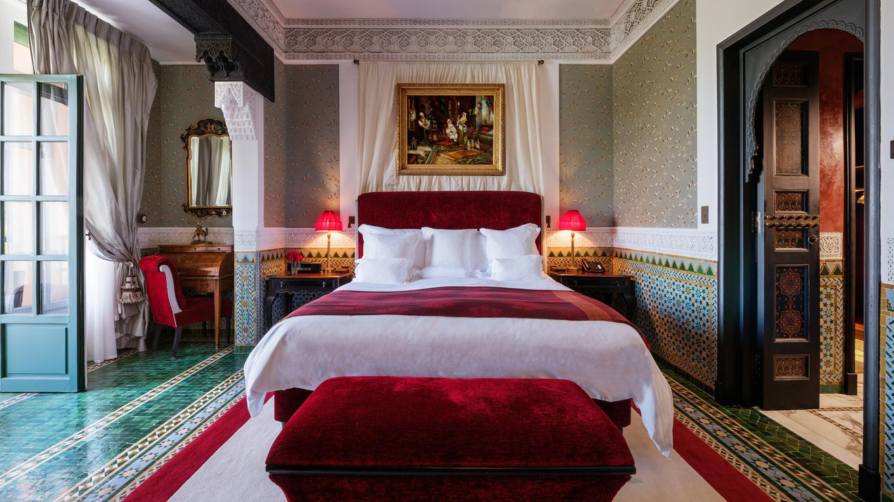
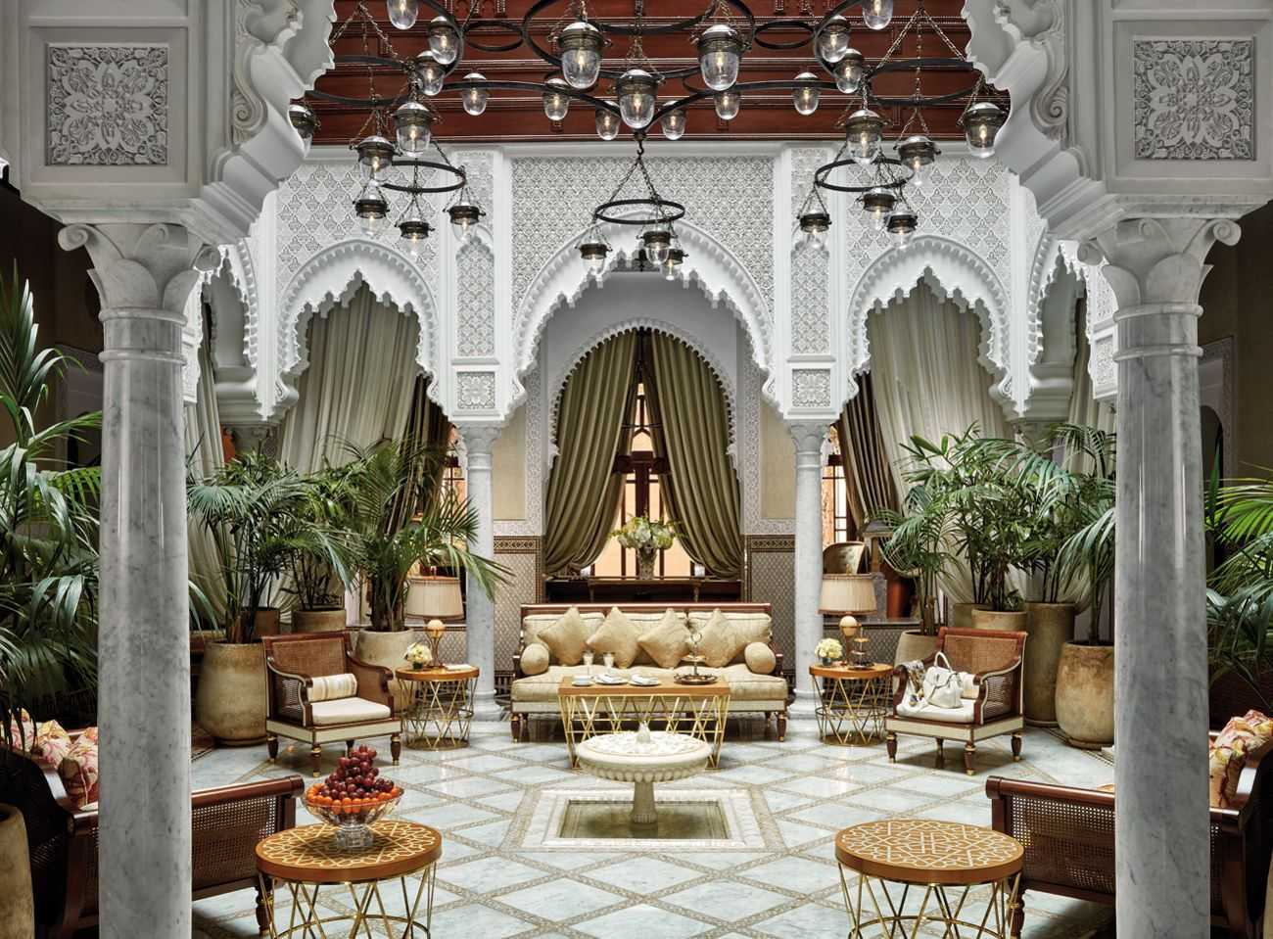
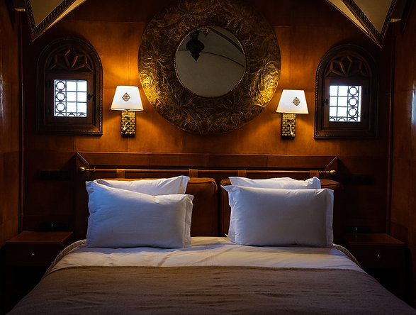
MICE Destination : Morocco | Our Services
Stay,…
feeling the uniqueness of moroccan design & welfare
www.fivetravel.ma
Notes:
An International Airport as a Hub
9 732 044 Million passengers 2019 statistics
Business Destination
Good Hotel infrastructure
Meetings and conferences Halls
Start point of Many Tour Programs
Sightseeing might be done from 3hours to 2 days
Main attraction is Greart Mosque Hassan II, Mohammed V square and Art deco, Habous quarter, Catholique church

Slide 6
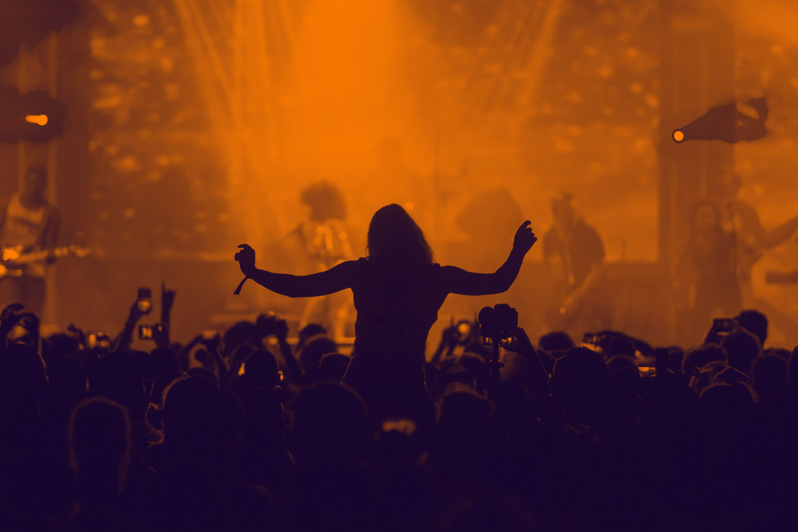

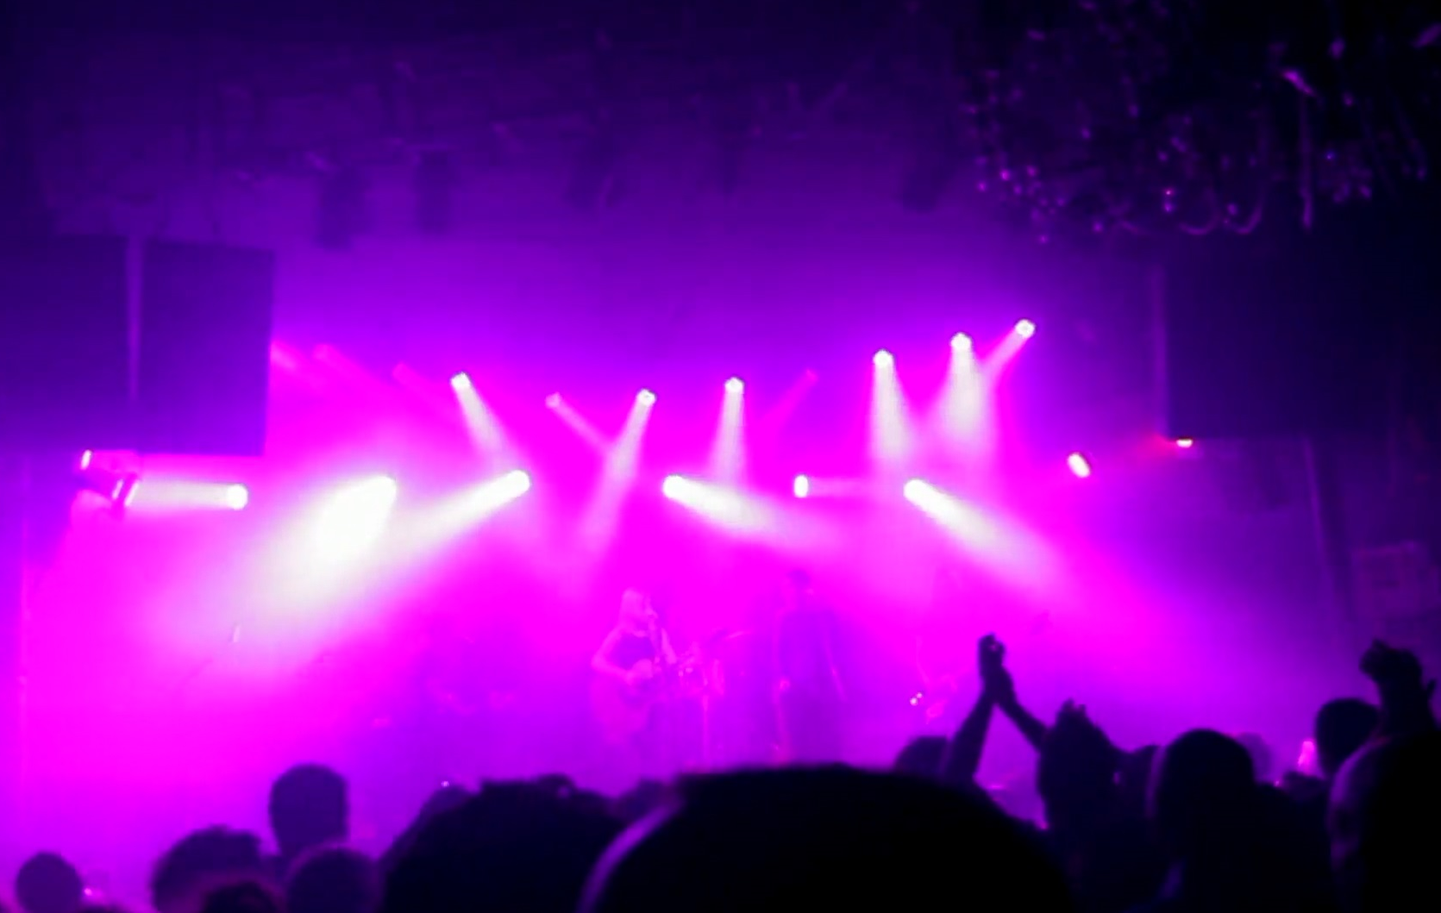
MICE Destination : Morocco | Our Services
Play,…
move to the rhythm of enchanting atmospheres
www.fivetravel.ma
Notes:
An International Airport as a Hub
9 732 044 Million passengers 2019 statistics
Business Destination
Good Hotel infrastructure
Meetings and conferences Halls
Start point of Many Tour Programs
Sightseeing might be done from 3hours to 2 days
Main attraction is Greart Mosque Hassan II, Mohammed V square and Art deco, Habous quarter, Catholique church

Slide 7

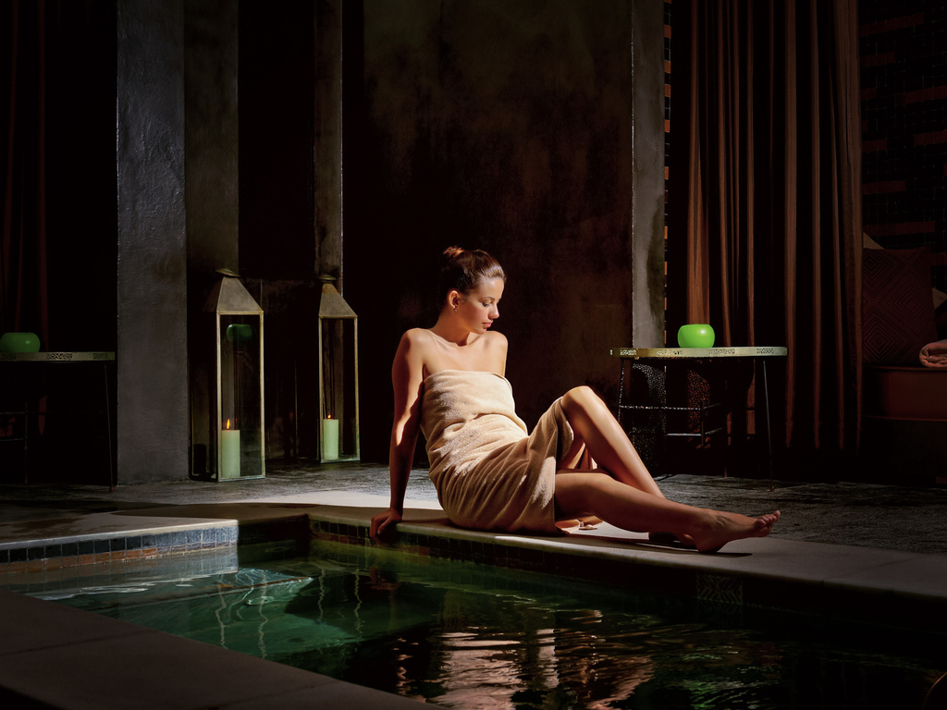
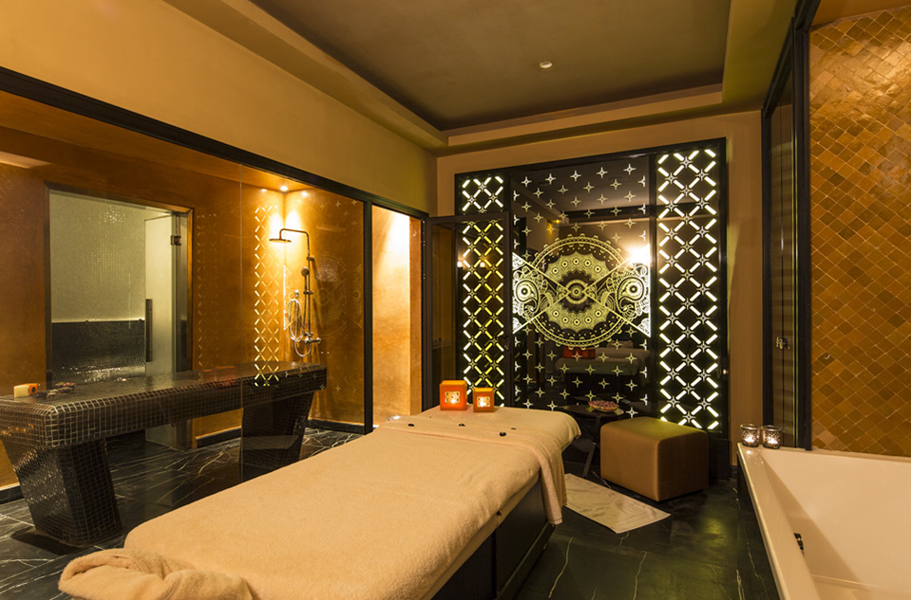
MICE Destination : Morocco | Our Services
Relax,…
dive deep into the peaceful self, indulging your senses
www.fivetravel.ma
Notes:
An International Airport as a Hub
9 732 044 Million passengers 2019 statistics
Business Destination
Good Hotel infrastructure
Meetings and conferences Halls
Start point of Many Tour Programs
Sightseeing might be done from 3hours to 2 days
Main attraction is Greart Mosque Hassan II, Mohammed V square and Art deco, Habous quarter, Catholique church

Slide 8
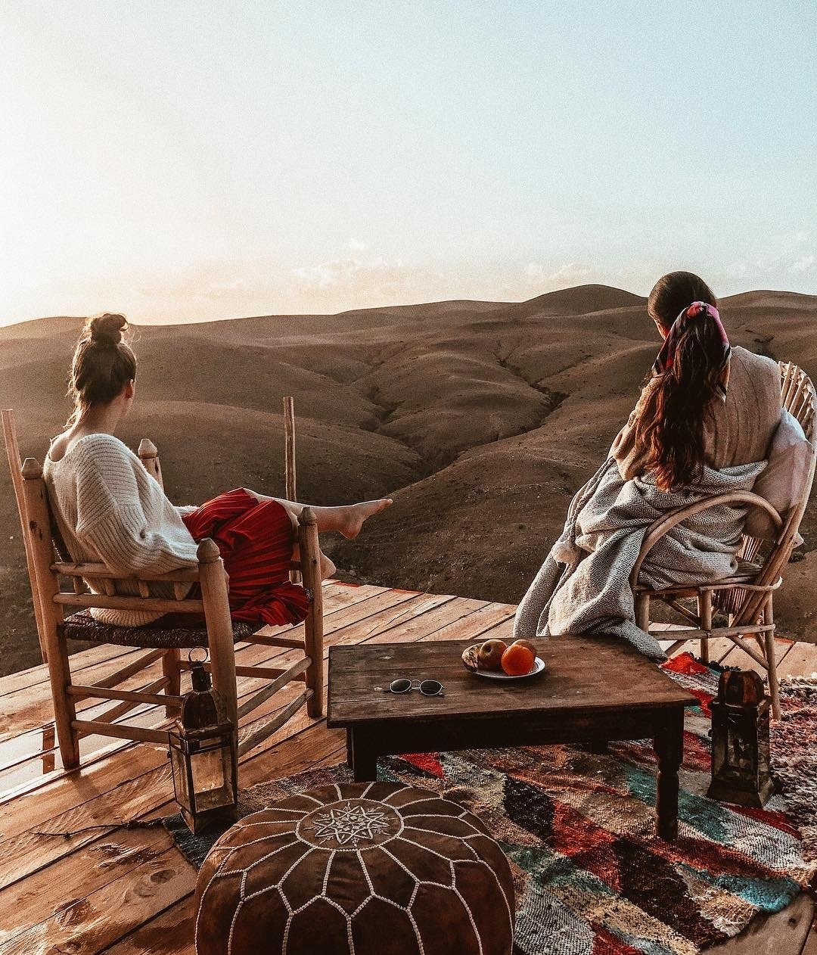
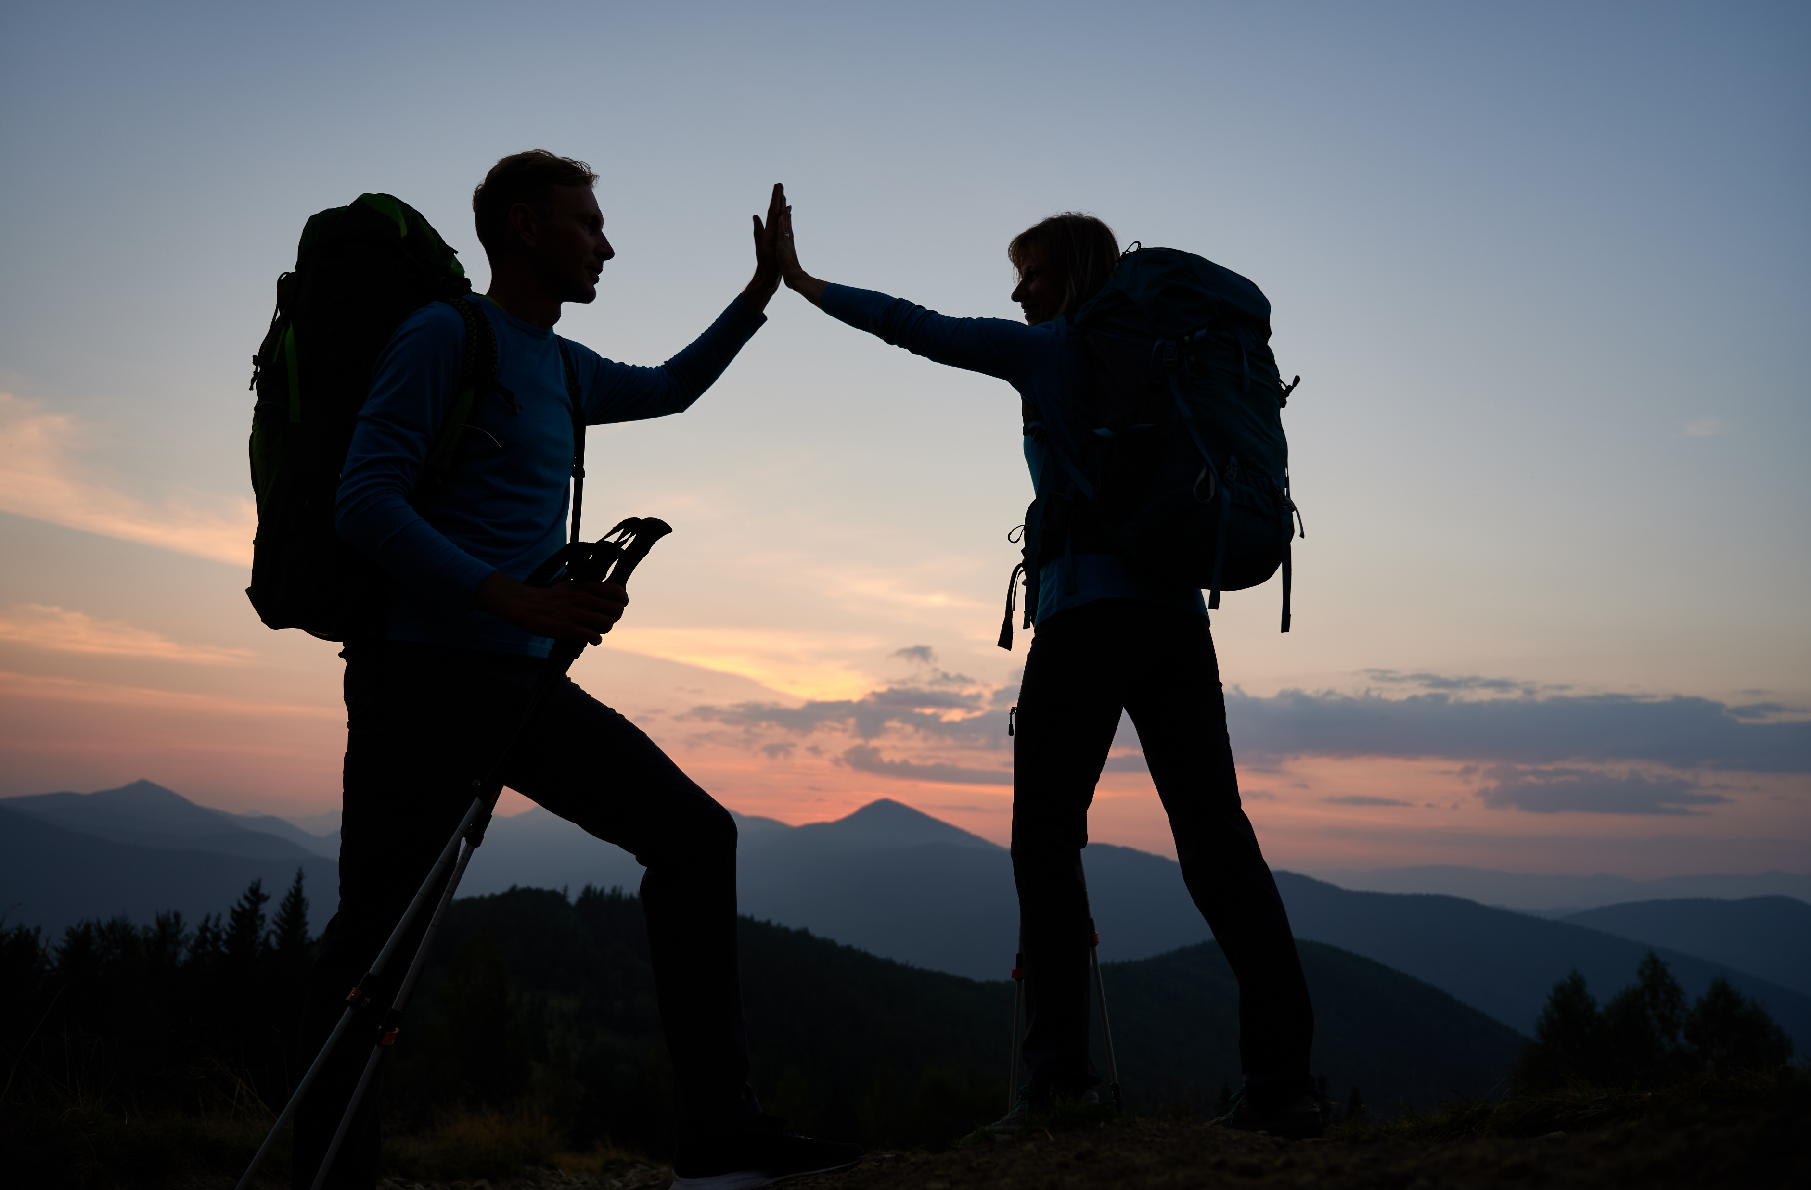
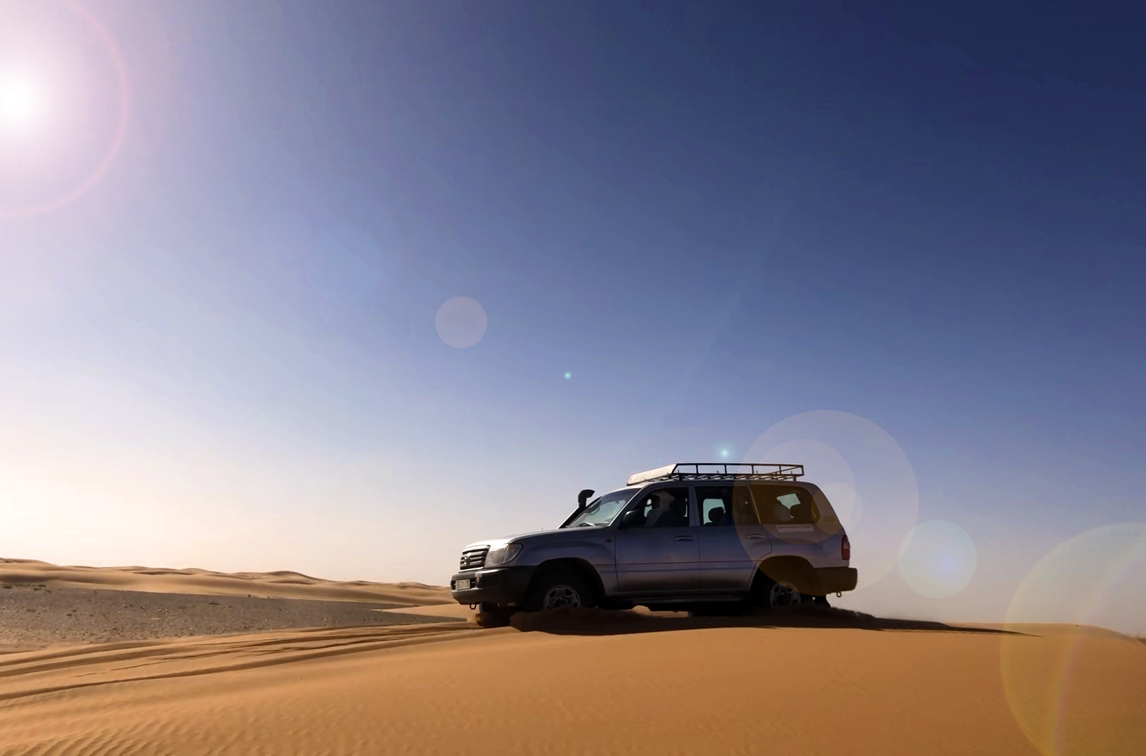
MICE Destination : Morocco | Our Services
Explore,…
myriad rich diversity of Morocco’s land & culture
www.fivetravel.ma
Notes:
An International Airport as a Hub
9 732 044 Million passengers 2019 statistics
Business Destination
Good Hotel infrastructure
Meetings and conferences Halls
Start point of Many Tour Programs
Sightseeing might be done from 3hours to 2 days
Main attraction is Greart Mosque Hassan II, Mohammed V square and Art deco, Habous quarter, Catholique church

Slide 9
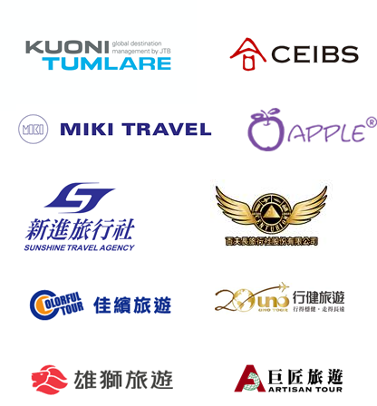
Some
International
references
www.fivetravel.ma

Slide 10


Amoud
A Ma Bretagne
Colaruf
Scandi Maroc
Tecmom
Casatechnique
Alizés Travel
Artisanat des Habous
Atlantic Beach
Casa Aero /filière RAM
Cruise Transport
El Mouhajir Transport
Exposition Artisanat
Hotel Al Manzil
Musée A. Slaoui
Park Suite Hotel
Playa Del Mar
Qualité de change
Restaurant F. Kabbaj
Restaurant Golden China
Restaurant Maï Thaï
Restaurant Saveurs du Palais
Restaurant Sinatra Restaurant Zayna
Secret des plantes
UAE Exhange
Wang Thai Spa
Some
Local
references
in Partneship with
www.fivetravel.ma

Slide 11
FESTIVALS
- Fez Festival of Sacred World Music from 2011 to 2019 (technical services)
- Fez Festival of Sufi Culture from 2012 to 2019
- Festival "MAWAZINE" from 2010 to 2012 (Stage management)
- Culinary Arts Festival Fondation Esprit de Fès.
- National Educational Film Festival 2011 - 2012.
- Festival des Andalousies Atlantiques 2010 – 2011 Essaouira (Technical management
- Street Arts Festival, Ministry of Culture of Fez 2019
- Sefrou Cherry Festival 2017
- Oujda Gharnatie Music Festival, 2019
- Moga Festival | Essaouira 2017 (Technical control),
- Short Film Festival, Ifrane 2017 – 2018 Al Akhawayn University,
some
Local Events
in Partneship with
www.fivetravel.ma

Slide 12
FASHION SHOW
Miss Sultana fashion show organized at the "Pacha" club - Marrakech
(on the sidelines of the Marrakech International Film Festival)
De Fil en Aiguille, Caftan parade at the Mokri Palace - Fez.
Fashion show "Chants et Caftans" organized by the Jnan Palace hotel -
Fès in partnership with the ESCOM School: 2011.
Fashion show with the association Trois vetues at the University of
Al Akhawayn 19 Sep. 2016.
…
Fashion Events
in Partneship with
www.fivetravel.ma

Slide 13
CONVENTIONS/CONGRESSES
- National Congress of Chartered Accountants in Fez 2009.
- 1st Meeting of Moroccan skills from Germany - Ministry in charge of the Moroccan Community abroad at the Hotel Jnan Palace - Fez: 2009
- MITEX, exhibition of new information technologies at the Hyatt Regency Hotel - Casablanca: 2009
- Earth day, Rabat world capital of the environment: 2010
- TMSA Convention: "Tangier Mediterranean Special Agency", Marrakech: 2011
- HEM School (conferences, competitions, big game, evening of consecration and various evenings): 2013-2014-2015
- Graduation ceremony Al Akhawayn University, 2014 - 2015.
- Medical Symposium, Hotel Four Seasons Marrakech (Green DDB Casablanca), 2017
- Graduation ceremony Euromed University, 2019
- Les assises de la fiscalité with the finance department and the Fès-Meknes chamber of Commerce and industry. May 03 and 04, 2019
…
Meetings
in Partneship with
www.fivetravel.ma

Slide 14
Shows/Music concerts/Gala
evenings/New product launch
- Placement of artists and supply of technical equipment for various hotel
institutions, Riads and guest houses (Sofitel Palais Jamaï, Hôtel Palais
Médina & SPA, Hotel Jnan Fès, Hotel Michlifen - Ifrane, Hotel Barcelo, Riad
Fès, Palais Faraj. ..): 2010 - 2011 - 2012 - 2013 - 2013 – 2015
- Celebration "MAS Winner of the African Super Cup" - Evening organized by the JAMAI Group in Fez: 2012
- Production "Flash Mob La Vache qui Rit" at the Morocco Mall – Casablanca (Régie Technique): 2012
- Inauguration of the FERRARI Show Room in Casablanca (Technical management): 2013
&
Fun Events
too…
in Partneship with
www.fivetravel.ma

Slide 15
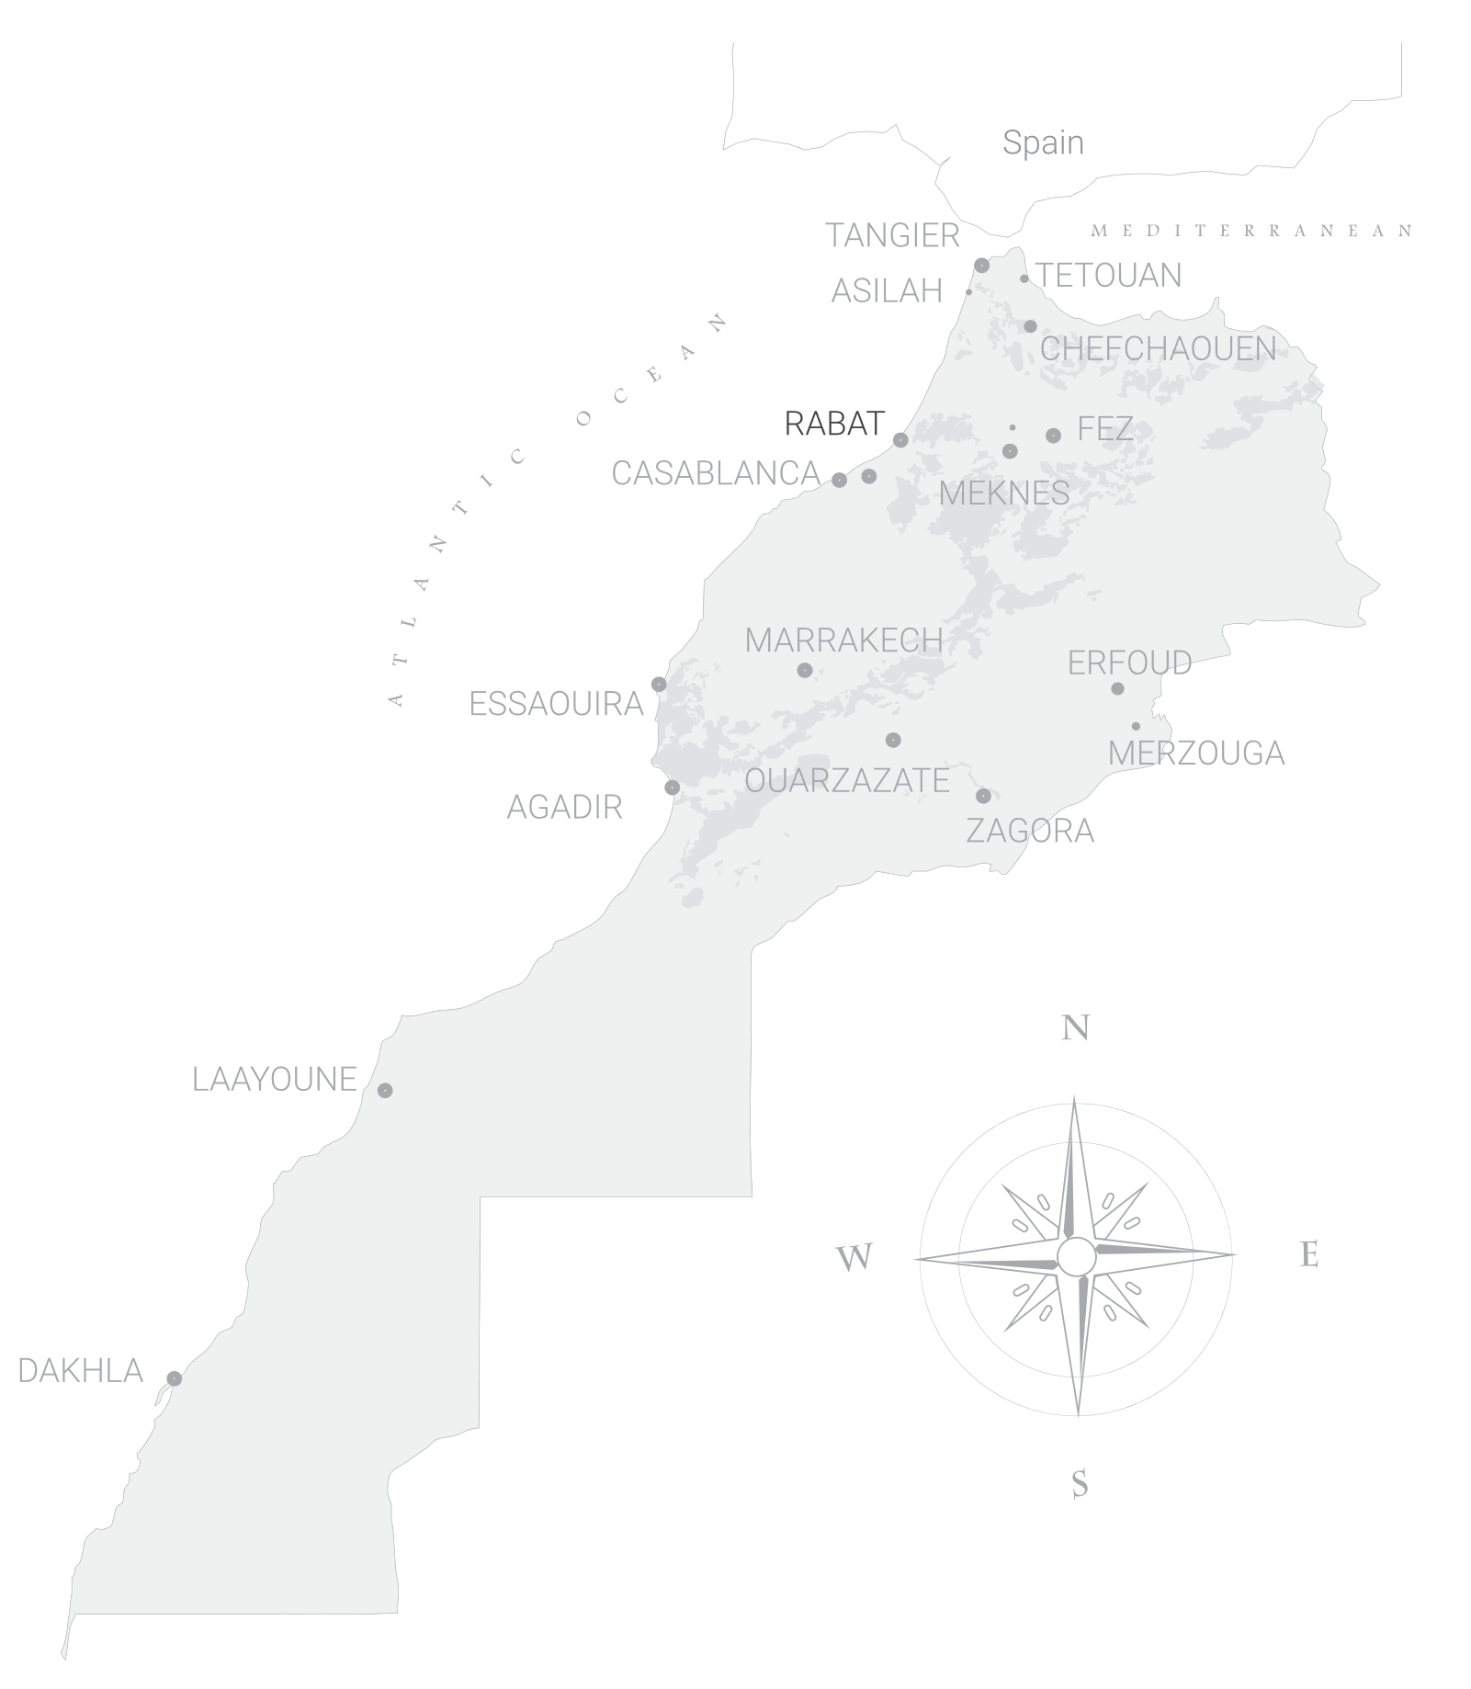











Marrakech’s
Main Assets
An International Airport
Over 5 Million passengers
Departure point of most tours
1st MICE and International EVENTs Destination
Visits
1 day and more
www.fivetravel.ma
Notes:
International Airport
1st Destination by excellence for
Conference & Congress
Cultural discovery
Activities
Adventure & Sport
Long stays
A
Also a start point of many tours
we have handpicked and tested From its Outstanding Touristic infrastructure, many hotels.
Very renown for Unesco World Heritage Jemaa El Fna, Several Monuments from 12th century and the Majorelle Garden

Slide 16

Marrakech’s
Main Assets
Morocco’s
Hotel Beds Capacities Overview
www.fivetravel.ma

Slide 17

Casablanca’s
Main Assets
An International Hub Airport
9 732 044 passengers
1st in Morocco
Business travel
Destination
MICE
Destination
Departure point of most tours
Sightseeing
3 hours to 2 days
www.fivetravel.ma
Notes:
An International Airport as a Hub
9 732 044 Million passengers 2019 statistics
Business Destination
Good Hotel infrastructure
Meetings and conferences Halls
Start point of Many Tour Programs
Sightseeing might be done from 3hours to 2 days
Main attraction is Greart Mosque Hassan II, Mohammed V square and Art deco, Habous quarter, Catholique church

Slide 18



Spain
Tangier’s
Main Assets
2 Harbours
Morocco
Combine
Spain-Morocco Tour
MICE
Destination
High Speed Train Station
Business travel
Destination
Sightseeing
3 hours to more
www.fivetravel.ma
Notes:
Its 2 Harbors (Tanger Ville & Tanger Med) connecting to spain in less than an hour ferry.
Enables us to combine Spain tour with Morocco Tour
Its Old Town The Cap Spartel
Five Star Hotels and Conference Rooms
The Hilton, Royal Tulip and other Five Star is situated at a walking distance from the High-speed Train Station
Some of our programs include this transportation

Slide 19

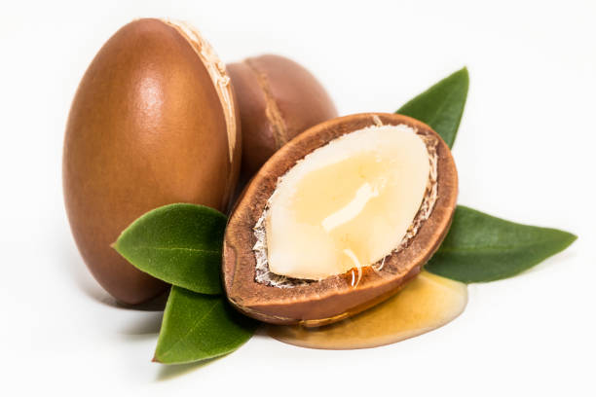

Essaouira’s
Other Assets
An International Airport
Eco Lodges
Argan Forests
1st Organic Winery in Morocco
Tourism
For Sustainable Development Goals
www.fivetravel.ma
Notes:
International Airport
1st Destination by excellence for
Conference & Congress
Cultural discovery
Activities
Adventure & Sport
Long stays
A
Also a start point of many tours
we have handpicked and tested From its Outstanding Touristic infrastructure, many hotels.
Very renown for Unesco World Heritage Jemaa El Fna, Several Monuments from 12th century and the Majorelle Garden

Slide 20

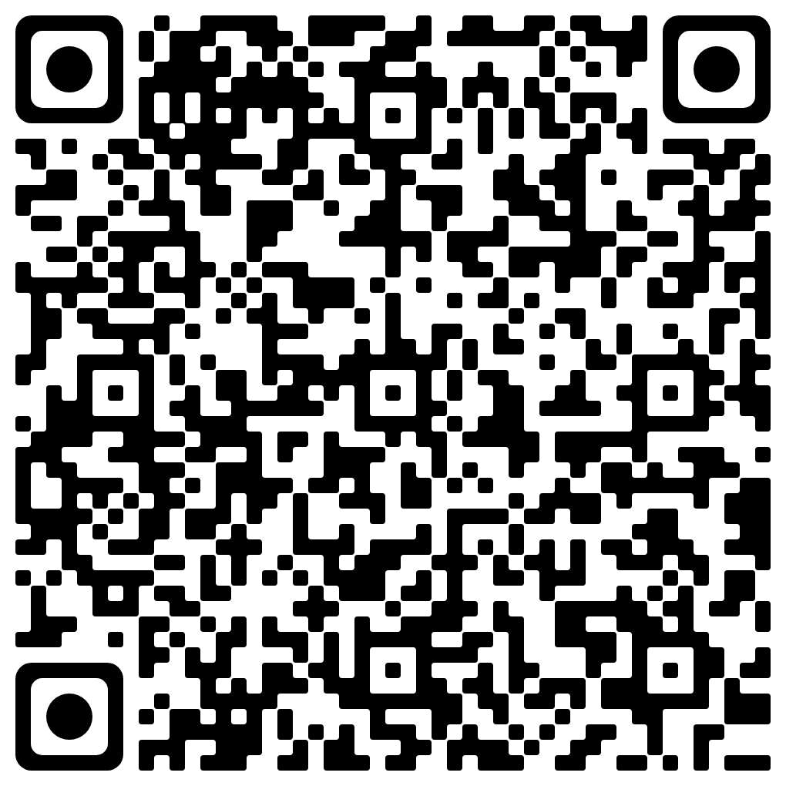



By Five Dragons’ Group
Scan,
to keep in touch!

