Slide 1



Slide 2
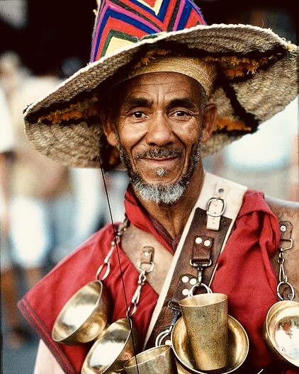
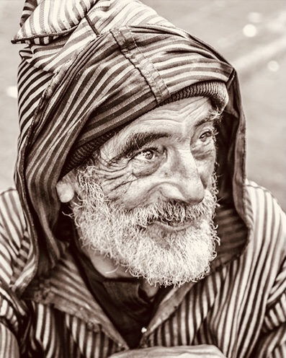
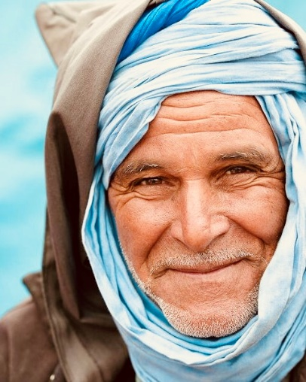
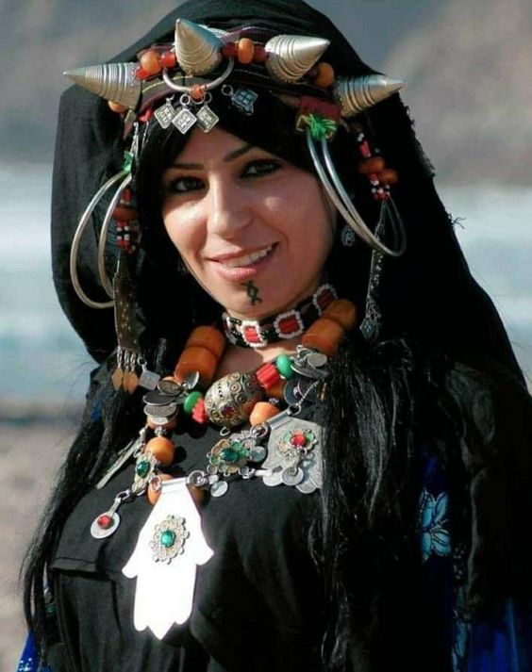




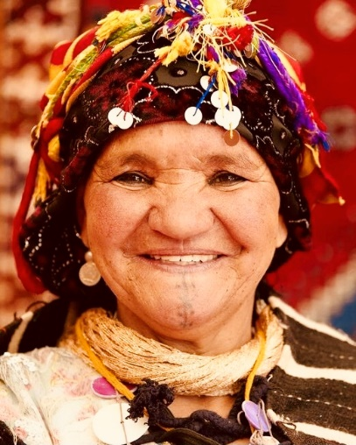
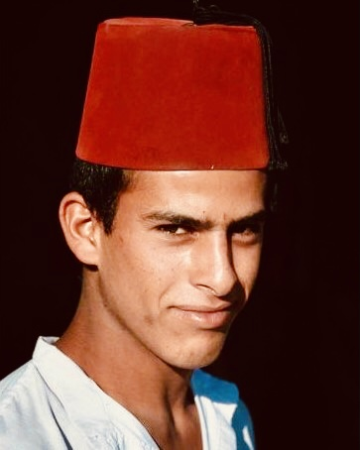
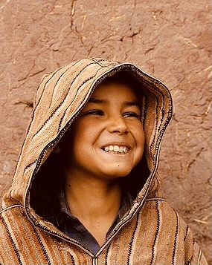
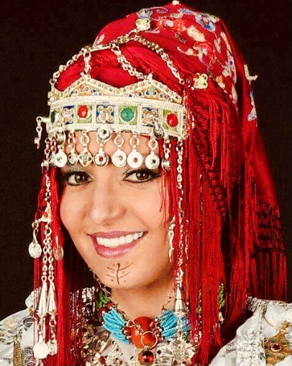
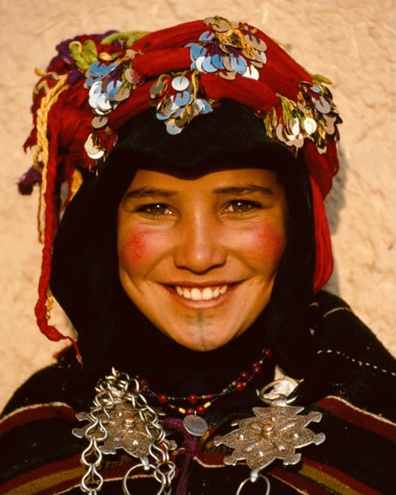
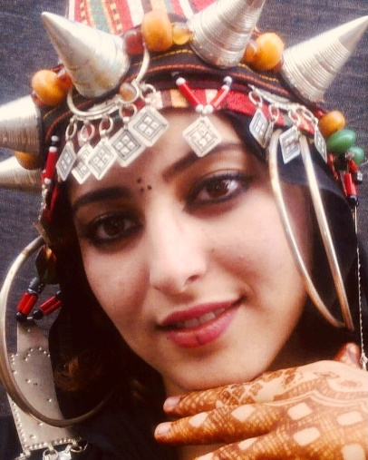
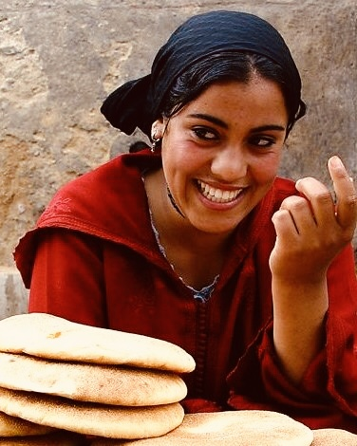
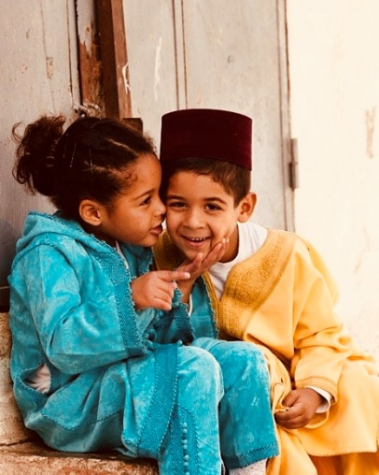
Welcome
back to
Morocco
Morocco : A Kingdom of stability and vibrant cultural diversity. A mix of african, oriental and european influences : Berber, Arab, Muslim and Jewish heritage
www.fivedragons.ma
Notes:
A diversity that will welcome you back to morocco with positive vibes

Slide 3
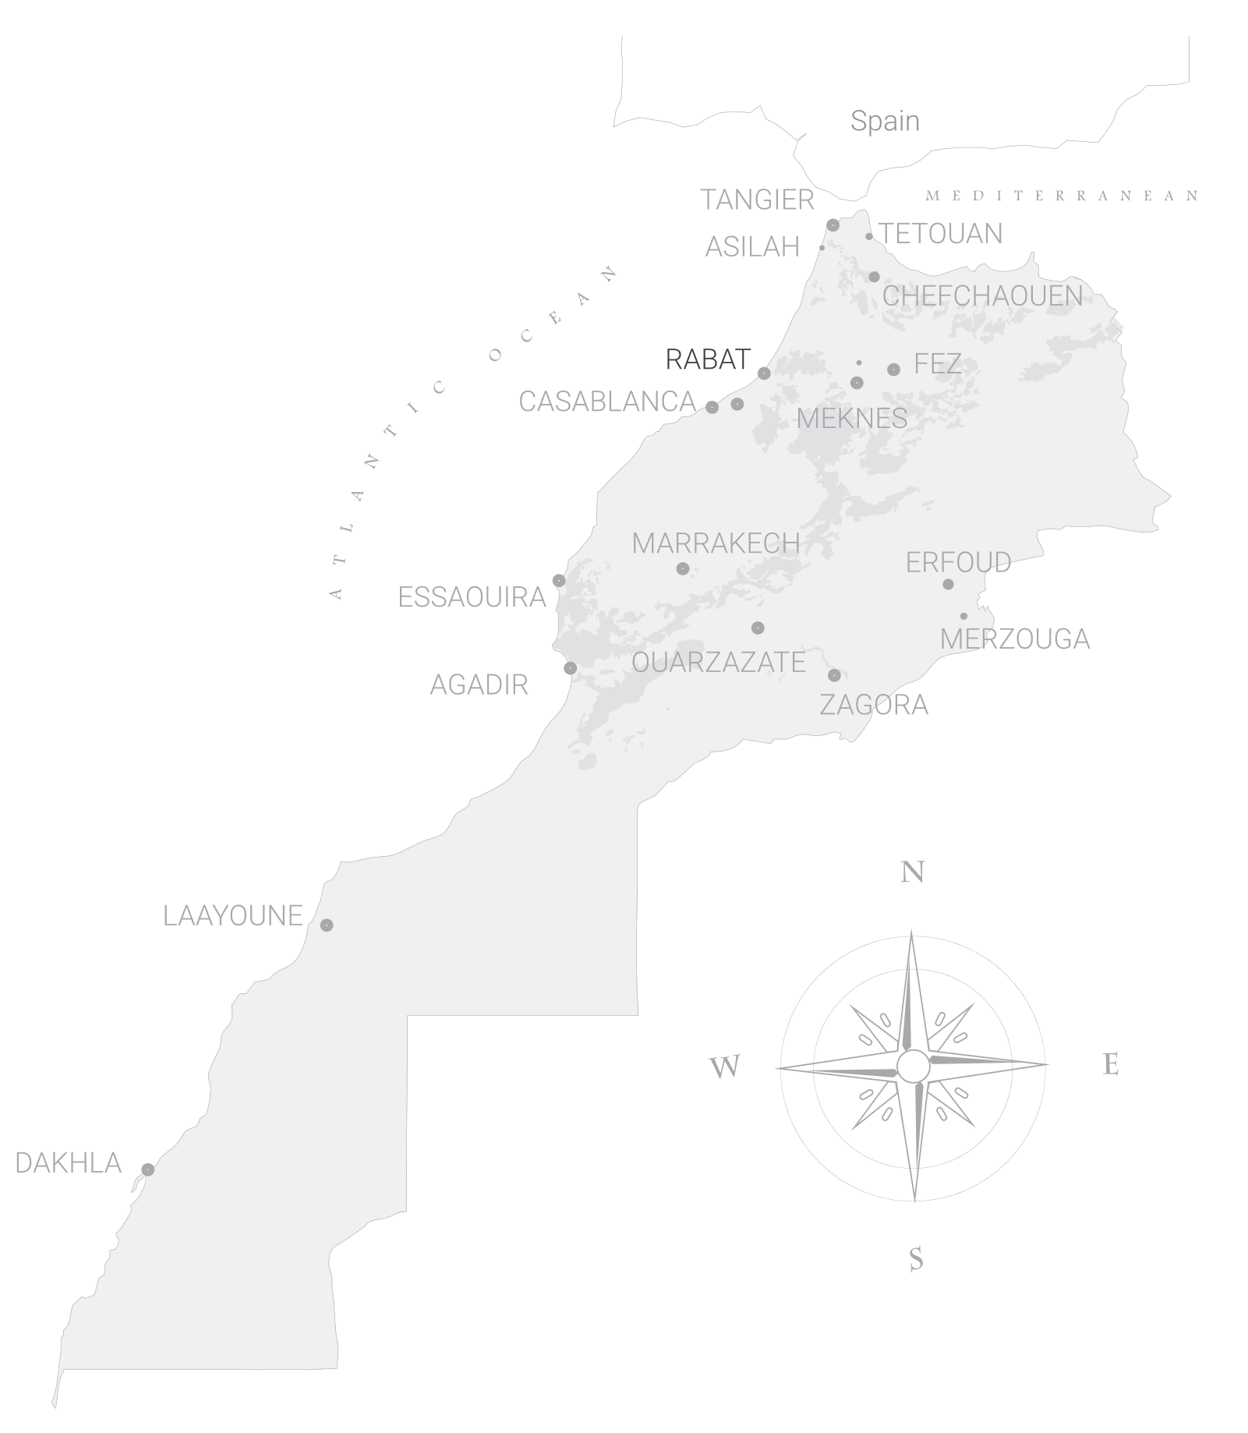



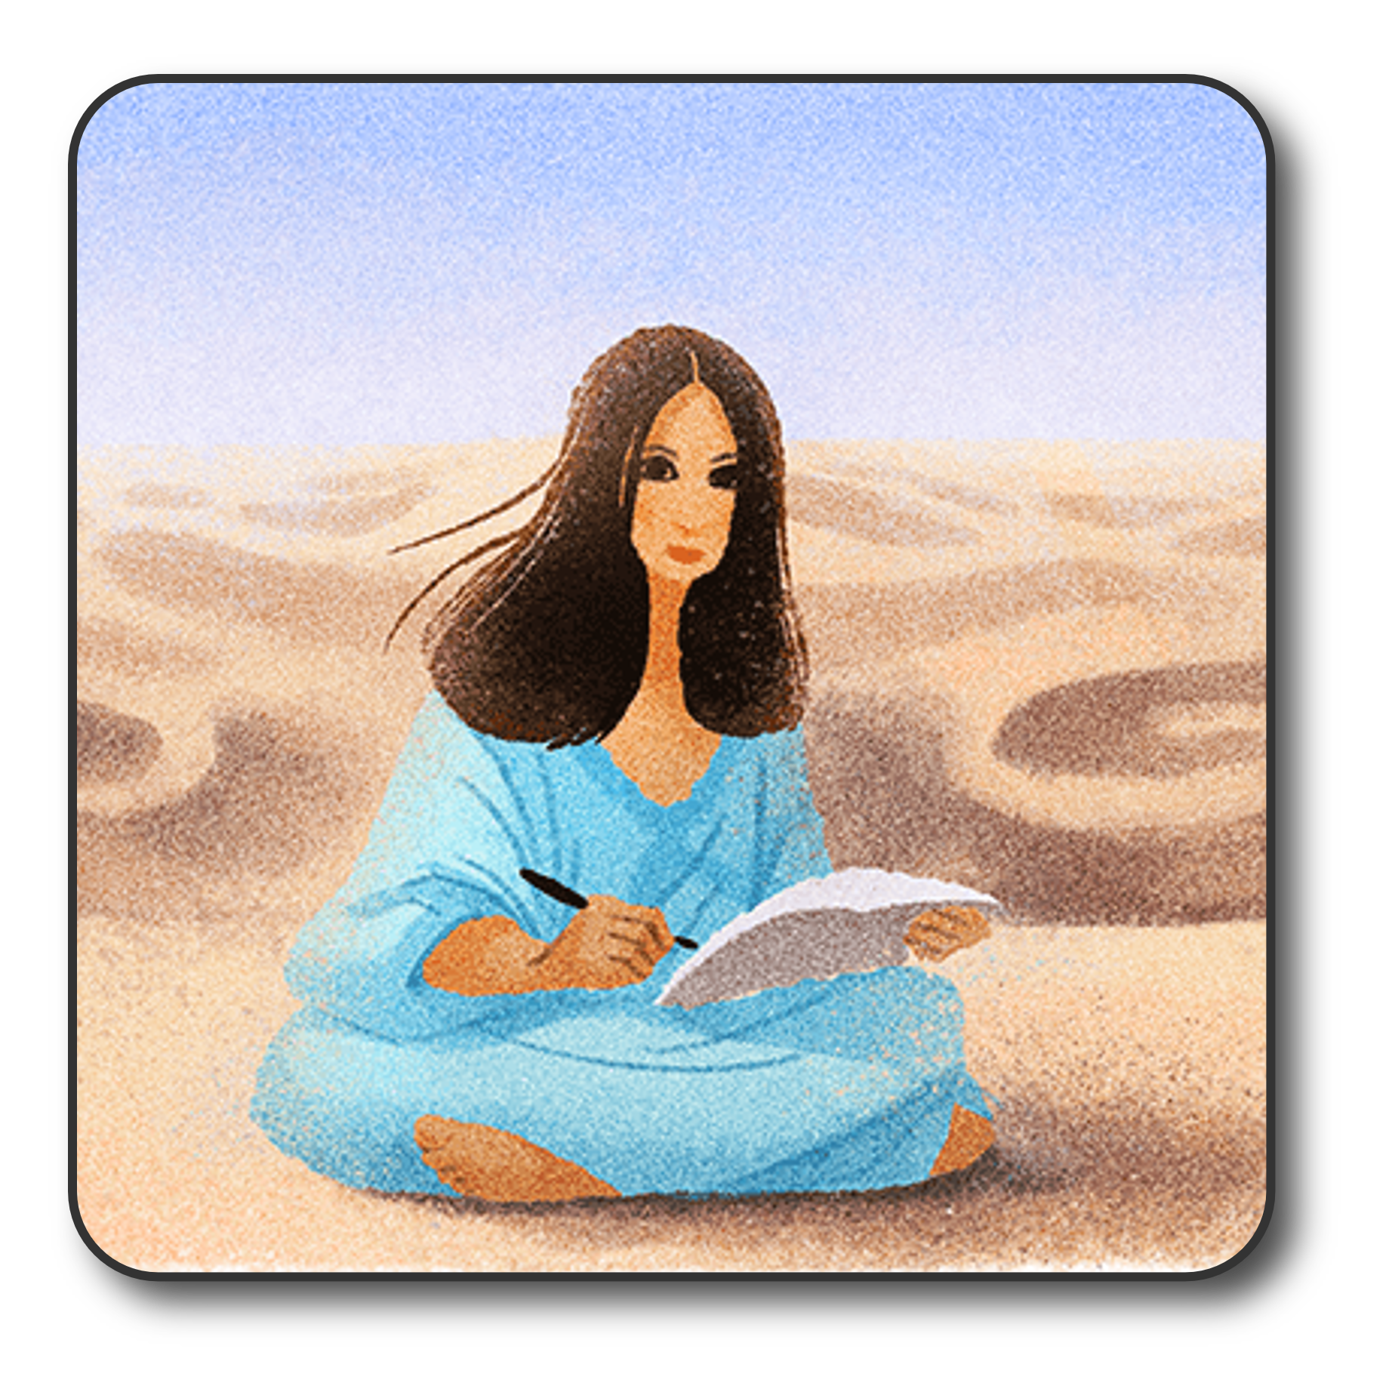

ERFOUD
Desert
& Oasis of
Morocco
OUARZAZATE
MERZOUGA
ZAGORA
LAAYOUNE
DAKHLA
www.fivedragons.ma
Notes:
A diversity that will welcome you back to Morocco with positive vibes

Slide 4
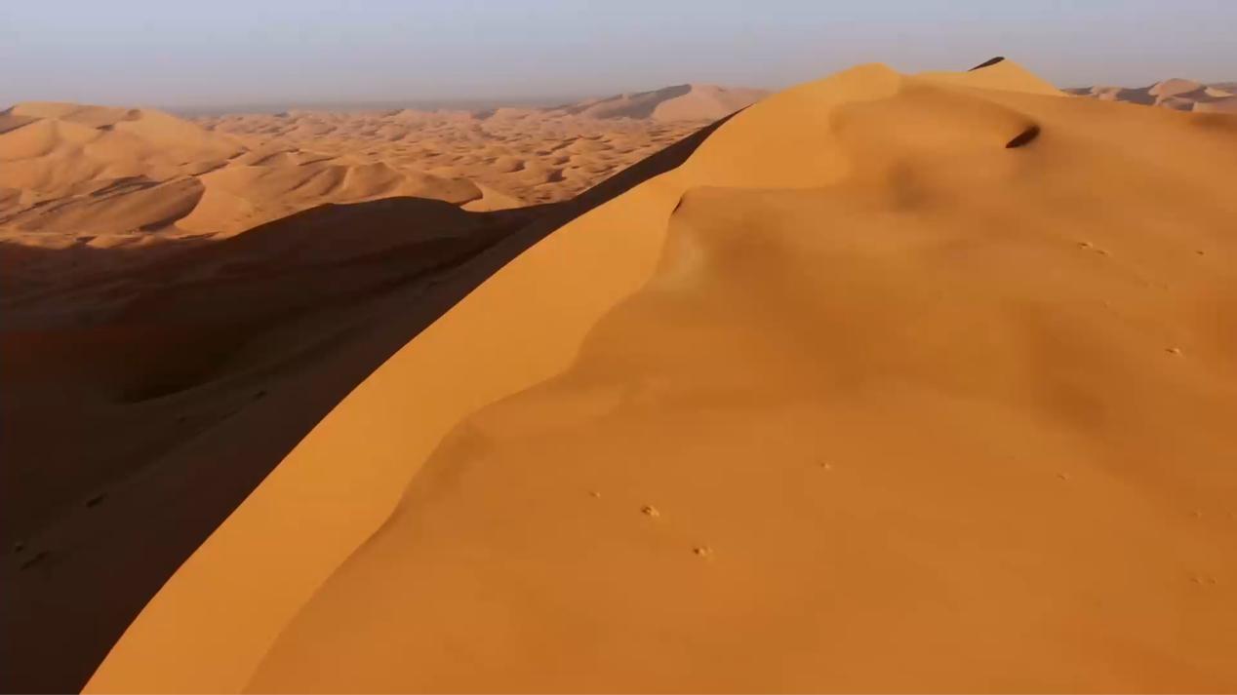

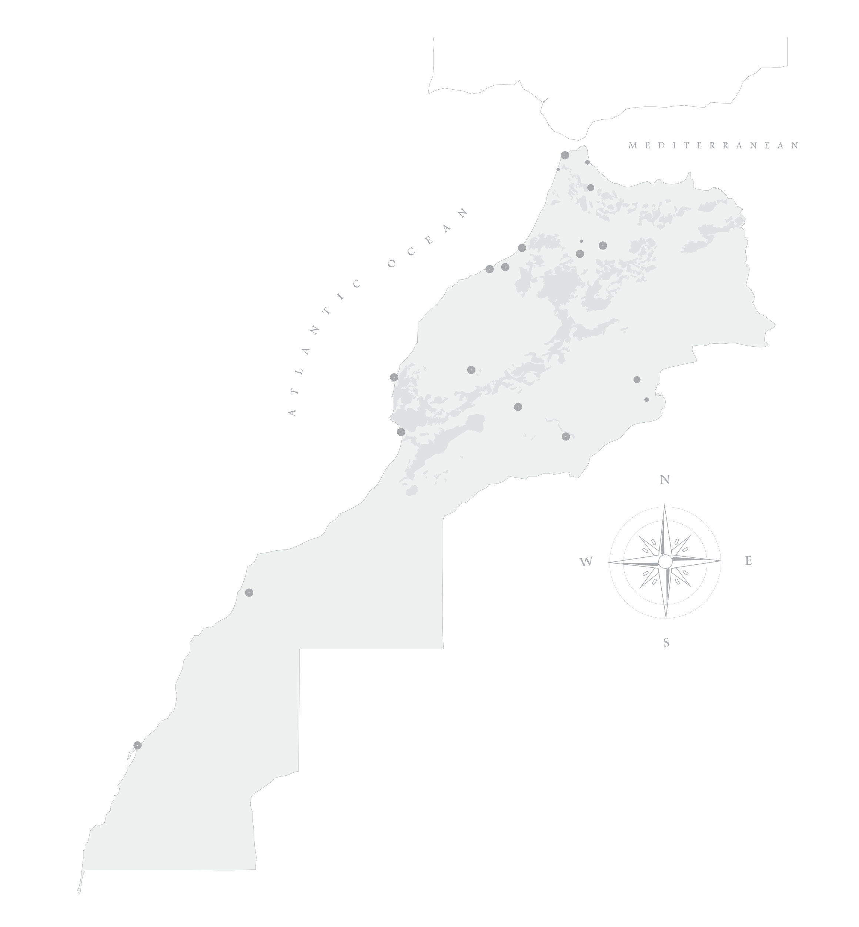





Merzouga
Dunes
Travel,…. a step further
Hotels
5803 beds
Restaurants
TOURISM
Attractions
For Sustainable Development Goals
www.fivedragons.ma

Slide 5
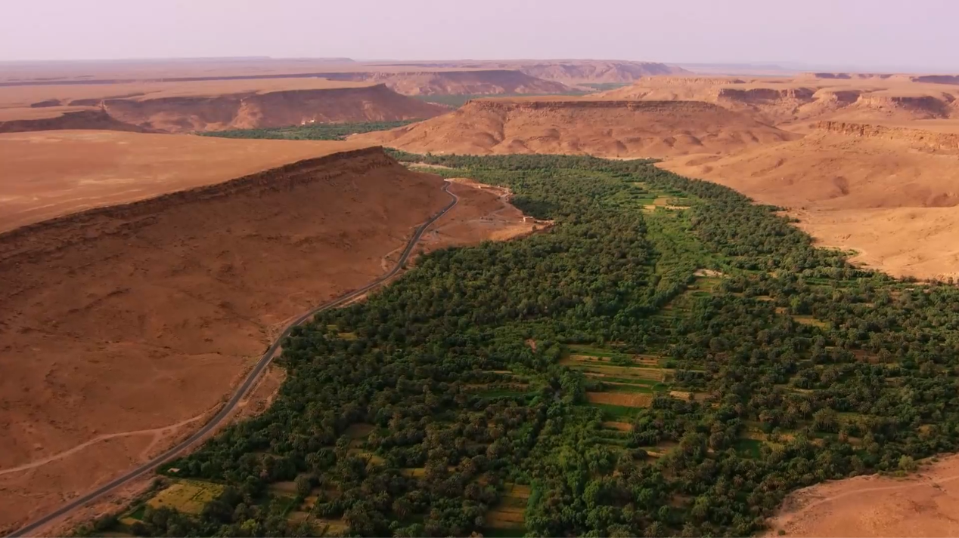
1001 Kasbah
Oasis & Valley
Travel,…. a step further
Hotels
2347 beds
Restaurants
TOURISM
Attractions
For Sustainable Development Goals
www.fivedragons.ma

Slide 6
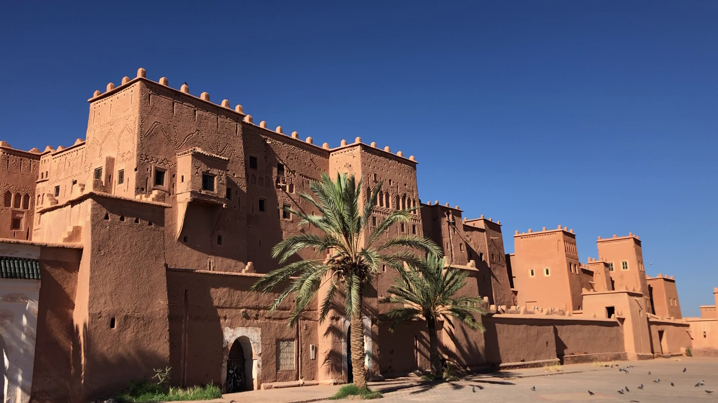
Ouarzazate
Travel,…. a step further
Hotels
7293 beds
Restaurants
TOURISM
Attractions
For Sustainable Development Goals
www.fivedragons.ma

Slide 7
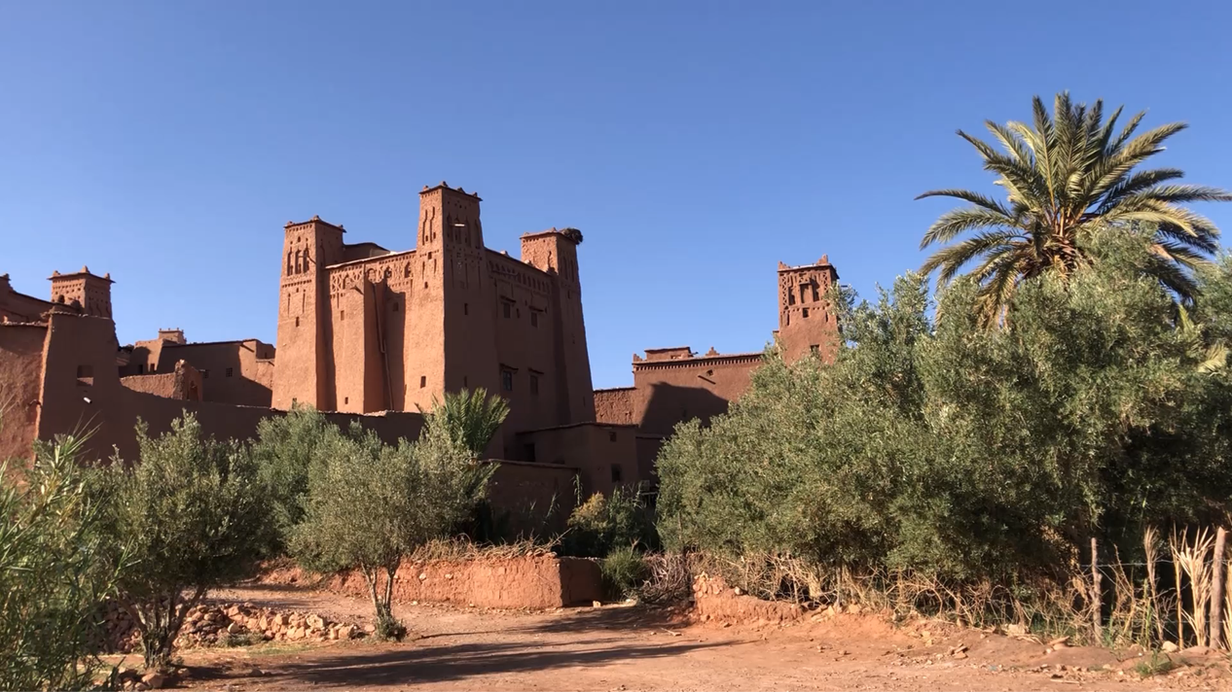
Ait Ben
Haddou
Travel,…. a step further
TOURISM
For Sustainable Development Goals
www.fivedragons.ma

Slide 8
Laayoune
more South …
Hotels
1858 beds
Restaurants
TOURISM
Attractions
For Sustainable Development Goals
www.fivedragons.ma
Notes:
Better Air Service via Casablanca or Marrakech
We created and exclusive itinerary for you to discover the path of the famous Writer San Mao
NB : Limited Hotel infrastructure

Slide 9
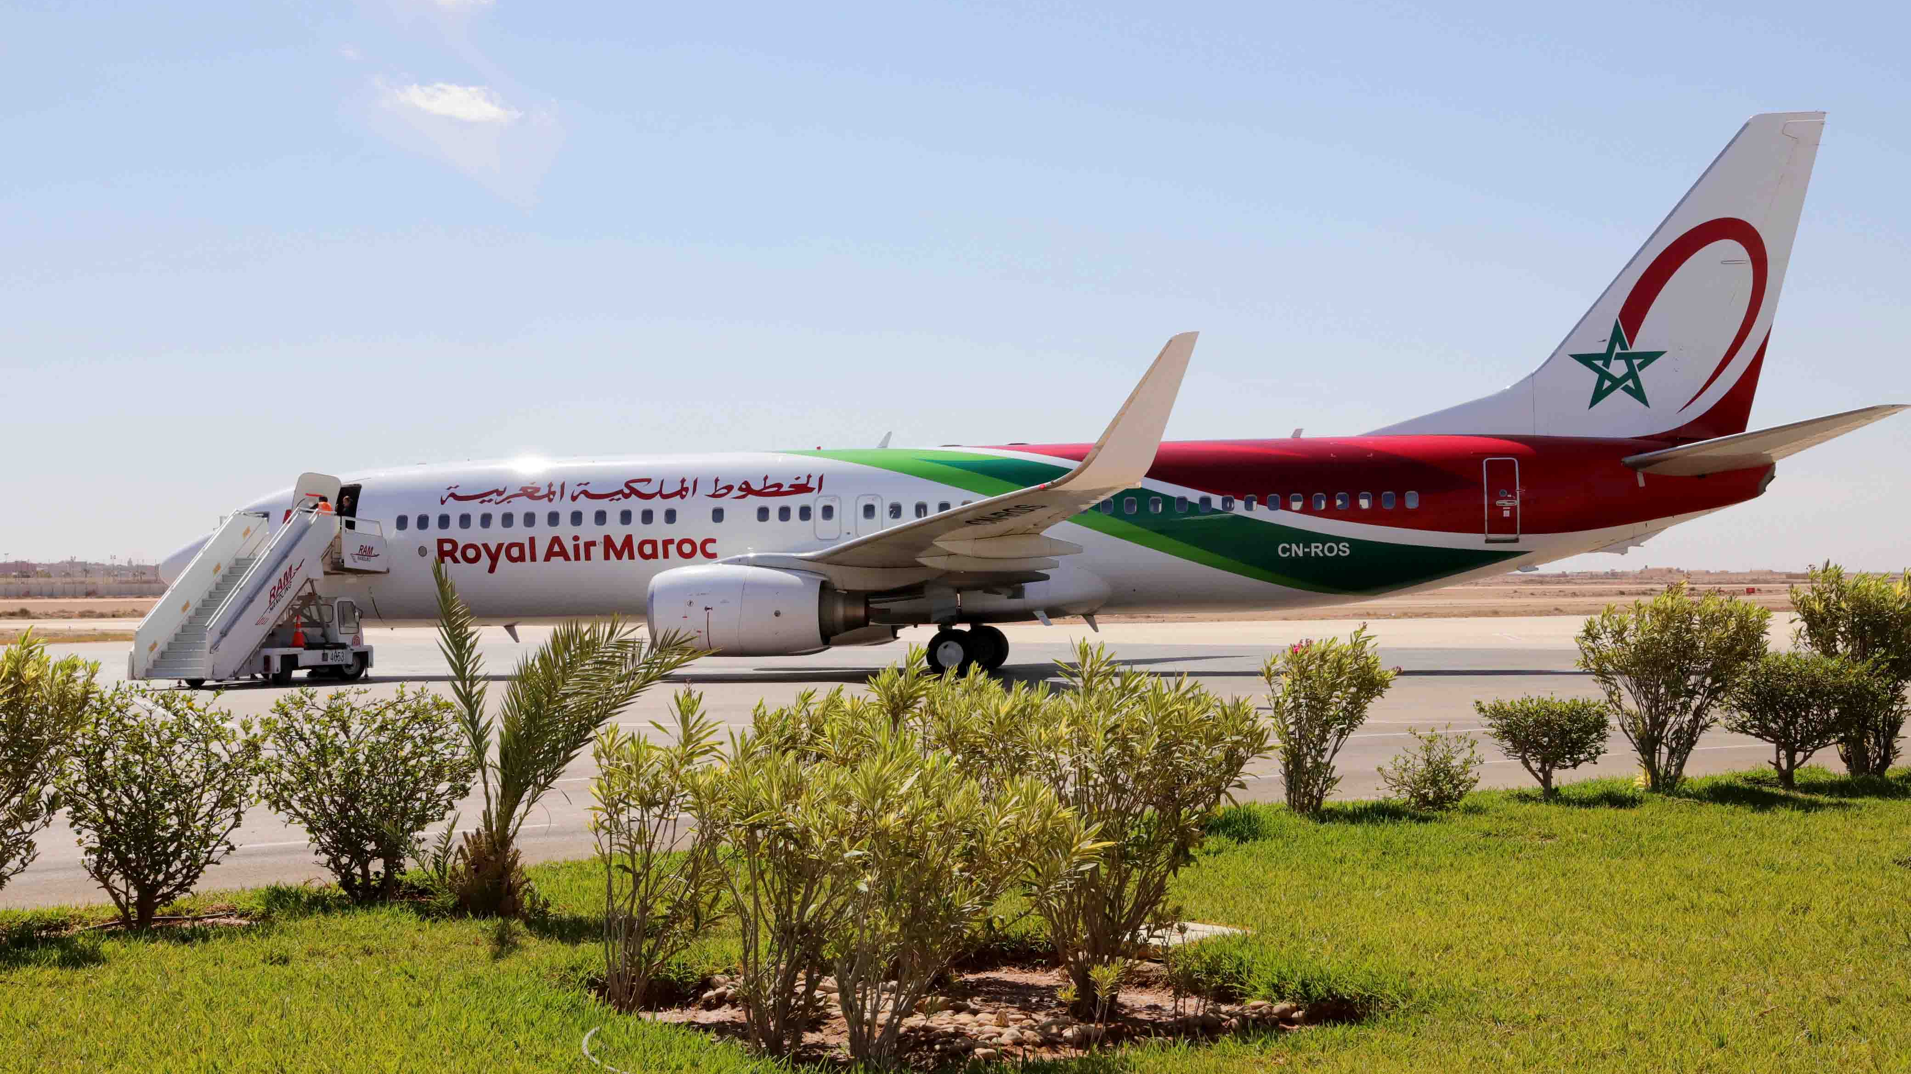
Laayoune
Travel,…. a step further
The Hassan 1st Airport
The airport is located at 3 kilometers from the city center of Laayoune . Built on 7500 m2, out of which 4000 m2 is allocated for air cargo services . Two runways with a total length of 7100 meters thus connecting the north of the kingdom to the region as well as the Canary Islands and Dakhla . .
www.fivedragons.ma
© lematin.ma

Slide 10
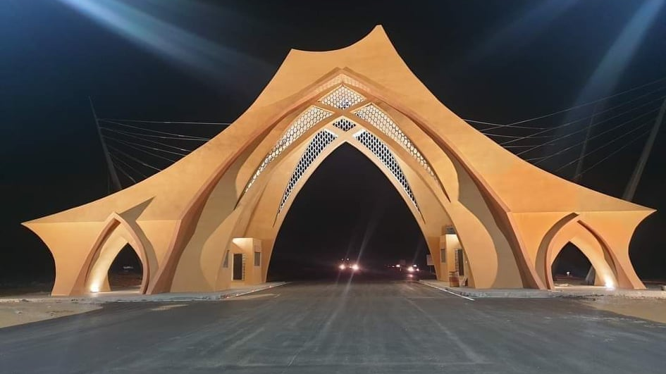
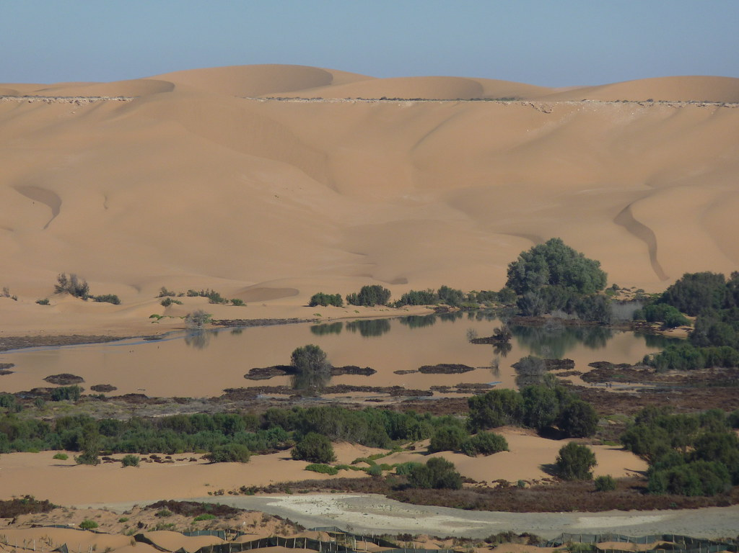
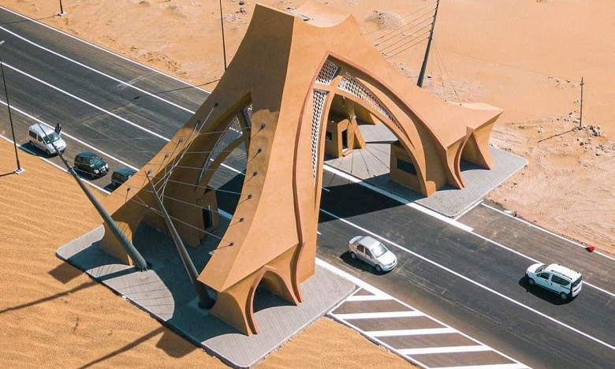

Laayoune
Travel,…. a step further
The Laayoune Iconic Entrance
(In the shape of a Desert Tent)
Designed in the form of a tent, the gate was built on an area of 774m². 18 meters wide, 50m long and 21m high.
www.fivedragons.ma

Slide 11
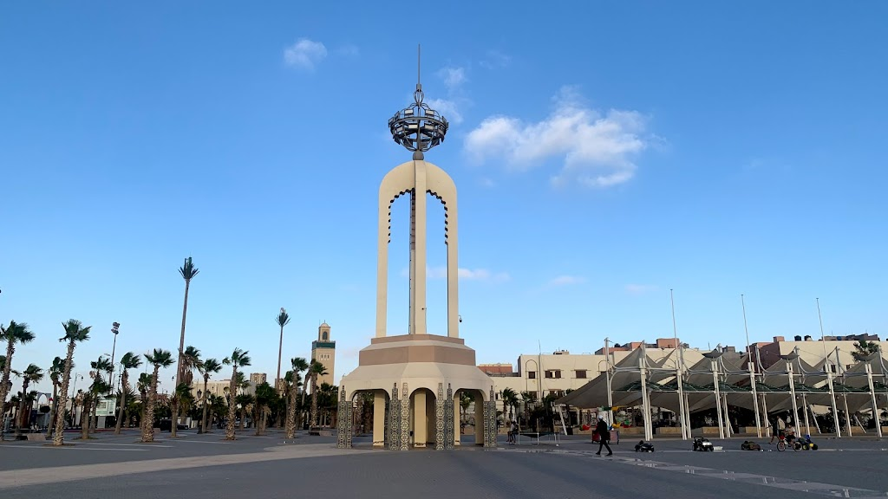
Laayoune
Travel,…. a step further
The Laâyoune Royal
Mechouar Square
www.fivedragons.ma

Slide 12
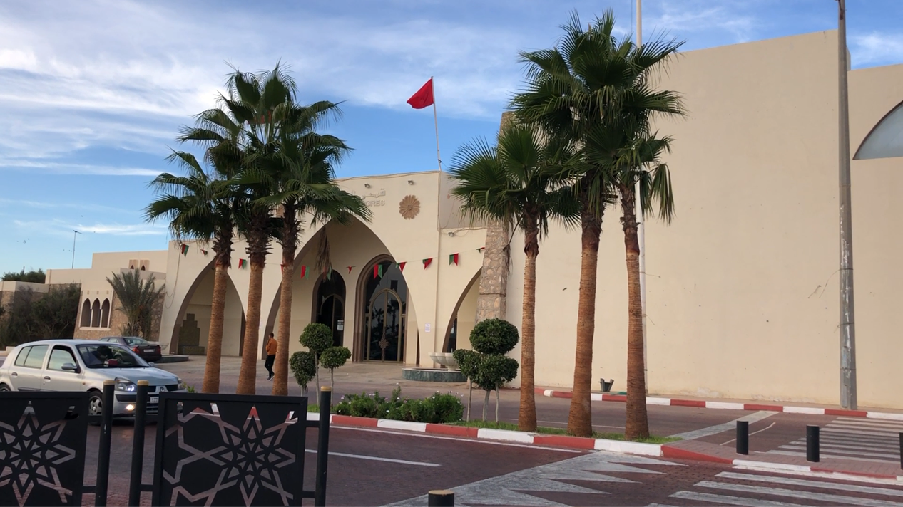
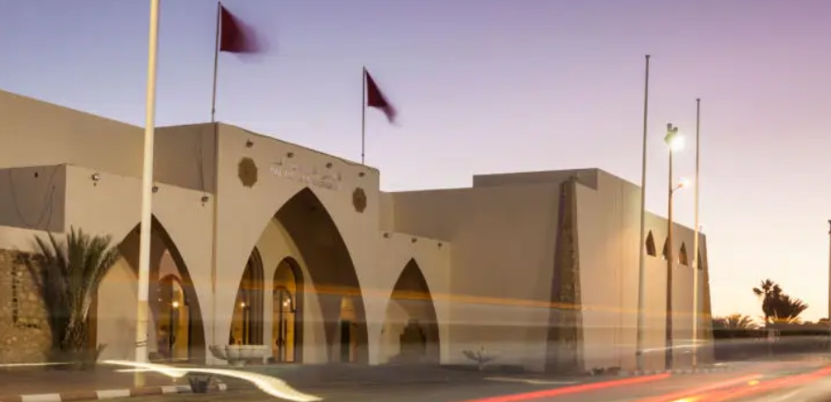
Laayoune
Travel,…. a step further
The Laâyoune
Convention Center
www.fivedragons.ma

Slide 13
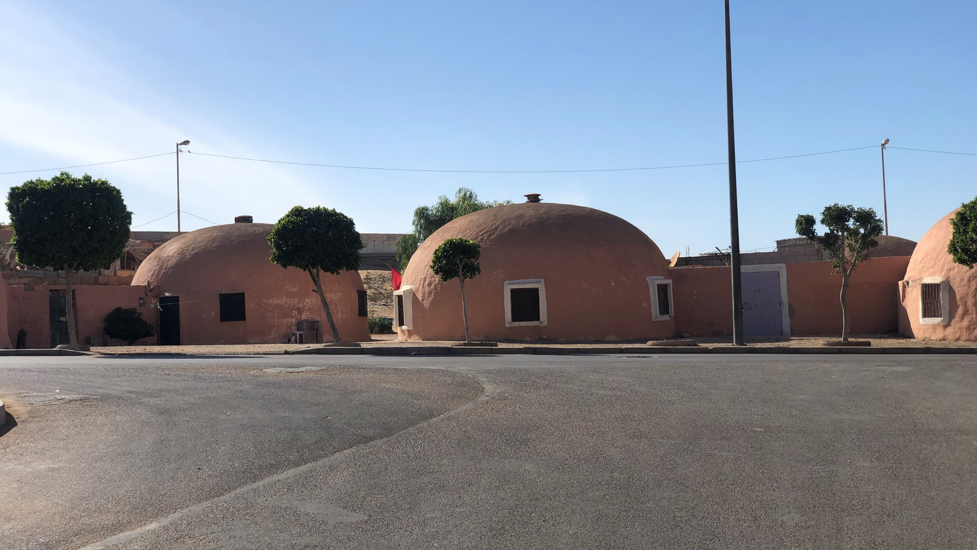
Laayoune
Travel,…. a step further
Spanish
Dome Houses
Workers houses, during Spanish protectorate
www.fivedragons.ma

Slide 14
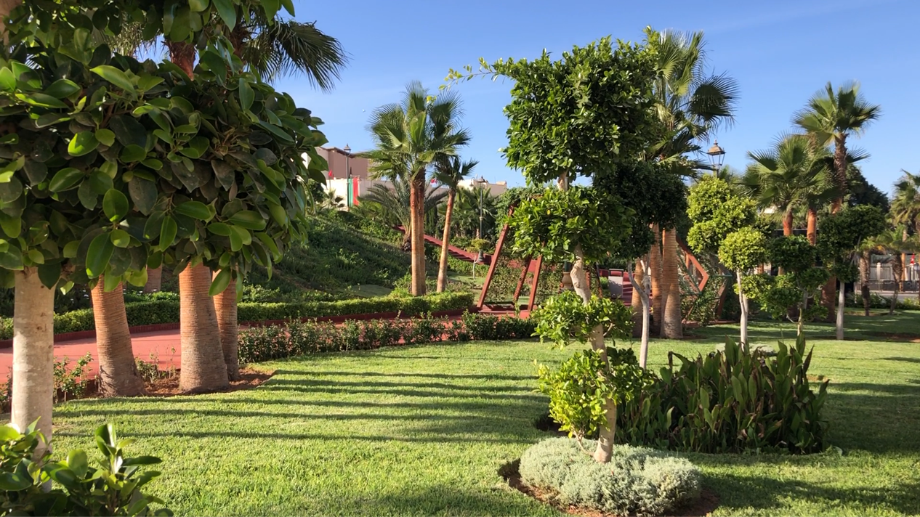
Laayoune
Travel,…. a step further
Gardens
Infrastructure
www.fivedragons.ma

Slide 15
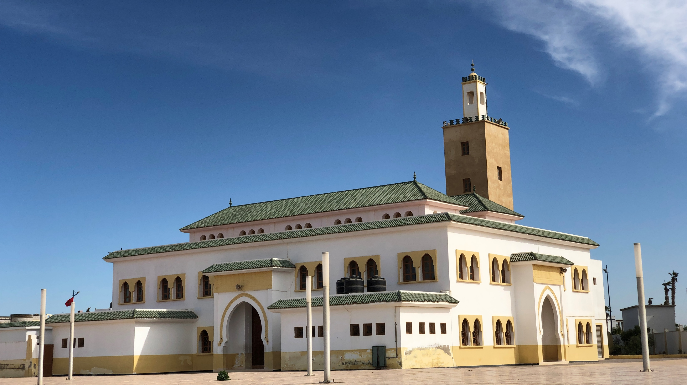
Laayoune
Travel,…. a step further
Mosque
nearby the Port
www.fivedragons.ma

Slide 16
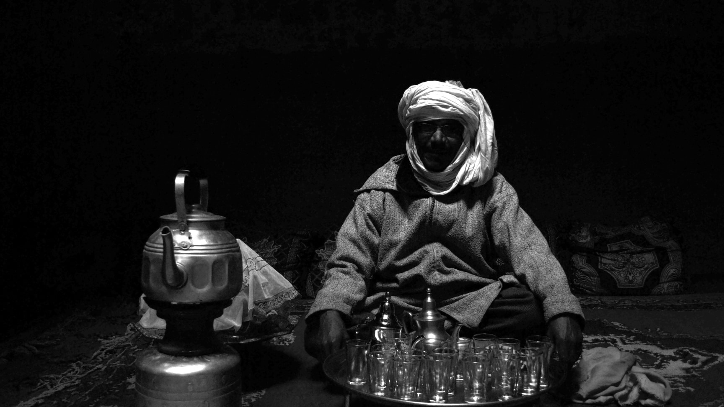
Laayoune
Travel,…. a step further
Tea culture
Under Hassani hospitality
www.fivedragons.ma

Slide 17
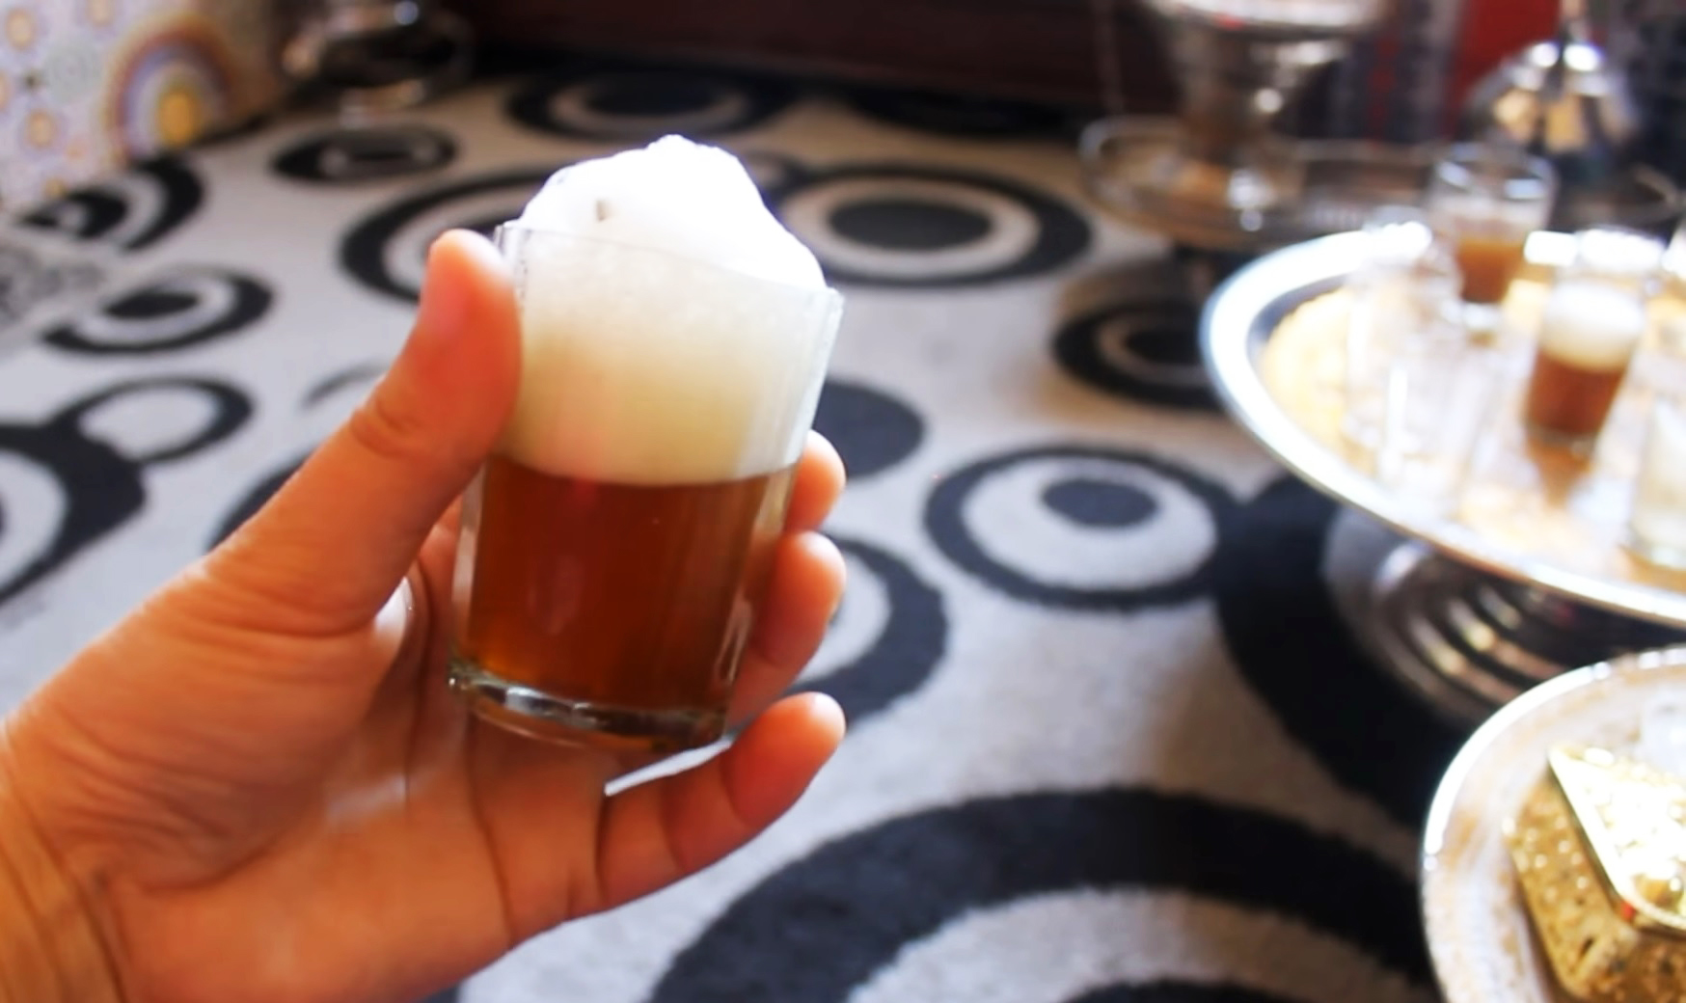
Laayoune
Travel,…. a step further
Tea culture
Under Hassani hospitality
www.fivedragons.ma

Slide 18
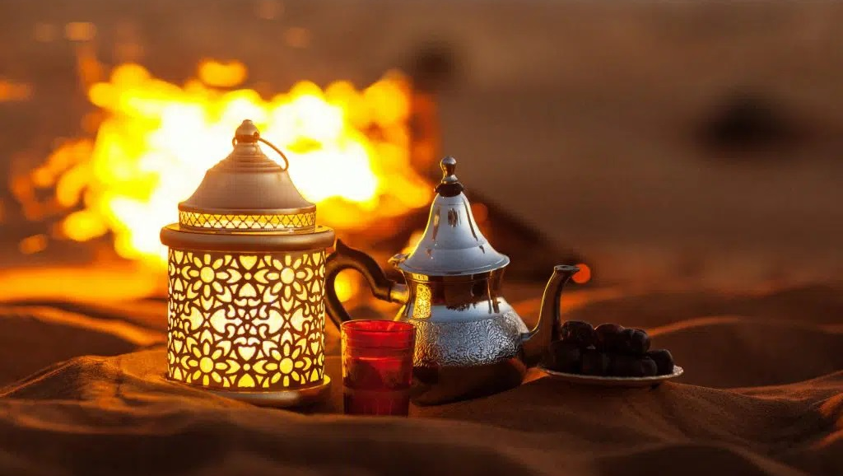
Laayoune
Travel,…. a step further
Tea culture
Under Hassani hospitality
www.fivedragons.ma

Slide 19
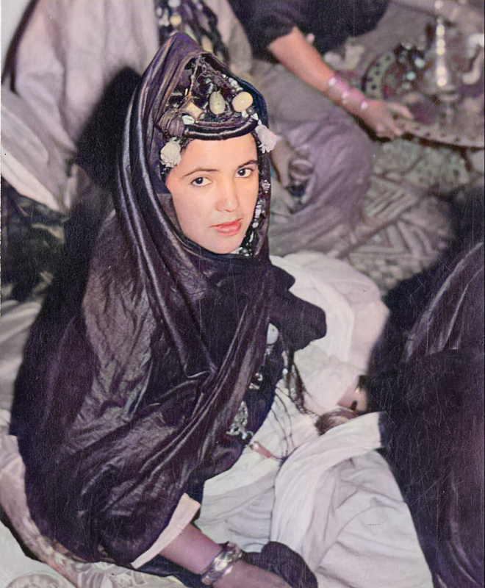

Laâyoune
Secret Stories
CASABLANCA
MARRAKECH
Morocco Sahara
& Story Telling
www.fivedragons.ma
Notes:
Morocco : A Kingdom of stability and vibrant cultural diversity
A mix of african, oriental and european influences
Berber, Arab, Muslim and Jewish heritage
A kingdom where you can perfect your swing
Embarking in a journey to the sahara
The african holywood

Slide 20
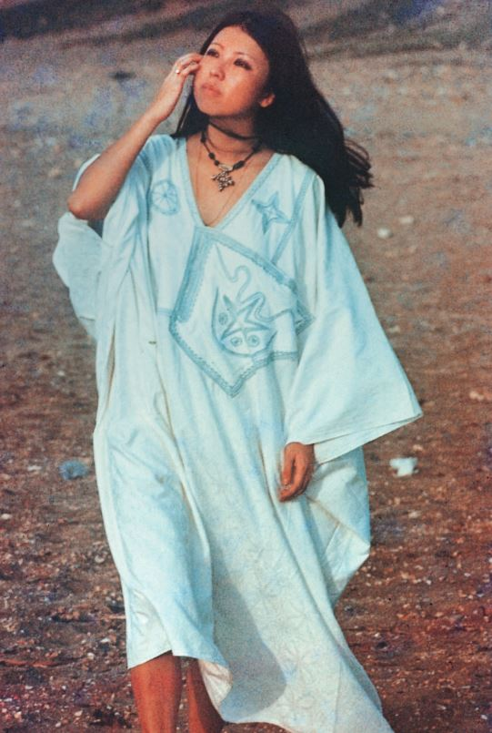
In the Footsteps of San Mao
“The writer who knew how to bring East & West closer together on the dunes of the Moroccan Sahara
San Mao
The story of San Mao (1943-1991)
San Mao is a chinese writer
“She embodied the archetype of a well-heeled and well-travelled modern girl. […] she transcended national boundaries and embraced worldliness in her lifestyle”
www.fivedragons.ma

Slide 21

In the Footsteps of
San Mao
Introduction
The tour will commemorate the arrival of San Mao in the Moroccan Sahara, when it was still under Spanish occupation.
Many of her fans knew the desert and its dunes thanks to the autobiographical stories with a touch of fiction, as narrated by the writer herself
www.fivedragons.ma

Slide 22
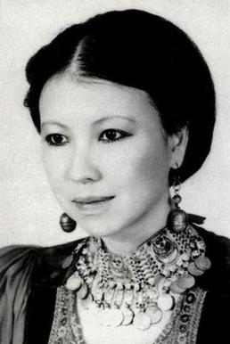
In the Footsteps of San Mao
Who is San Mao?
(1943-1991) Chen Ping, is a Chinese writer, known by two pseudonyms "San Mao" and "Echo".
Born in China, she greatly influenced Chinese literature, and inspired a whole international generation of the 70s and 80s by bringing together, through her writings, the Far East and the West.
She found inspiration in the Moroccan Sahara, and more precisely in Laayoune !
www.fivedragons.ma

Slide 23



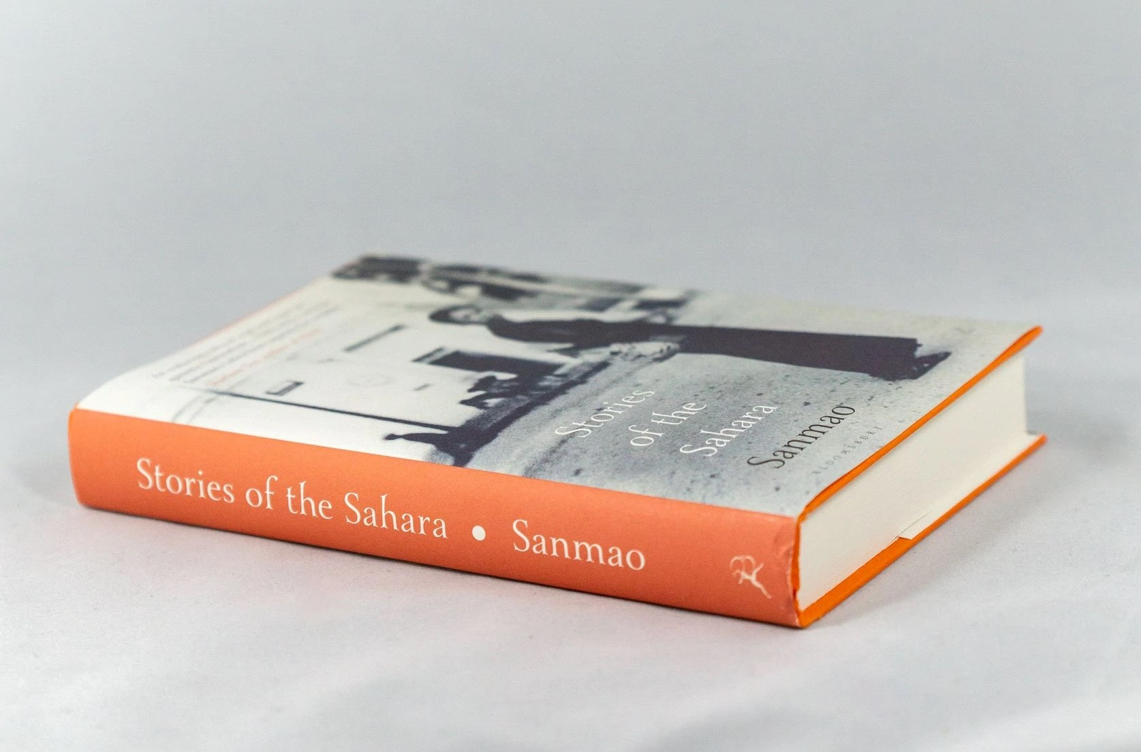
In the Footsteps of San Mao
Morocco Sahara
& Story Telling
The San Mao Legacy
The mystical experience of San Mao in Laayoun lives on in large part through her book, her first and most beloved work : Stories of The Sahara.
This best seller was sold in more than 14 million copies. It is an autobiography, where at the same time, "San Mao" is an extraordinary character, blurring the boundaries between fiction and reality, truth and fantasy , with Laayoun as a magical setting.
www.fivedragons.ma

Slide 24
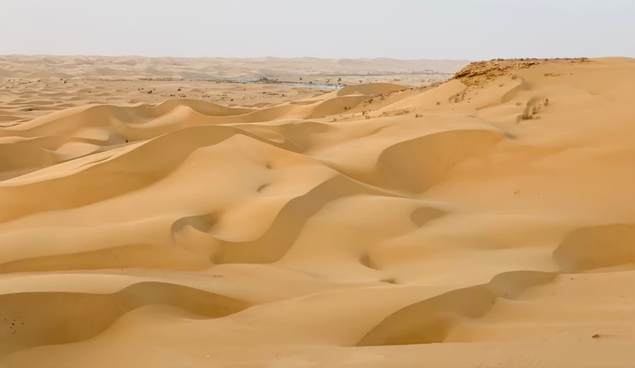

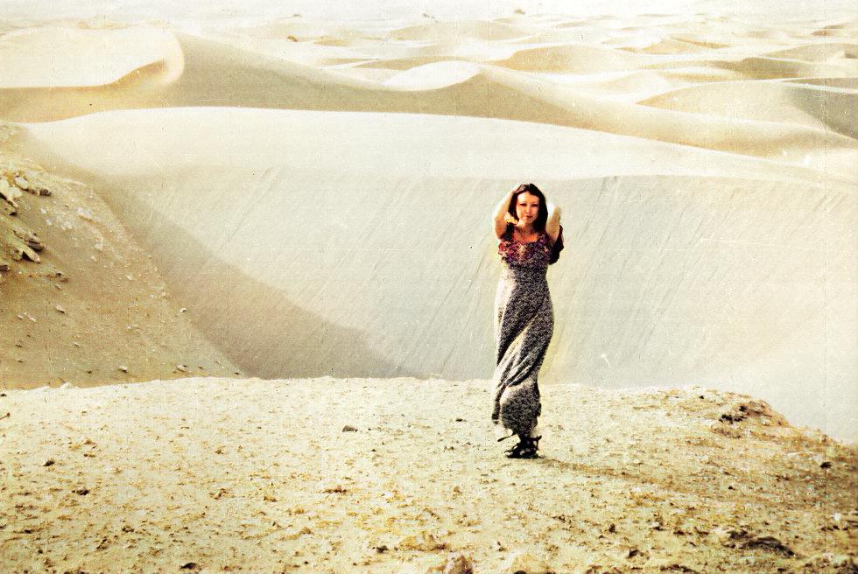
In the Footsteps of San Mao
The San Mao
Legacy
By Five Dragons’ Group
Her source of inspiration
The Laayoune Dunes
www.fivetravel.ma

Slide 25
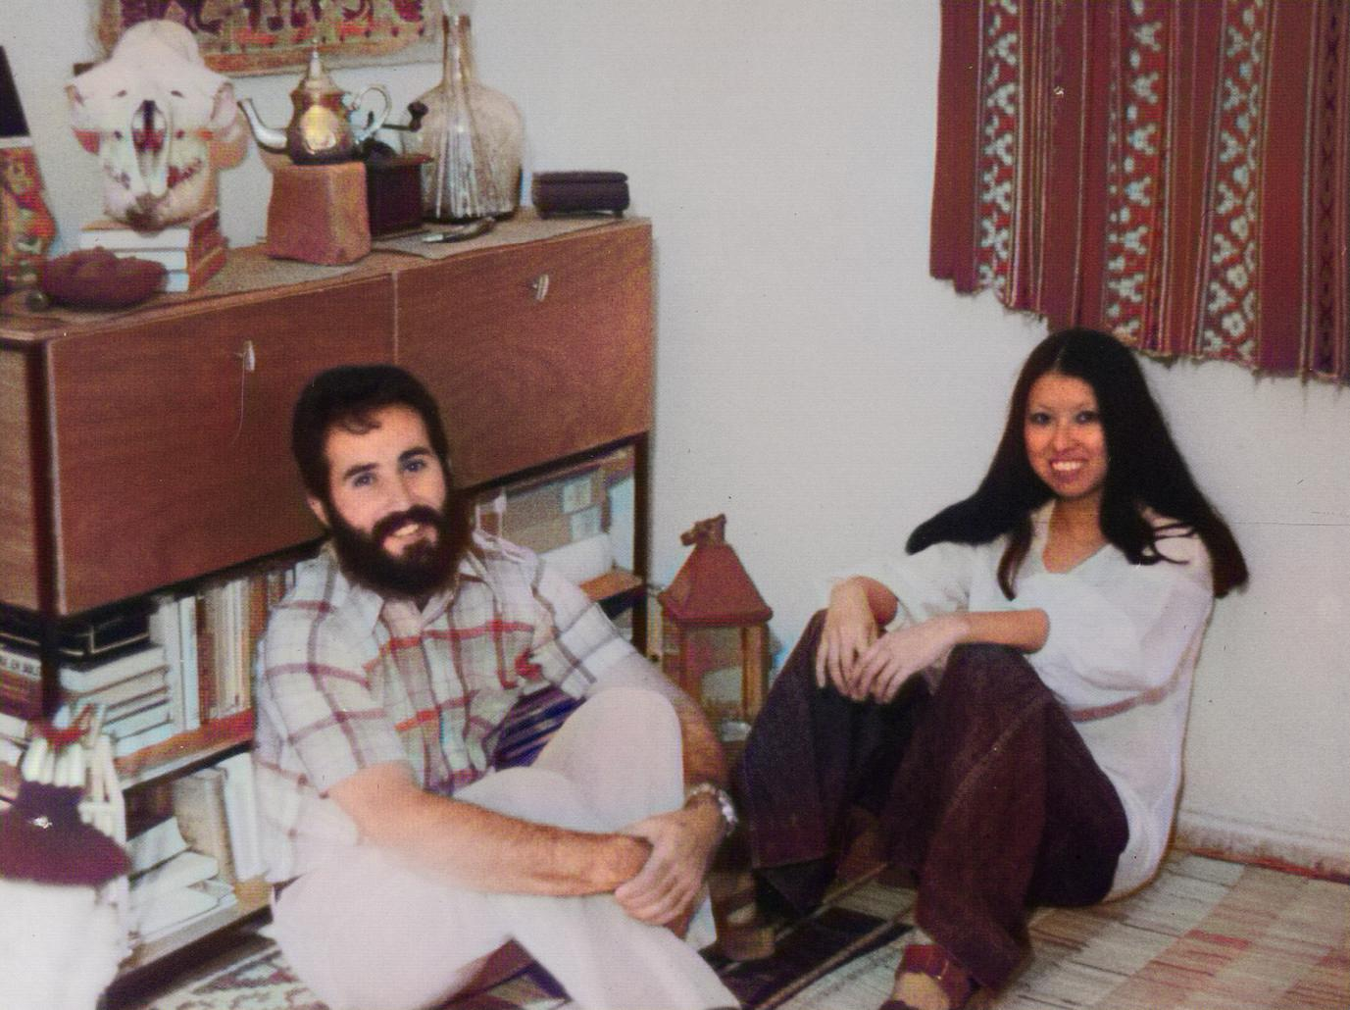
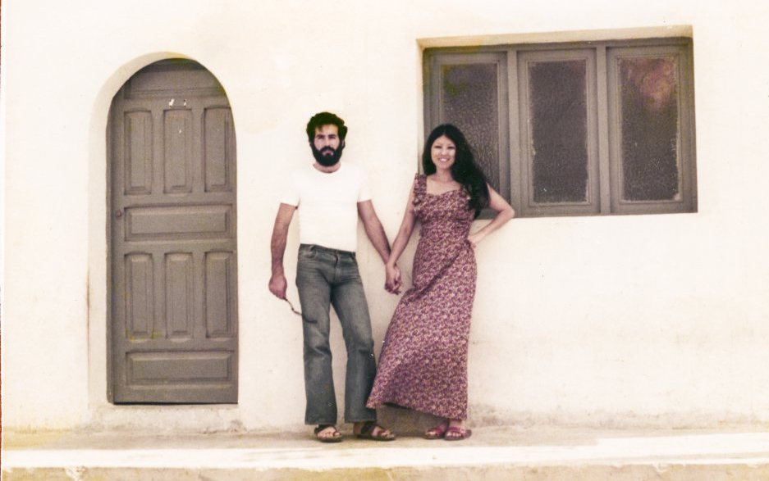
In the Footsteps of San Mao
The San Mao
Legacy
… Her house in Laayoune
with her husband Jose
www.fivedragons.ma

Slide 26
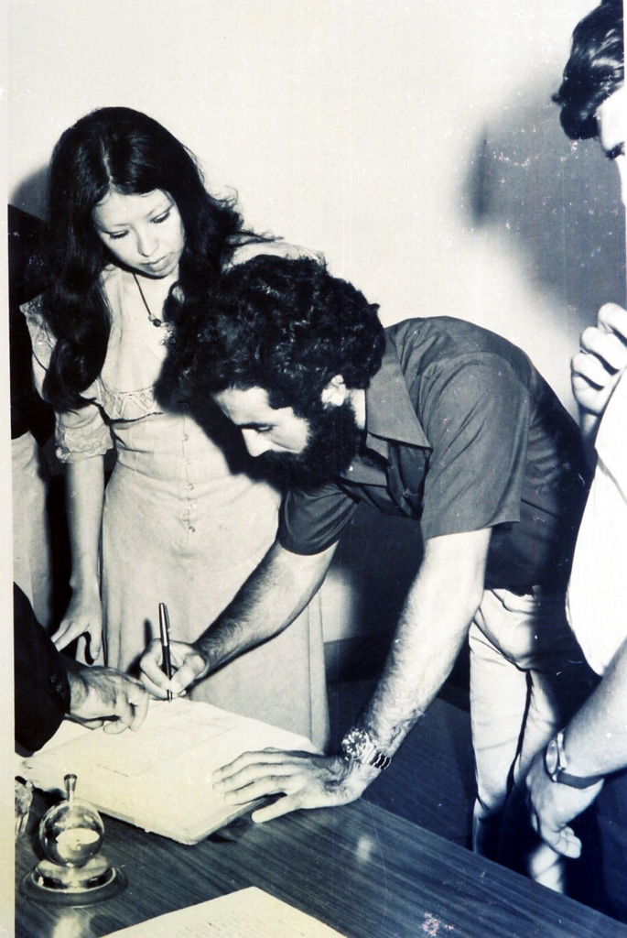
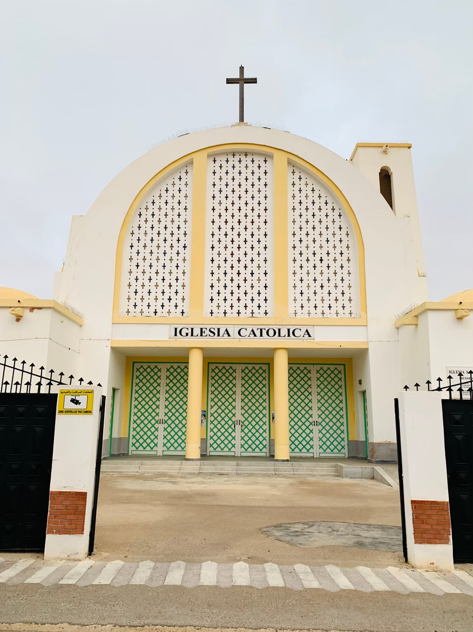

In the Footsteps of San Mao
The San Mao
Legacy
… Church Saint Francis of Assisi where she got married to Jose ….
www.fivedragons.ma

Slide 27
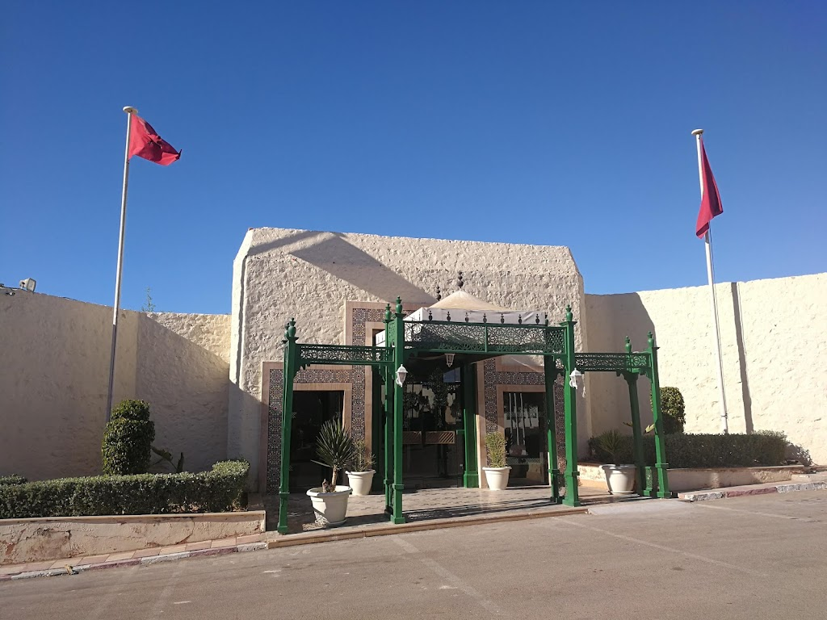
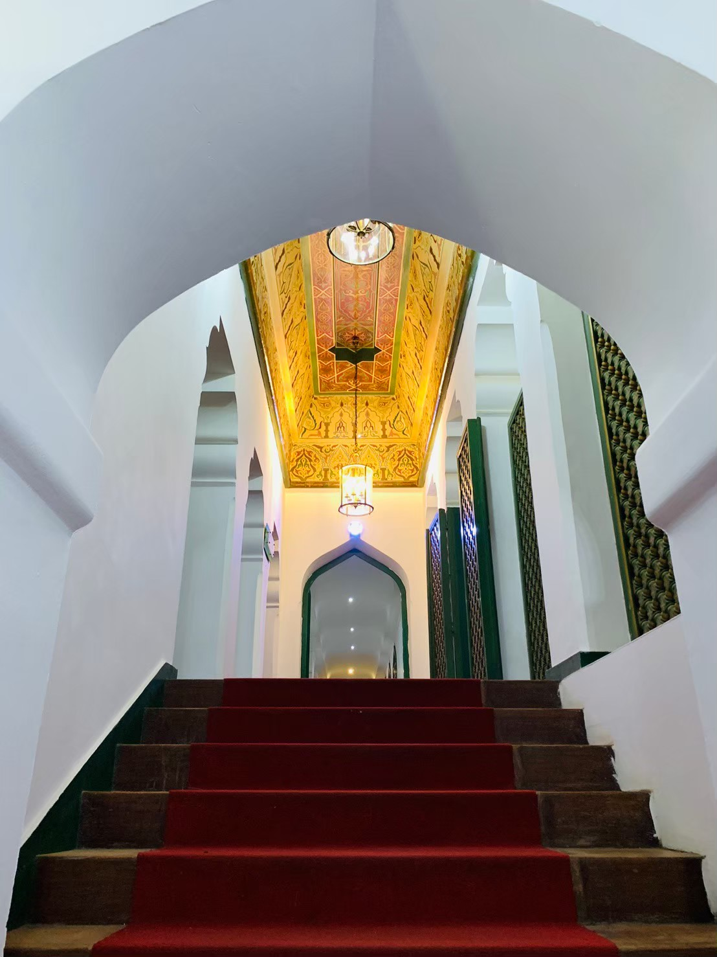
In the Footsteps of San Mao
The San Mao
Legacy
… The former
Hotel Nacional
Today called “Parador”,… this hotel was mentioned in her “Stories of the Sahara”….
San Mao used to sell fresh fish, newly fished by her husband, to help the couple with domestic expenses
www.fivedragons.ma

Slide 28
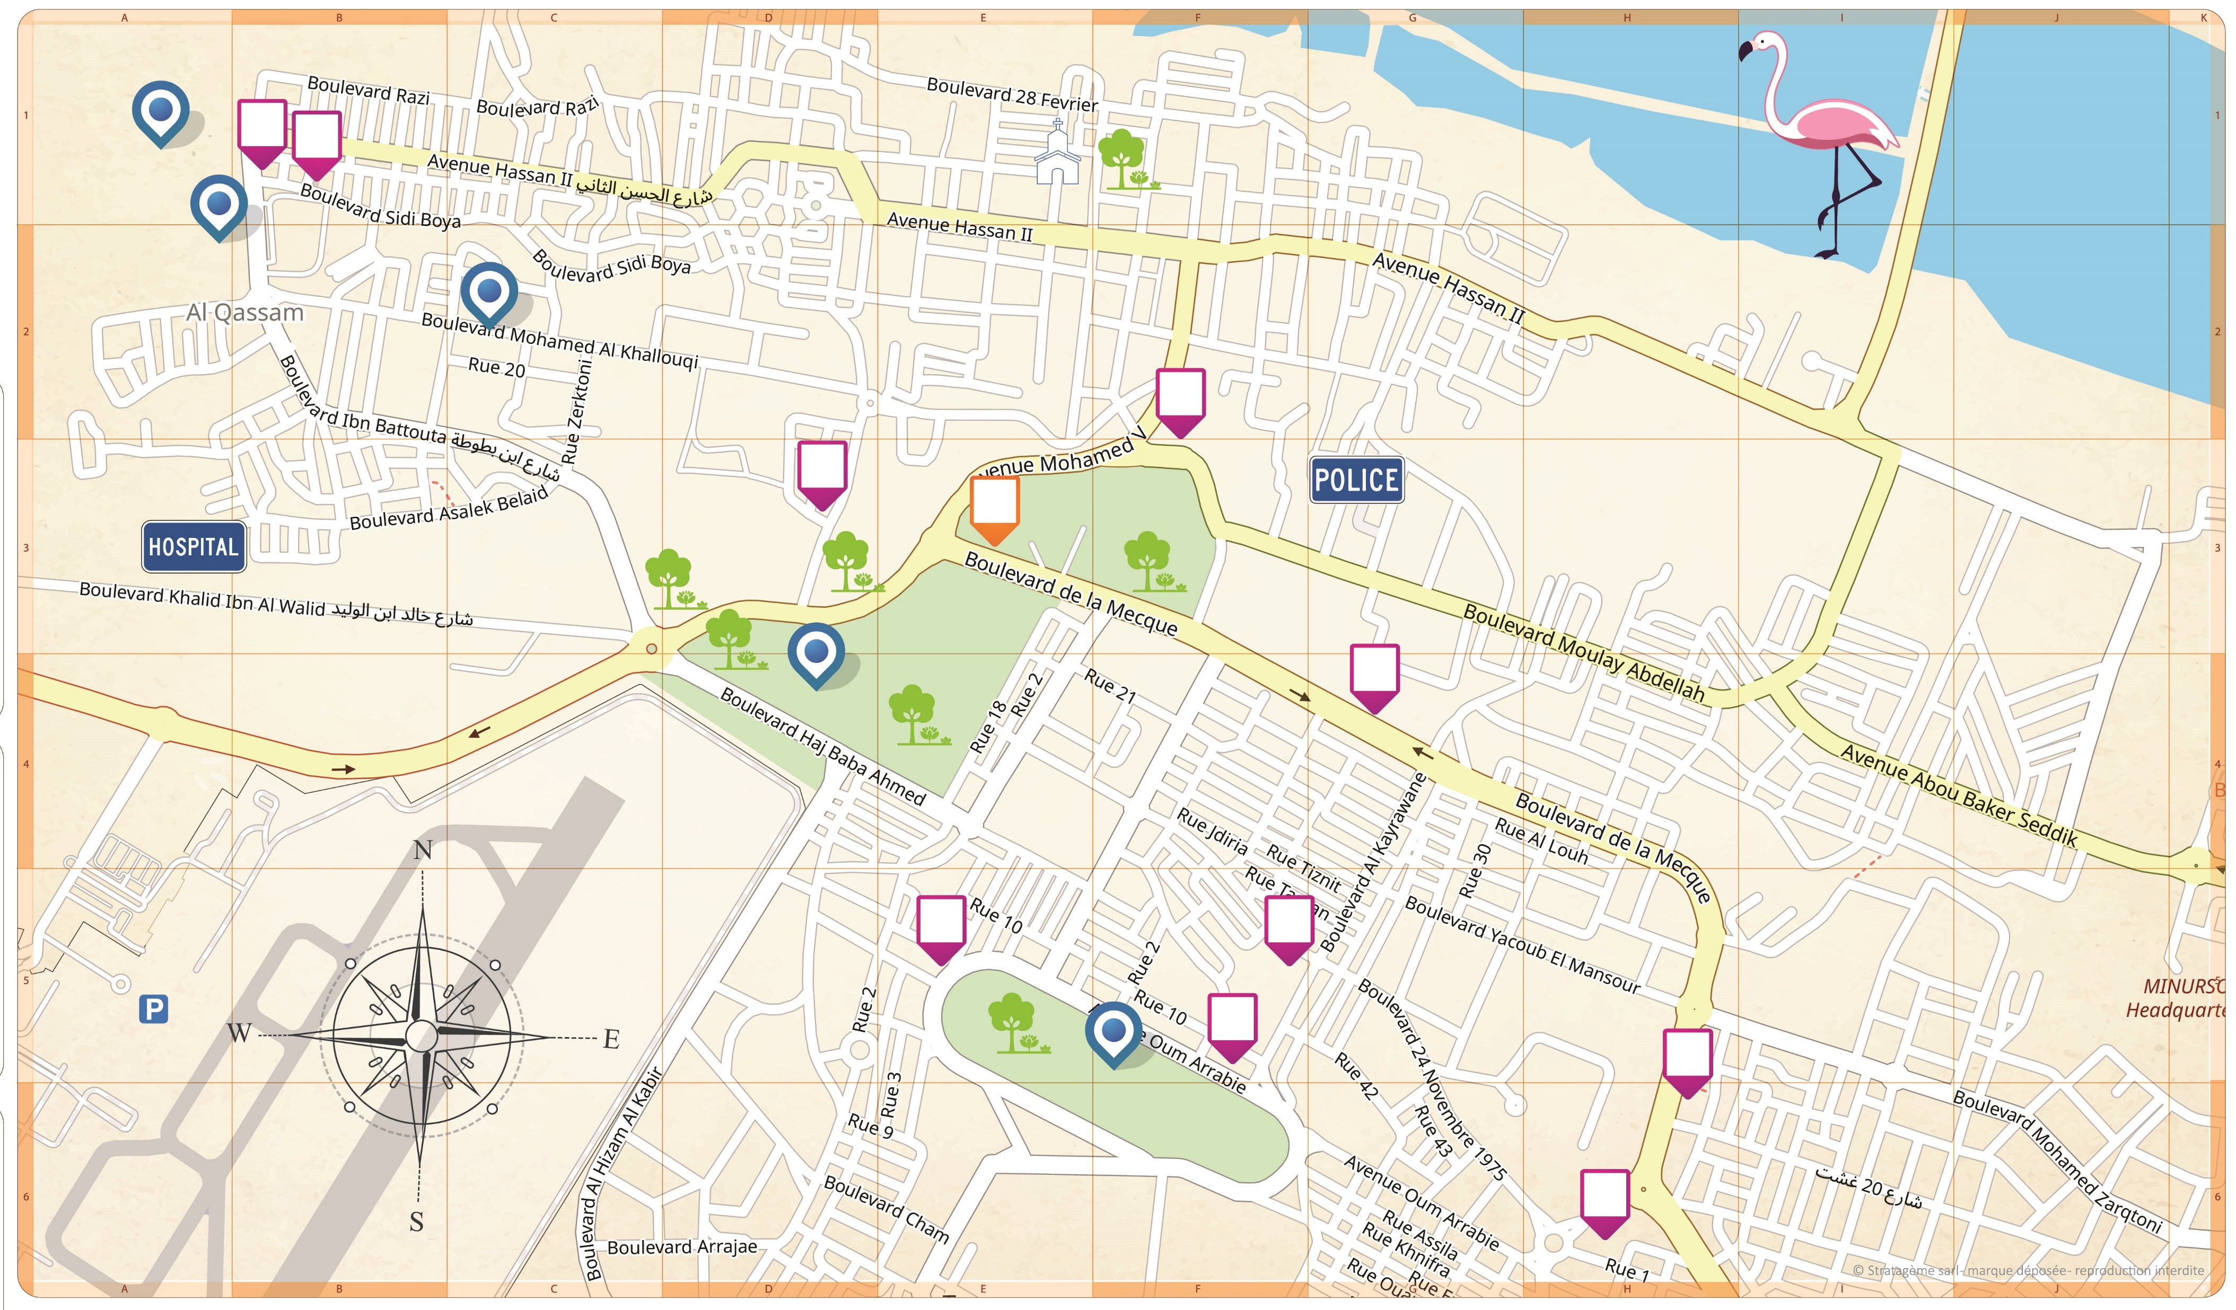
In the Footsteps of San Mao
Coming
Soon!...
Tourist Map
of Laayoune
www.fivedragons.ma

Slide 29
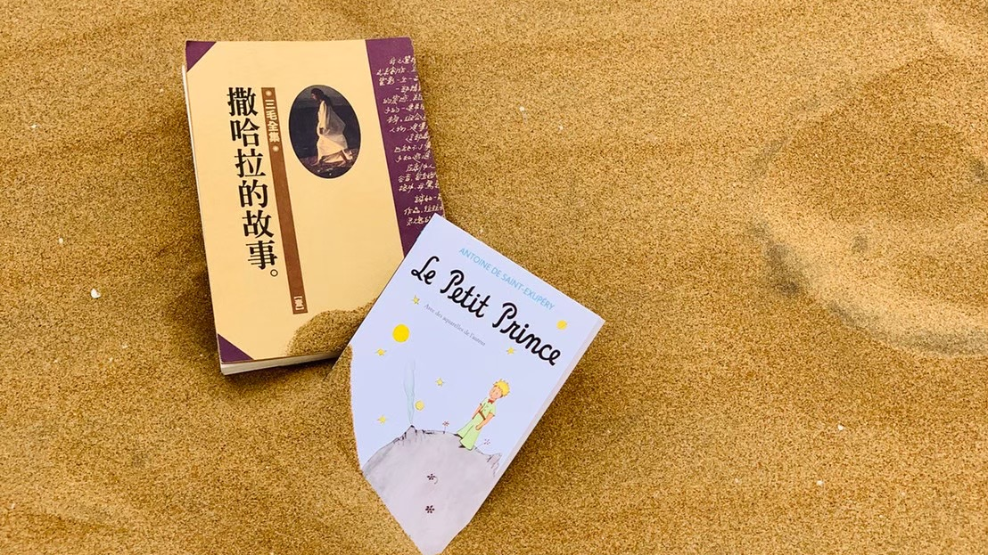
In the Footsteps of San Mao
Laayoune’s
Secret Stories
Travel,…. a step further
Inspiring writers
www.fivedragons.ma

Slide 30


Laayoune
Morocco Sahara
The Legendary Antoine
de Saint
Exupery
& Story Telling
1h15 drive
TARFAYA
LAAYOUNE
& The
Little
Prince
Antoine de Saint Exupery
(1900-1944),
was a French writer, poet, aristocrat, journalist and pioneering aviator. He was known for his famous novel “The little prince”.
www.fivedragons.ma

Slide 31
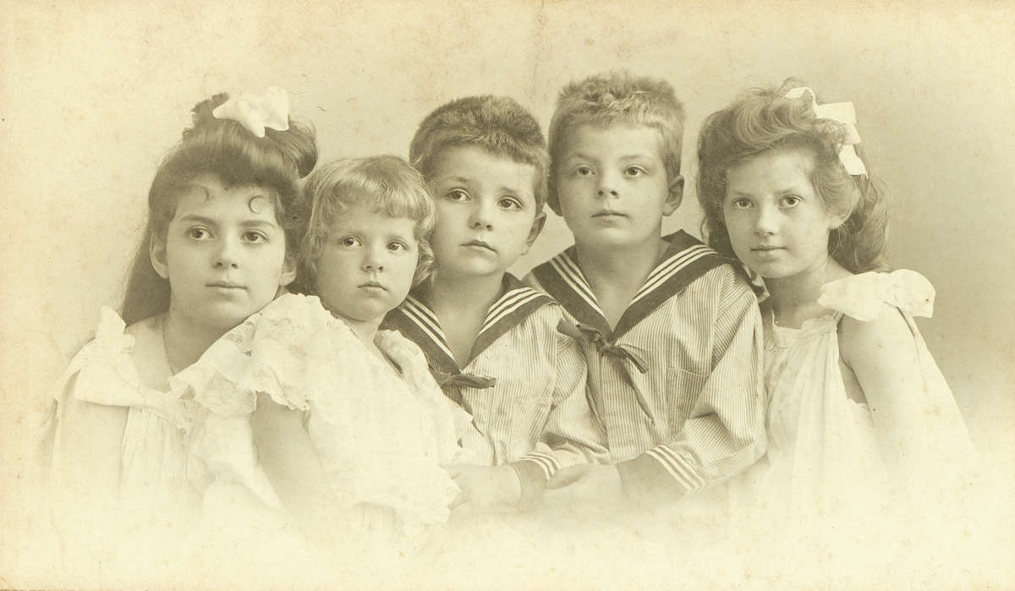
Who could predict , that this young kid will influence generations of people through his famous book « the little prince »
The Little Prince became Saint-Exupéry's most successful work, selling an estimated 140 million copies worldwide, which makes it one of the best-selling in history. He found his inspiration in the Moroccan Sahara.
Antoine
de Saint
Exupery
www.fivedragons.ma
Notes:
Who could predict , that this young kid will influence generations of people through his famous book « the little prince »
The Little Prince became Saint-Exupéry's most successful work, selling an estimated 140 million copies worldwide, which makes it one of the best-selling in history. He foud his inspiration in Moroccan sahara

Slide 32

Tarfaya
Travel,…. a step further
Antoine de Saint Exupery
« Sir... I’d like to fly...
Just fly. »
— Antoine de Saint Exupéry
www.fivedragons.ma
Notes:
Antoine Marie Jean-Baptiste Roger, comte de Saint-Exupéry
was a French writer, poet, aristocrat, journalist and pioneering aviator.
By 1926, he became one of the pioneers of international postal flight, in the days when aircraft had few instruments. He worked for Aéropostale between Toulouse and Dakar, and then also became the airline stopover manager for the Cape Juby airfield in the Spanish zone of South Morocco, in the Sahara desert.
It's here when he was majorly inspired for writing his famous Novella

Slide 33
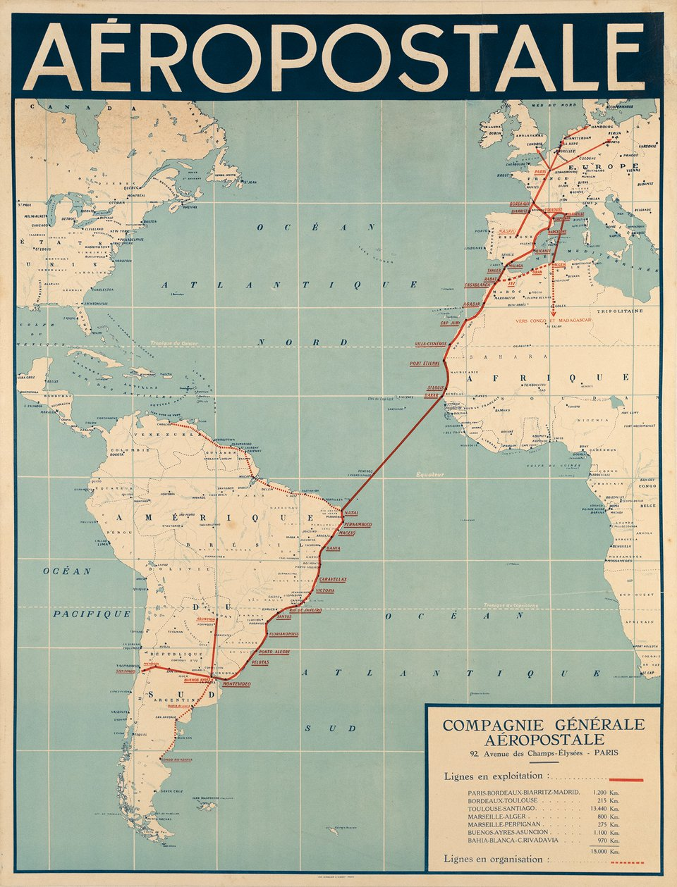
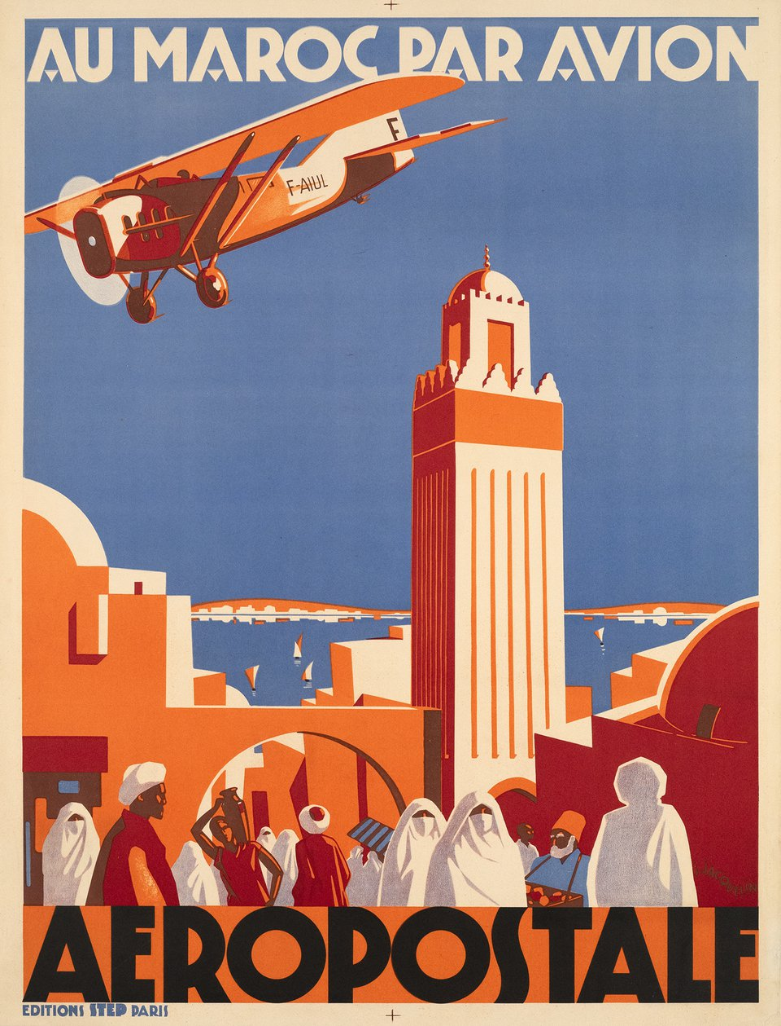
Tarfaya
Formerly Cap Juby
TARFAYA
The
Little
Prince legacy
www.fivedragons.ma
Notes:
The famous aeropostale founded by Pierre-Georges Latécoère (1883–1943) a pioneer of aeronautics, connected Europe to south America, passing by Morocco, west Africa and south America.

Slide 34
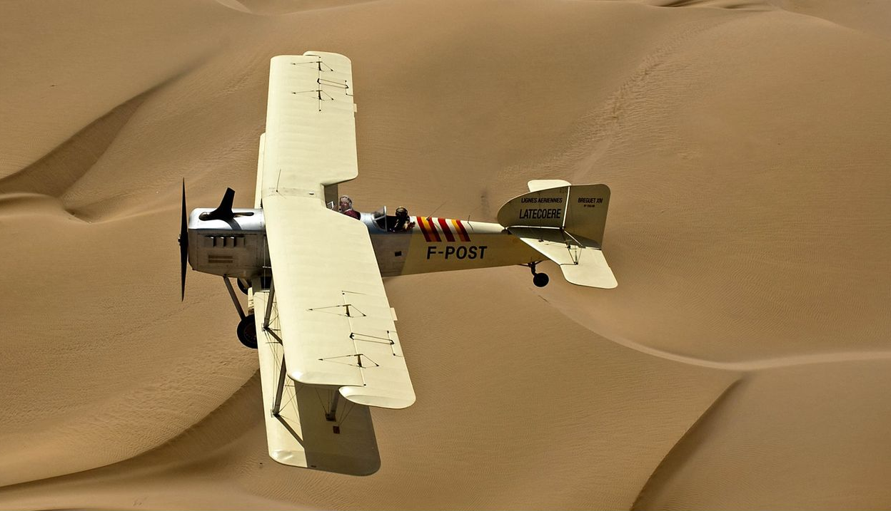
Tarfaya
Formerly Cap Juby
Travel,…. a step further
The Bréguet 14 was designed by aviation pioneer and aeronautical engineer Louis Bréguet .
The Bréguet 14 was among the first mass-produced aircraft to use large amounts of aluminium, rather than wood or steel, in its structure.
Is actually an iconic air plane, which has played an important role in civil aviation after world war 1
A Breguet XIV
Flying over
the dunes
www.fivedragons.ma
Notes:
The Bréguet 14 was designed by aviation pioneer and aeronautical engineer Louis Bréguet .
The Bréguet 14 was among the first mass-produced aircraft to use large amounts of aluminium, rather than wood or steel, in its structure.
Is actually an iconic air plane, which has played an important role in civil aviation after world war 1

Slide 35

Tarfaya
Formerly Cap Juby
Travel,…. a step further
The Breguet XIV
Statue in Tarfaya
www.fivedragons.ma

Slide 36

Tarfaya
Formerly Cap Juby
Travel,…. a step further
The Breguet XIV
Statue in Tarfaya
www.fivedragons.ma

Slide 37



Tarfaya
Formerly Cap Juby
The
Saint Exupery
Museum
www.fivedragons.ma

Slide 38


Tarfaya
Formerly Cap Juby
The
Saint Exupery
Museum
www.fivedragons.ma

Slide 39

Laayoune
Morocco Sahara
& Story Telling
The
immaculated Khenifiss National
Park
1h45 drive
Knifiss National Park
LAAYOUNE
The only natural reserve
in the world that combines…
Ocean, Laguna & Desert
www.fivedragons.ma

Slide 40

Laayoune
Excursions
Travel,…. a step further
Khenifiss
National Park
www.fivedragons.ma

Slide 41

Laayoune
Observing a preserved nature and fauna
Travel,…. a step further
Khenifiss
National Park
www.fivedragons.ma

Slide 42

Laayoune
Excursions
Travel,…. a step further
Observing a preserved nature and fauna
Khenifiss
National Park
www.fivedragons.ma

Slide 43
Laayoune
Morocco Sahara
& Story Telling
1h45 drive
Knifiss National Park
Some of
Most popular species …
LAAYOUNE
www.fivedragons.ma

Slide 44

Khenifiss National
Park
Travel,…. a step further
Observing a preserved nature and fauna
Gray Heron
(Ardea cinerea)
© Xavier Rufray, (CC-BY-NC)
www.fivedragons.ma

Slide 45

Khenifiss National
Park
Travel,…. a step further
Observing a preserved nature
& fauna
Flamingos
(Phoenicopterus roseus)
© Xavier Rufray, (CC-BY-NC)
www.fivedragons.ma

Slide 46

Khenifiss National
Park
Travel,…. a step further
Observing a preserved nature
& fauna
Eurasian Curlew
(Numenius arquata)
© Xavier Rufray, (CC-BY-NC)
www.fivedragons.ma

Slide 47

Khenifiss National
Park
Travel,…. a step further
Observing a preserved nature
& fauna
Curlis Corlieu
(Numenius Phaeopus)
© Xavier Rufray, (CC-BY-NC)
www.fivedragons.ma

Slide 48

Khenifiss National
Park
Travel,…. a step further
Observing a preserved nature and fauna
Black-backed Gull
(Larus marinus)
© Xavier Rufray, (CC-BY-NC)
www.fivedragons.ma

Slide 49

Khenifiss National
Park
Travel,…. a step further
Observing a preserved nature
& fauna
Oystercatcher
(Haematopus ostralegus)
© Xavier Rufray, (CC-BY-NC)
www.fivedragons.ma

Slide 50

Khenifiss National
Park
Travel,…. a step further
Observing a preserved nature
& fauna
Great Cormorant
(Phalacrocorax carbo maroccanus)
© Xavier Rufray, (CC-BY-NC)
www.fivedragons.ma

Slide 51

Khenifiss National
Park
Travel,…. a step further
Observing a preserved nature
& fauna
Great Cormorant
(Phalacrocorax carbo maroccanus)
© Xavier Rufray, (CC-BY-NC)
www.fivedragons.ma

Slide 52

Khenifiss National
Park
Travel,…. a step further
Observing a preserved nature
& fauna
Ringed Plover
(Charadrius hiaticula)
© Xavier Rufray, (CC-BY-NC)
www.fivedragons.ma

Slide 53

Khenifiss National
Park
Travel,…. a step further
Observing a preserved nature
& fauna
Hoopoe Lark
(Alaemon alaudipes)
© Alain Roujas (CC-BY-NC)
www.fivedragons.ma

Slide 54

Khenifiss National
Park
Travel,…. a step further
Observing a preserved nature
& fauna
Black wheatear
(Oenanthe leucura)
© Alain Roujas (CC-BY-NC)
www.fivedragons.ma

Slide 55

Khenifiss National
Park
Travel,…. a step further
Observing a preserved nature
& fauna
Caspian tern
(Hydroprogne caspia)
© Xavier Rufray, (CC-BY-NC)
www.fivedragons.ma

Slide 56

Khenifiss National
Park
Travel,…. a step further
Observing a preserved
nature & fauna
West African crested tern
(Thalasseus albididorsalis)
© Xavier Rufray, (CC-BY-NC)
www.fivedragons.ma

Slide 57

Observing a preserved nature & fauna
Khenifiss National
Park
Travel,…. a step further
Osprey / Sea Hawk
(Pandion haliaetus)
© Boujemaa Elkrik
www.fivedragons.ma

Slide 58
Dakhla
& further South …
www.fivedragons.ma
Notes:
Ecolodges

Slide 59

Dakhla
Travel,…. a step further
Hotels
1893 beds
Restaurants
TOURISM
Attractions
For Sustainable Development Goals
www.fivedragons.ma
Notes:
Ecolodges

Slide 60

Dakhla
Travel,…. a step further
The pearl of the south
www.fivedragons.ma
Notes:
Ecolodges

Slide 61

Dakhla
Travel,…. a step further
The pearl of the south
Dune Blanche
www.fivedragons.ma
Notes:
Ecolodges

Slide 62

Dakhla
Travel,…. a step further
The pearl of the south
Mystical Lagoon
& Kitesurf
www.fivedragons.ma
Notes:
Ecolodges

Slide 63

Dakhla
Travel,…. a step further
The pearl of the south
Ecolodges
With stunnig Ocean view
www.fivedragons.ma
Notes:
Ecolodges

Slide 64

Dakhla
Travel,…. a step further
The pearl of the south
www.fivedragons.ma
Notes:
Ecolodges

Slide 65

Dakhla
Travel,…. a step further
The pearl of the south
www.fivedragons.ma
Notes:
Ecolodges

Slide 66
Welcome
back to
Morocco
www.fivedragons.ma
Notes:
A diversity that will welcome you back to morocco with positive vibes

